Slide 1
Chef Fundamentals
training@chef.io
Copyright (C) 2014 Chef Software, Inc.

Slide 2
Introductions
Notes:
ref0001
Ensure you have your bio on a slide. Then before delivery unhide your bio slide and ensure all others are hidden

Slide 3
Instructor Introduction
Name:
Current job role:
Previous job roles/background:
Experience with Chef/Config Management:
Favorite Text Editor:
Notes:
ref0001

Slide 4
Instructor Introduction
Name: John Fitzpatrick
Current job role: Curriculum Development/Trainer at Chef
Previous job roles/background: Before Chef I spent 3 years on Cloud Management at RightScale, and before that working in mobile internet at Openwave
Experience with Chef/Config Management: Two years experience with Chef, initially at RightScale
Favorite Text Editor: SublimeText
Notes:
ref0001

Slide 5

Instructor Introduction
Name: Nathen Harvey
Current job role: Director Community & #learnchef
Previous job roles/background: Web Operations, Customer Support, Web Development
Experience with Chef/Config Management: Thrown into the deep end of System Administration about 7 years ago. Saved by Chef about 4 years ago.
Favorite Text Editor: Sublime Text
Notes:
ref0001

Slide 6
Instructor Introduction
Name: Elon Bar-Evan
Current job role:
Previous job roles/background:
Experience with Chef/Config Management:
Favorite Text Editor:
Notes:
ref0001

Slide 7
Instructor Introduction
Name: Sean Carolan
Current job role: Chef Consultant
Previous job roles/background: In my previous life I was a Unix system administrator for EA (Electronic Arts). Before that I was also a sysadmin at Peoplefluent, an HR SaaS company.
Experience with Chef/Config Management: I used CFengine for about four years, then moved up to Puppet for about three years, and am now a happy Chef user. I have worked with several Fortune 500 companies helping them automate their infrastructure with Chef.
Favorite Text Editor: Vim, pimped out with about two dozen plugins
Notes:
ref0001

Slide 8
Instructor Introduction
Name: Michael Goetz
Current Job Role: Automation Consulting Engineer
Previous Job Roles/Background: Technical Architect, Build/Release Engineer, Technical Project Manager
Experience with Chef/Config Management: 3+ years with Chef, Maven & Ant (yes, as CM tools)
Favorite Text Editor: Sublime Text
Notes:
ref0001

Slide 9
Instructor Introduction
Name: Julian Dunn
Current Job Role: Consulting Engineer with Chef
Previous Experience: 15 years first as a software developer, then in operations
Previous Experience with Chef: My last company used Chef and they let me make lots of mistakes while learning it
Favorite Text Editor: vi
Notes:
ref0001

Slide 10
Instructor Introduction
# finger $(whoami)
Login: gmiranda Name: George Miranda
Directory: /home/gmiranda Shell: /bin/bash
EDITOR: /usr/bin/vim
On since Mon 14 Apr 1997 18:01 (GMT) on tty1 from :0
No mail on gmiranda@opscode.com
Plan:
twitter: gmiranda23
github: gmiranda23
irc: gmiranda23 (irc.freenode.net - #chef)
*.*: gmiranda23
Notes:
ref0001

Slide 11
Instructor Introduction
Name: Mandi Walls
Current Role: Technical Practice Manager
Previous: Consultant at Opscode/Chef since Nov 2011. Sysadmin running large websites for AOL before that - www.aol.com, moviefone.com, games.com
Experience with Chef: Using Chef since April 2011
Favorite Text Editor: vim
Notes:
ref0001

Slide 12
Instructor Introduction
Name: Stephen Lauck
Current job role: Consultant
Previous job roles/background: Rails Developer / Chef Developer
Experience with Chef/Config Management: Almost 4 years Chef dev experience
Favorite Text Editor: Emacs Baby! ( and some Sublime )
Notes:
ref0001

Slide 13
Instructor Introduction
Name: Alex Vinyar
Current job role: Consultant (or some other clever thing you hear from other guys)
Previous job roles/background: Xbox (systems engineer), Expedia(release engineer)
Experience with Chef/Config Management: New to Chef; been automating since batch files.
Favorite Text Editor: Notepad++ for Powershell and Sublime for Chef (Ruby)
Notes:
ref0001

Slide 14
Instructor Introduction
Name: Franklin Webber
Current job role: Developer / Instructor
Previous job roles/background: ARMY SGT, QA, SDET
Experience with Chef/Config Management: Deployments with Ruby on Rails Applications
Favorite Text Editor: Sublime Text
Notes:
ref0001

Slide 15
Instructor Introduction
Name: Dan Robinson
Current job role: Solutions Engineer, Consulting
Previous job roles/background: Consulting Engineer with Opsware/HP for 5 years prior to joining Chef, working with HP Server Automation. Background also includes various consulting and engineering roles in email security, interactive television, and Internet services
Experience with Chef/Config Management: 1.5 years working with (and working at) Chef
Favorite Text Editor: SublimeText
Notes:
ref0001

Slide 16
Instructor Introduction
Name: Larry Eichenbaum
Current job role: Automation Engineer
Previous job roles/background: Automation Engineer for ‘other’ automation tools, Change/Release Mgr., QA Mgr., Technical Project Mgr., SysAdmin, farmer…
Experience with Chef/Config Management: Well versed with variety of CM tools, process definition, etc.
Favorite Text Editor: Sublime Text 2 and vi

Slide 17
Introduce Yourselves
Name
Current job role
Previous job roles/background
Experience with Chef and/or config management
Favorite Text Editor
Notes:
Student introduction
* Name
* Current job role
* Previous job roles/background
* Experience with Chef
* Favorite Text Editor

Slide 18
Course Objectives and Style

Slide 19
Course Objectives
Upon completion of this course you will be able to
Automate common infrastructure tasks with Chef
Describe Chef’s architecture
Describe Chef’s various tools
Apply Chef’s primitives to solve your problems

Slide 20
How to learn Chef
You bring the domain expertise about your business and problems
Chef provides a framework for solving those problems
Our job is to work together to teach you how to express solutions to your problems with Chef
Notes:
Hammer home that the students know how to run their infrastructure
YOU are the best person capable of automating your environment
Chef training is about understanding the framework Chef can provide to solving those problems
* STUDENT KNOWLEDGE + CHEF TRAINING = VICTORY

Slide 21
Chef is a Language
Learning Chef is like learning the basics of a language
80% fluency will be reached very quickly
The remaining 20% just takes practice
The best way to learn Chef is to use Chef
Notes:
We will get you fluent
We will do it in a way that maps to what experts do
We will teach you how to find and use the resources that will make you an expert in time

Slide 22
Training is really a discussion
We will be doing things the hard way
We’re going to do a lot of typing
You can’t be:
Absent
Late
Left Behind
We will troubleshoot and fix bugs on the spot
The result is you reaching fluency fast

Slide 23
Training is really a discussion
I’ll post objectives at the beginning of a section
Ask questions when they come to you
Ask for help when you need it
You’ll get the slides after class
Notes:
I get asked at every class, "will we get the slides" so I thought it prudent to address it here. Why not hand them out at the beginning? To make people type things and learn by muscle memory.

Slide 24
Fundamentals
This course covers the fundamentals of Chef
We likely will not have time to discuss the latest trends in the Chef ecosystem
Any discussion items that are too far off topic will be captured
We'll return to these items as time permits

Slide 25

Stages of Learning - Shuhari
Shuhari - first learn, then detach, and finally transcend
shu - "obey" - traditional wisdom
ha - "detach" - break with tradition
ri - "separate" - transcend
Notes:
http://en.wikipedia.org/wiki/Shuhari
"It is known that, when we learn or train in something, we pass through the stages of shu, ha, and ri. These stages are explained as follows. In shu, we repeat the forms and discipline ourselves so that our bodies absorb the forms that our forbearers created. We remain faithful to the forms with no deviation. Next, in the stage of ha, once we have disciplined ourselves to acquire the forms and movements, we make innovations. In this process the forms may be broken and discarded. Finally, in ri, we completely depart from the forms, open the door to creative technique, and arrive in a place where we act in accordance with what our heart/mind desires, unhindered while not overstepping laws."

Slide 26
Agenda

Slide 27
Topics
Overview of Chef
Workstation Setup
Organization Setup
Test Node Setup
Writing your first cookbook
Dissecting your first Chef run
Introducing the Node object
Attributes, Templates, and Cookbook Dependencies

Slide 28
Topics
Template Variables, Notifications, and Controlling Idempotency
Data bags, search
Roles
Environments
Using community cookbooks
Further Resources

Slide 29
Breaks!
We’ll take a break between each section, or every hour, whichever comes first
We’ll obviously break for lunch :)
Notes:
Take 5 minute breaks frequently

Slide 30
Overview of Chef

Slide 31
Lesson Objectives
After completing the lesson, you will be able to
Describe how Chef thinks about Infrastructure Automation
Define the following terms:
Node
Resource
Recipe
Cookbook
Run List
Roles
Search

Slide 32

Complexity
http://www.flickr.com/photos/michaelheiss/3090102907/
Notes:
As sysadmins, developers, service providers, we have a lot of complexity to manage. This could be a small 4 node application, right up to an application with 1000's nodes

Slide 33
Items of Manipulation (Resources)
Networking
Files
Directories
Symlinks
Mounts
Registry Keys
Powershell Scripts
Users
Groups
Packages
Services
Filesystems
Notes:
This complexity manifests itself through the various items of manipulation that we have across our infrastructure. We call these items 'resources'
In Chef, a resource is an element of an operating system that can be manipulated by code to achieve a certain task

Slide 34
A tale of growth...
Application
Notes:
Let's look at a simple tale of a web application. Sure, this may not be representative of your current infrastructure but it will give you a glimpse into the complexity that we have to manage every day.
When you start developing a new application, you need to install, manipulate, and configure a bunch of those resources. You'll need to create users, install a database, configure a web server to serve up your application, and more.

Slide 35
Add a database
Application
Application Database
Notes:
But, running all of the application’s components on a single server won’t scale well. Let’s move the database to another server.

Slide 36
Make database redundant
Application
App Databases
Notes:
Moving the database to a separate server helps with scalability but also introduces another point of failure. Let's add a second database server as a stand-by to the primary database. We can now failover to the stand-by database if the primary database fails. Doing so will allow us to keep our application running and servicing our customers.

Slide 37
Application server redundancy
App Servers
App Databases
Notes:
Now that we've addressed the redundancy of our database, let's turn back to the application server. We need to eliminate the application server as a single point of failure so we add another. With redundancy at both the application and database tier we are now much better equipped to handle the failure of any individual server in our infrastructure.

Slide 38
Add a load balancer
App LB
App Servers
App Databases
Notes:
Our customers love our application and our business is growing. Growing so much, in fact, that we've started to experinece some performance issues. Introducing a load balancer will allow us to distribute the load across more applicaiton servers, improve performance, and keep our customers happy.

Slide 39
Webscale!
App LBs
App Servers
App Databases
Notes:
Failure is to be expected and we experienced an outage when the load balancer failed. To prevent this from happening in the future, we've added another load balancer and have increased our application's capacity by adding more applicaiton servers.

Slide 40
Now we need a caching layer
App LBs
App Servers
App DB Cache
App DBs
Notes:
As load continues to grow, we're searching for additional ways to improve performance on the site. After careful analysis, we've noticed that the database is starting to respond slowly to certain queries. A database cache is introduced to improve the effeciency of read opearations and to allow the database to and application to perform better.

Slide 41
Infrastructure has a Topology
App LBs
App Servers
App DB Cache
App DBs
Notes:
Of course, it's easy to talk in the about the servers in our infrastructure as individual components but that's not the way things really work. Infrastructure has a topology; the load balancers need to know which servers can respond to their requests; the application servers need to know where to send database queries and updates. The services running on each of the nodes must be properly configured.

Slide 42
Your Infrastructure is a Snowflake
Round Robin DNS
App Servers
App DB Cache
Floating IP?
App DBs
Notes:
But, just like you, your infrastructure is a beautiful and unique snowflake. Your infrastructure is not the same as my infrastructure. Heck, the infrastructure of one application in your business isn't the same as another application. I have no idea, and, frankly, don't even care much about the specifics of your infrastructure's design. There are, however, a couple of things that I KNOW, or can guess, about your infrastructue. First, it has evolved over time, much like our current sample infrastructure.

Slide 43

Complexity Increases Quickly
App LBs
Cache
App Servers
< Shiny!
DB Cache
DB slaves
Are we monitoring??
DBs
Notes:
I also know that the complexity of your applications and infrastrucutre increases quickly. Whether you're resolving technical debt, addressing new business requirements, or succumbing to shiny object syndrome, your infrastructure: it is a-changin'

Slide 44
...and change happens!
App LBs
Cache
App Servers
DB Cache
DB slaves
DBs
Notes:
This isn't just a story of growth, it's a also a story of change.

Slide 45

...and change happens!
Add a Central Log Host
App LBs
Cache
App Servers
DB Cache
DB slaves
Central Log Host
DBs
Notes:
As an example, let's say you want a central logging host so that it's easier to trace individual customer requests across your infrastruture.

Slide 46

...and change happens!
Add a Central Log Host
Update syslog.conf on all Nodes
App LBs
Cache
App Servers
DB Cache
DB slaves
Central Log Host
DBs
Notes:
Doing so is relatively simple, you simply need to update the syslog.conf file on EVERY...SERVER...IN...YOUR..INFRASTRUCTURE. Not a big deal, right, a simple update to a text file. But what happens if you make a mistake? What happens if you forget one, or more, of the servers? Maybe you'll miss a couple of log events, not a big deal, right? Or is it? How will that effect your compliance efforts? What if it's a customer-impacting change that you're making such as installing a new SSL certificate? This simple change could cause a major disruption in service. Manually updating each of these files simply won't do.

Slide 47

Chef Solves This Problem
But you already guessed that, didn’t you?

Slide 48
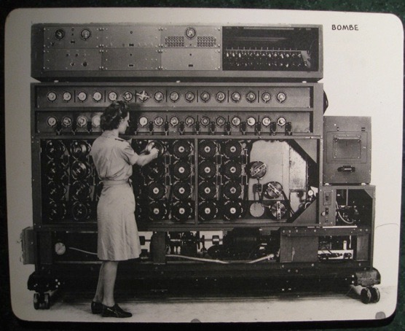
Chef is Infrastructure as Code
Programmatically provision and configure components
http://www.flickr.com/photos/louisb/4555295187/
Notes:
Use the Chef framework and Chef programming language to define the components of your infrastructure. This allows you to capture and document the shape of your infrastructure in a consistent way.

Slide 49
Chef is Infrastructure as Code
Treat like any other code base
http://www.flickr.com/photos/louisb/4555295187/
Notes:
Treat this like any other code base:
1. Store the code in a version control system.
2. Add automated tests to the code.
3. Refactor the code over time.
4. Build and version software artifacts (e.g. packages)
5. The code is executable documentation.
6. Store the code in a version control system.

Slide 50
Chef is Infrastructure as Code
Reconstruct business from code repository, data backup, and compute resources
http://www.flickr.com/photos/louisb/4555295187/
Notes:
With your infrastructure now fully captured in code, you are now able to rebuild your entire business, well, at least all of your business’s applications, with your code repository, a backup of your data, and compute resources, be they bare metal, virtual machines, or cloud instances.

Slide 51
Chef is Infrastructure as Code
Programmatically provision and configure components
Treat like any other code base
Reconstruct business from code repository, data backup, and compute resources
http://www.flickr.com/photos/louisb/4555295187/
Notes:
Stop for a minute and think about what we're saying here. Think about how freeing this can be. The next configuration change you need to make in production starts with a commit to your version control system. You can re-provision your infrastructure with another service provider; move from the data center to the clould and back again.
How will this impact the way you run operations in your organization?
What questions do you have?

Slide 52
Configuration Code
Chef ensures each Node complies with the policy
Policy is determined by the configurations in each Node’s run list
Reduce management complexity through abstraction
Store the configuration of your infrastructure in version control
Notes:
Chef provides a domain-specific language (DSL) that allows you to specify policy without worrying too much about the underlying semantics of how to implement that policy. Of course, you’re a professional and will be storing this policy in a version control system.

Slide 53
Declarative Interface to Resources
You define the policy in your Chef configuration
Your policy states what state each resource should be in, but not how to get there
Chef-client will pull the policy from the Chef Server and enforce the policy on the Node
Notes:
Each of our “items of manipulation” are modeled as Resources within Chef. Using Chef’s DSL, you define the state that each of these resources should be in but not how to get there. The chef-client, an application running on each server, or node, will pull the policy from the chef server and enforce the policy for all of the resources on that individual node.

Slide 54
Managing Complexity
Organizations
Environments
Roles
Nodes
Recipes
Cookbooks
Search
Notes:
Modeling everything in your infrastructure as a collection of resources will quickly become untenable. We need many different layers of abstraction in order to better reason about our infrastructure. Chef gives us number of items to help us manage this complexity.

Slide 55

Organizations
My Infrastructure
Your Infrastructure
Their Infrastructure

Slide 56
Organizations
Completely independent tenants of Enterprise Chef
Share nothing with other organizations
May represent different
Companies
Business Units
Departments
Notes:
Organizations are independent tenants in Enterprise Chef

Slide 57
Environments
Development
Staging
Production
Notes:
Environments are used to manage stages in your application

Slide 58
Environments
Environments reflect your patterns and workflow, and can be used to model the life-stages of your applications
Development
Test
Staging
Production
etc.
Every Organization starts with a single environment!
Notes:
<<Review Comments: Updated for Rhiannon's review comments

Slide 59
Environments Define Policy
Environments may include data attributes necessary for configuring your infrastructure, e.g.
The URL of your payment service’s API
The location of your package repository
The version of the Chef configuration files that should be used

Slide 60
Roles
Load Balancers
Application Servers
DB Cache
Database
Notes:
Roles are a way of classifying the different types of server in your infrastructure

Slide 61
Roles
Roles represent the types of servers in your infrastructure
Load Balancer
Application Server
Database Cache
Database
Monitoring

Slide 62
Roles Define Policy
Roles may include an ordered list of Chef configuration files that should be applied
This list is called a Run List
Order is always important in the Run List
Roles may include data attributes necessary for configuring your infrastructure, for example:
The port that the application server listens on
A list of applications that should be deployed

Slide 63
Nodes
Notes:
You could have many nodes in your infrastructure, in any configuration.

Slide 64
Nodes
Nodes represent the servers in your infrastructure
Could be physical servers or virtual servers
May represent hardware that you own or compute instances in a public or private cloud
Could also be network hardware - switches, routers, etc
Notes:
network device support for some vendors Arista, Juniper, Cisco

Slide 65
Node
Each Node will
Belong to one Organization
Belong to one Environment
Have zero or more Roles

Slide 66
Nodes Adhere to Policy
The chef-client application runs on each node, which
Gathers the current system configuration of the node
Downloads the desired system configuration policies from the Chef server for that node
Configures the node such that it adheres to those policies

Slide 67
Resources
A Resource represents a piece of the system and its desired state
A package that should be installed
A service that should be running
A file that should be generated
A cron job that should be configured
A user that should be managed
and more

Slide 68
Resources in Recipes
Resources are the fundamental building blocks of Chef configuration
Resources are gathered into Recipes
Recipes ensure the system is in the desired state

Slide 69
Recipes
Configuration files that describe resources and their desired state
Recipes can:
Install and configure software components
Manage files
Deploy applications
Execute other recipes
and more
Notes:
"Recipes are segments of code that do task X."

Slide 70
Example Recipe
package "apache2"
template "/etc/apache2/apache2.conf" do
source "apache2.conf.erb"
owner "root"
group "root"
mode "0644"
variables(:allow_override => "All")
notifies :reload, "service[apache2]"
end
service "apache2" do
action [:enable,:start]
supports :reload => true
end
Notes:
Take some time here to walk through the code. Describe what’s happening within each resource declaration. Show how notifications work. Cover sufficient detail that it is clear that each resource in a recipe will (or may):
* Describe the desired state of that resource (via the “action” keyword)
* Include a number of resource-specific attributes (owner, mode, supports, etc.)
* Interact with other resources through the notification mechanism.
* Will only take action if required. If a resource is out of policy, it will be repaired.
Go into as much detail as you like and as the students will consume.
“What questions do you have?”

Slide 71

Cookbooks
Recipes are stored in Cookbooks
Cookbooks contain recipes, templates, files, custom resources, etc
Code re-use and modularity
http://www.flickr.com/photos/shutterhacks/4474421855/
Notes:
LEAD IN: How are these recipes applied to a node? (RUN LIST!)
"Cookbooks are a collection of recipes, templates, attributes, providers resources that can be executed against a node to achieve convergence and idempotency"

Slide 72
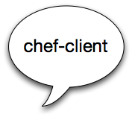
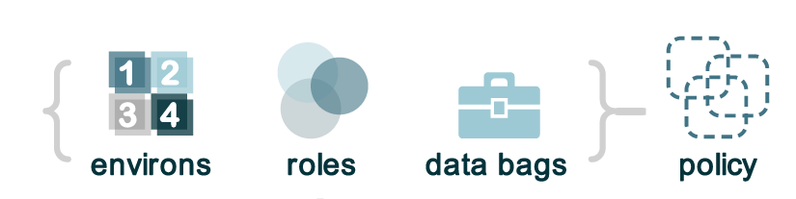


Run List
Enterprise Chef
What policy should I follow?
Node
Notes:
When the chef-server run on the node it asks the chef server what policy should I follow, or what is my run list

Slide 73
Run List
Enterprise Chef
What policy should I follow?
Node
"recipe[ntp::client]"
"recipe[users]"
"role[webserver]"
Notes:
Chef server looks at the run_list and sends the appropriate cookbooks to the node

Slide 74
Run List
Enterprise Chef
What policy should I follow?
"recipe[ntp::client]"
"recipe[users]"
"role[webserver]"
Notes:
Chef-client then executes the resources on the run list
All the heavy lifting is done on the node!! the server is quite light weight!

Slide 75
Run List Specifies Policy
The Run List is an ordered collection of policies that the Node should follow
Chef-client obtains the Run List from the Chef Server
Chef-client ensures the Node complies with the policy in the Run List

Slide 76

Search
Search for nodes with Roles
Find Topology Data
IP addresses
Hostnames
FQDNs
http://www.flickr.com/photos/kathycsus/2686772625
Notes:
Chef Search is one of its killer features. It enables you to do a lot of heavy lifting easily.
Search for nodes by their roles, or other attributes (you assign, or assume via cookbooks).

Slide 77
Search for Nodes
pool_members = search("node","role:webserver")
template "/etc/haproxy/haproxy.cfg" do
source "haproxy-app_lb.cfg.erb"
owner "root"
group "root"
mode 0644
variables :pool_members => pool_members.uniq
notifies :restart, "service[haproxy]"
end

Slide 78
HAProxy Configuration
HA Proxy
Webservers

Slide 79


HAProxy Load Balancer
pool_members = search("node","role:webserver")
Enterprise Chef
HA Proxy
Webservers

Slide 80
HAProxy Load Balancer
pool_members = search("node","role:webserver")
Enterprise Chef
Webservers?
HA Proxy
Webservers

Slide 81
HAProxy Load Balancer
pool_members = search("node","role:webserver")
Enterprise Chef
Webservers?
HA Proxy
Webservers

Slide 82
HAProxy Load Balancer
pool_members = search("node","role:webserver")
Enterprise Chef
Webservers?
HA Proxy
{
"web01" : {
"hostname" : "web01",
"ipaddress" : "10.1.1.1"
},
"web02" : {
"hostname" : "web02",
"ipaddress" : "10.1.1.2"
},
"web03" : {
"hostname" : "web03",
"ipaddress" : "10.1.1.3"
},
"web04" : {
"hostname" : "web04",
"ipaddress" : "10.1.1.4"
}
}
Webservers

Slide 83
HAProxy Load Balancer
pool_members = search("node","role:webserver")
Enterprise Chef
Webservers?
HA Proxy
{
"web01" : {
"hostname" : "web01",
"ipaddress" : "10.1.1.1"
},
"web02" : {
"hostname" : "web02",
"ipaddress" : "10.1.1.2"
},
"web03" : {
"hostname" : "web03",
"ipaddress" : "10.1.1.3"
},
"web04" : {
"hostname" : "web04",
"ipaddress" : "10.1.1.4"
}
}
Webservers

Slide 84
HAProxy Load Balancer
pool_members = search("node","role:webserver")
Enterprise Chef
Webservers?
pool_members
{
"web01" : {
"hostname" : "web01",
"ipaddress" : "10.1.1.1"
},
"web02" : {
"hostname" : "web02",
"ipaddress" : "10.1.1.2"
},
"web03" : {
"hostname" : "web03",
"ipaddress" : "10.1.1.3"
},
"web04" : {
"hostname" : "web04",
"ipaddress" : "10.1.1.4"
}
}
HA Proxy
{
"web01" : {
"hostname" : "web01",
"ipaddress" : "10.1.1.1"
},
"web02" : {
"hostname" : "web02",
"ipaddress" : "10.1.1.2"
},
"web03" : {
"hostname" : "web03",
"ipaddress" : "10.1.1.3"
},
"web04" : {
"hostname" : "web04",
"ipaddress" : "10.1.1.4"
}
}
Webservers

Slide 85
Search for Nodes
pool_members = search("node","role:webserver")
template "/etc/haproxy/haproxy.cfg" do
source "haproxy-app_lb.cfg.erb"
owner "root"
group "root"
mode 0644
variables :pool_members => pool_members.uniq
notifies :restart, "service[haproxy]"
end
Notes:
Execute a search against the Chef Server’s search index and store the results of that search in the “pool_member” variable.
Pass the unique pool_members to the template as a template variable named pool_members.

Slide 86
Pass results into Templates
# Set up application listeners here.
listen application 0.0.0.0:80
balance roundrobin
<% @pool_members.each do |member| -%>
server <%= member[:hostname] %> <%= member[:ipaddress] %>:> weight 1 maxconn 1 check
<% end -%>
<% if node["haproxy"]["enable_admin"] -%>
listen admin 0.0.0.0:22002
mode http
stats uri /
<% end -%>

Slide 87
HAProxy Configuration
<% @pool_members.each do |member| -%>
server <%= member[:hostname] %> <%= member[:ipaddress] %>:> weight 1 maxconn 1 check
<% end -%>
pool_members
{
"web01" : {
"hostname" : "web01",
"ipaddress" : "10.1.1.1"
},
"web02" : {
"hostname" : "web02",
"ipaddress" : "10.1.1.2"
},
"web03" : {
"hostname" : "web03",
"ipaddress" : "10.1.1.3"
},
"web04" : {
"hostname" : "web04",
"ipaddress" : "10.1.1.4"
}
}
HA Proxy
Webservers

Slide 88
HAProxy Configuration
<% @pool_members.each do |member| -%>
server <%= member[:hostname] %> <%= member[:ipaddress] %>:> weight 1 maxconn 1 check
<% end -%>
pool_members
{
"web01" : {
"hostname" : "web01",
"ipaddress" : "10.1.1.1"
},
"web02" : {
"hostname" : "web02",
"ipaddress" : "10.1.1.2"
},
"web03" : {
"hostname" : "web03",
"ipaddress" : "10.1.1.3"
},
"web04" : {
"hostname" : "web04",
"ipaddress" : "10.1.1.4"
}
}
HA Proxy
haproxy.cfg
server web01 10.1.1.1 weight 1 maxconn 1 check
server web02 10.1.1.2 weight 1 maxconn 1 check
server web03 10.1.1.3 weight 1 maxconn 1 check
server web04 10.1.1.4 weight 1 maxconn 1 check
Webservers

Slide 89
HAProxy Configuration
<% @pool_members.each do |member| -%>
server <%= member[:hostname] %> <%= member[:ipaddress] %>:> weight 1 maxconn 1 check
<% end -%>
pool_members
{
"web01" : {
"hostname" : "web01",
"ipaddress" : "10.1.1.1"
},
"web02" : {
"hostname" : "web02",
"ipaddress" : "10.1.1.2"
},
"web03" : {
"hostname" : "web03",
"ipaddress" : "10.1.1.3"
},
"web04" : {
"hostname" : "web04",
"ipaddress" : "10.1.1.4"
}
}
HA Proxy
haproxy.cfg
server web01 10.1.1.1 weight 1 maxconn 1 check
server web02 10.1.1.2 weight 1 maxconn 1 check
server web03 10.1.1.3 weight 1 maxconn 1 check
server web04 10.1.1.4 weight 1 maxconn 1 check
Webservers

Slide 90
HAProxy Configuration
<% @pool_members.each do |member| -%>
server <%= member[:hostname] %> <%= member[:ipaddress] %>:> weight 1 maxconn 1 check
<% end -%>
pool_members
{
"web01" : {
"hostname" : "web01",
"ipaddress" : "10.1.1.1"
},
"web02" : {
"hostname" : "web02",
"ipaddress" : "10.1.1.2"
},
"web03" : {
"hostname" : "web03",
"ipaddress" : "10.1.1.3"
},
"web04" : {
"hostname" : "web04",
"ipaddress" : "10.1.1.4"
}
}
HA Proxy
haproxy.cfg
server web01 10.1.1.1 weight 1 maxconn 1 check
server web02 10.1.1.2 weight 1 maxconn 1 check
server web03 10.1.1.3 weight 1 maxconn 1 check
server web04 10.1.1.4 weight 1 maxconn 1 check
Webservers

Slide 91
HAProxy Configuration
<% @pool_members.each do |member| -%>
server <%= member[:hostname] %> <%= member[:ipaddress] %>:> weight 1 maxconn 1 check
<% end -%>
pool_members
{
"web01" : {
"hostname" : "web01",
"ipaddress" : "10.1.1.1"
},
"web02" : {
"hostname" : "web02",
"ipaddress" : "10.1.1.2"
},
"web03" : {
"hostname" : "web03",
"ipaddress" : "10.1.1.3"
},
"web04" : {
"hostname" : "web04",
"ipaddress" : "10.1.1.4"
}
}
HA Proxy
haproxy.cfg
server web01 10.1.1.1 weight 1 maxconn 1 check
server web02 10.1.1.2 weight 1 maxconn 1 check
server web03 10.1.1.3 weight 1 maxconn 1 check
server web04 10.1.1.4 weight 1 maxconn 1 check
Webservers

Slide 92
So when this...
Graphite
Nagios
Jboss App
Memcache
Postgres Slaves
Postgres Master

Slide 93
...becomes this
Graphite
Nagios
Jboss App
Memcache
Postgres Slaves
Postgres Master

Slide 94
...this can happen automatically
Graphite
Graphite
Nagios
Nagios
Jboss App
Memcache
Memcache
Postgres Slaves
Postgres Slaves
Postgres Master
Postgres Master

Slide 95
Count the Resources
Load balancer config
Nagios host ping
Nagios host ssh
Nagios host HTTP
Nagios host app health
Graphite CPU
Graphite Memory
Graphite Disk
Graphite SNMP
Memcache firewall
Postgres firewall
Postgres authZ config
Graphite
Graphite
Nagios
Nagios
Jboss App
Memcache
Postgres Slaves
12+ resource changes for 1 node addition
Notes:
... this is the core of what Chef does.
Gives you tools to manage complexity while being flexible enough to evolve with your Infrastructure.

Slide 96
Manage Complexity
Determine the desired state of your infrastructure
Identify the Resources required to meet that state
Gather the Resources into Recipes
Compose a Run List from Recipes and Roles
Apply a Run List to each Node in your Environment
Your infrastructure adheres to the policy modeled in Chef
Notes:
So, how will you manage all this complexity? Here's a roadmap. Start by determining the desired state of yuor infrastructure. Identify..., Gather..., Compose..., Apply..., Profit!

Slide 97
Configuration Drift
Configuration Drift happens when:
Your infrastructure requirements change
The configuration of a server falls out of policy
Chef makes it easy to manage
Model the new requirements in your Chef configuration files
Run the chef-client to enforce your policies
Notes:
And this isn't just a story of provisioning. Sure, you need to bring your infrastructure into reality but it's going to change over time. You'll use the same process for managing that change, or configuration drift.

Slide 98
Design Tenets of Chef
Whipuptitude - aptitude for whipping things up
Reasonability
Sane defaults
Flexibility
Manipulexity - manipulation of complex things
Notes:
From Larry Wall, creator of perl
manipulexity: the manipulation of complex things
whipuptitude: the aptitude for whipping things up.
What's reasonable for your environment may not be for mine.
On "sane defaults": sanity is in the eye of the beholder
Might add or mention
Principle of least surprise
TIMTOWTDI - There Is More Than One Way To Do It

Slide 99
Review Questions
What is a Node?
What is a Resource?
What is a Recipe? How is it different from a Cookbook?
What is a Run List?
What is a Role?
Notes:
A node is a server you want to configure
A resource is an item of manipulation, ie. a primitive thats contained in a recipe.
A recipe is collection of resources
What you want coming out of this section is that folks have a high level understanding of the parts of the system. The rest of training goes into more detail about all these topics in due time.
Take 5.

Slide 100
Workstation Setup
Getting started

Slide 101
Lesson Objectives
After completing the lesson, you will be able to
Login to Enterprise Chef
View your Organization in Enterprise Chef
Describe Knife, the Chef command line utility
Use Knife on your Workstation

Slide 102
Legend
Notes:
Quick detour to provide you some context for the slide format used throughout this course.

Slide 103
Legend: Do I run that command on my workstation?
This is an example of a command to run on your workstation
$ whoami
i-am-a-workstation
This is an example of a command to run on your target node via SSH.
user@hostname:~$ whoami
i-am-a-chef-node
Notes:
This is a very frequent question in trainings.

Slide 104
Legend: Example Terminal Command and Output
$ ifconfig
lo0: flags=8049<UP,LOOPBACK,RUNNING,MULTICAST> mtu 16384
options=3<RXCSUM,TXCSUM>
inet6 fe80::1%lo0 prefixlen 64 scopeid 0x1
inet 127.0.0.1 netmask 0xff000000
inet6 ::1 prefixlen 128
gif0: flags=8010<POINTOPOINT,MULTICAST> mtu 1280
stf0: flags=0<> mtu 1280
en0: flags=8863<UP,BROADCAST,SMART,RUNNING,SIMPLEX,MULTICAST> mtu 1500
ether 28:cf:e9:1f:79:a3
inet6 fe80::2acf:e9ff:fe1f:79a3%en0 prefixlen 64 scopeid 0x4
inet 10.100.0.84 netmask 0xffffff00 broadcast 10.100.0.255
media: autoselect
status: active
p2p0: flags=8843<UP,BROADCAST,RUNNING,SIMPLEX,MULTICAST> mtu 2304
ether 0a:cf:e9:1f:79:a3
media: autoselect
status: inactive
utun0: flags=80d1<UP,POINTOPOINT,RUNNING,NOARP,MULTICAST> mtu 1406
inet 172.28.3.185 --> 172.28.3.185 netmask 0xffffff00

Slide 105
Legend: Example of editing a file on your workstation
OPEN IN EDITOR:
~/hello_world
Hi!
I am a friendly file.
SAVE FILE!

Slide 106
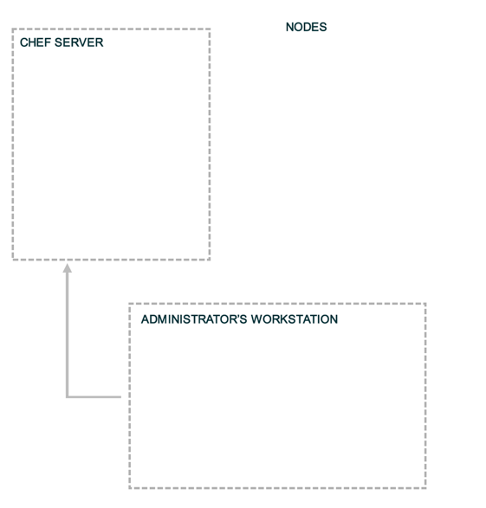
Landscape of a Chef-managed Infrastructure
Notes:
This diagram will be used throughout to help students remember which of the three components we’re talking about / working on.
Three main areas
1. Workstation
2. Enterprise Chef
3. Nodes in your infrastructure

Slide 107
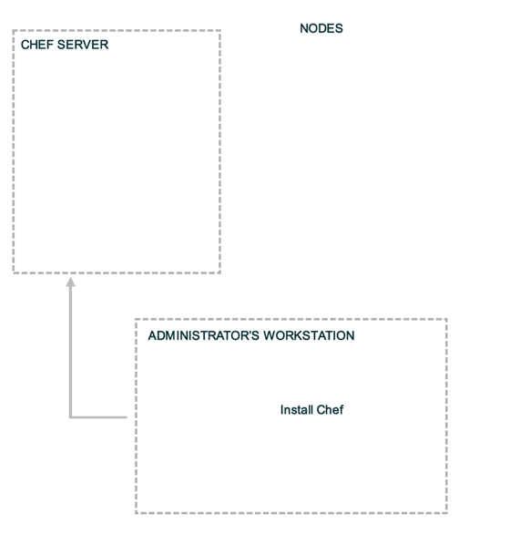
Landscape of a Chef-managed Infrastructure
Notes:
Start by installing Chef on the Workstation

Slide 108
Install Chef
Install Chef (if not already installed)
http://www.chef.io/chef/install
Notes:
Remember the version of Chef installed on the workstation determines the version of chef installed on any node you bootstrap with that workstation

Slide 109
Managing Your Own Ruby Environment
If you already have Ruby installed you can just install Chef as a gem
If you are using a ruby version manager, such as rvm, rbevn, or chruby, then we recommend creating a new gemset or ruby install and installing Chef (and any other tools designed to work with Chef) there
$ gem install chef
Notes:
This is an optional slide. Unhide this slide for customers who you know are ruby developers or when presenting at a ruby conference.
So no need to do '$ mv ~/.rvm{,.disabled}'
mv ~/.rvm{,.disabled}
is the same as
mv ~/.rvm ~/.rvm.disabled

Slide 110
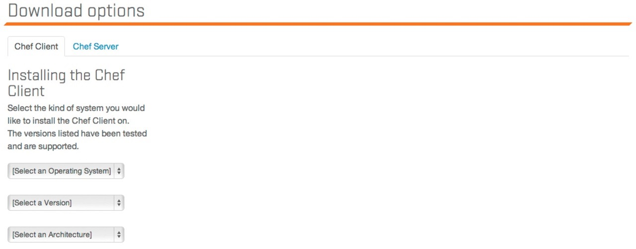
Install Chef
Notes:
Browse to the install page https://www.chef.io/download-chef-client/ and show the various options.
Highlight:
* Selecting different operating systems, versions, and hardware
* curl and pipe to bash or download a package
* Windows install

Slide 111
Install on Mac OSX

Slide 112
Install on Enterprise Linux

Slide 113
Workstation Setup - Mac OS X / Linux
$ curl -L http://www.chef.io/chef/install.sh | sudo bash
% Total % Received % Xferd Average Speed Time Time Time Current
Dload Upload Total Spent Left Speed
100 14100 100 14100 0 0 8814 0 0:00:01 0:00:01 --:--:-- 8812
Downloading Chef for mac_os_x...
downloading http://www.getchef.com/chef/metadata?v=&prerelease=false&p=mac_os_x&pv=10.7&m=x86_64
to file /tmp/install.sh.79770/metadata.txt
trying curl...
url http://opscode-omnibus-packages.s3.amazonaws.com/mac_os_x/10.7/x86_64/chef-11.8.2_1.mac_os_x.10.7.2.sh
md5 af157c6ef941e52f69a9dd6a3b57f597
sha256 c003c0951d80245b1f02c4588f9157a55e7b94a00dd6ac163aed8ef2e854619a
downloaded metadata file looks valid...
downloading http://opscode-omnibus-packages.s3.amazonaws.com/mac_os_x/10.7/x86_64/chef-11.8.2_1.mac_os_x.10.7.2.sh
to file /tmp/install.sh.79770/chef--mac_os_x-10.7-x86_64.sh
trying curl...
............................................................................
Thank you for installing Chef!
Checksum compare with shasum succeeded.
Installing Chef
installing with sh...
Verifying archive integrity... All good.
Uncompressing The full stack of chef
Notes:
Alternatively, Chef may be programmatically installed via the install.sh script. This is the method used during chef bootstraps.
This installs chef-client, knife, ohai and ruby along with any supporting ruby gems. This is exactly the same as gets installed on a node during bootstrap. Difference is the node does not use knife, while the workstation client does not use ohai - but each could be configured to perform either role!

Slide 114
Workstation Setup - Windows
Windows
2008 (Windows 7) or 2012 (Windows 8)
i686 (32-bit) or x86_64 (64-bit)
11.8.2
Download and install this file
Notes:
The versions shown for Windows are for Windows Server, but you're probably not running that one your workstation, so get the closest without going over (2008 ~= Windows7, 2012 ~=Windows8)
Get the closest without going over (2008 ~= Windows7, 2012 ~=Windows8)

Slide 115
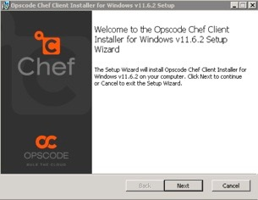
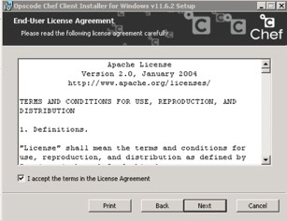
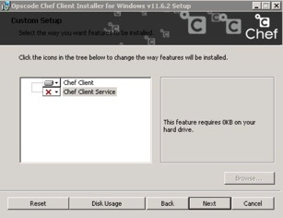
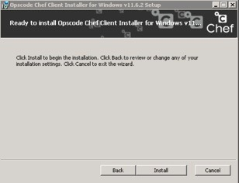
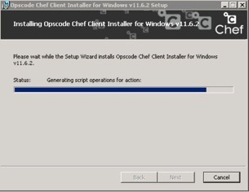
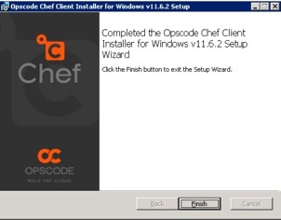
Install on Windows
Notes:
Screen shot of Windows installer

Slide 116
What just happened?
Chef and all of its dependencies installed via an operating system-specific package ("omnibus installer")
Installation includes
The Ruby language - used by Chef
knife - Command line tool for administrators
chef-client - Client application
ohai - System profiler
...and more
Notes:
A quick mention that we just used the omnibus installer which puts Chef and all of its dependencies on the workstation. The tools are installed under '/opt/chef' (linux/mac) or 'C:\Chef' (Windows).
Also mention that ‘gem install chef’ is also a valid installation method if students are already using rvm, rbevn, or chruby to manage their Ruby installations or if they’d prefer to use the system ruby (which should be at version 1.9 or better to use this method).
Opscode manages an open source project called "Omnibus". Use omnibus to create OS-specific packages.

Slide 117
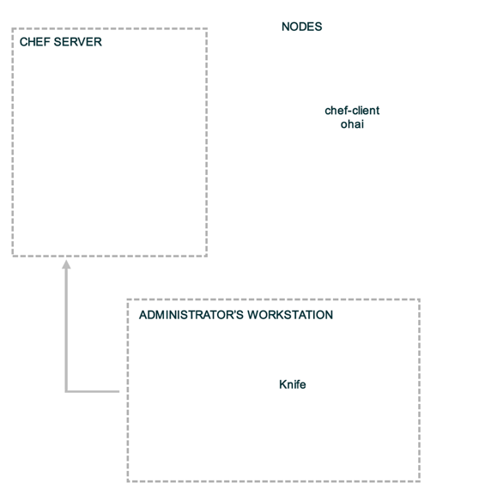
Workstation or Node?
Notes:
We've just installed chef-client, knife, ohai and ruby along with any supporting ruby gems. This is exactly the same as gets installed on a node during bootstrap. Difference is the node does not use knife, while the workstation client does not use chef-client - but each could be configured to perform either role!

Slide 118
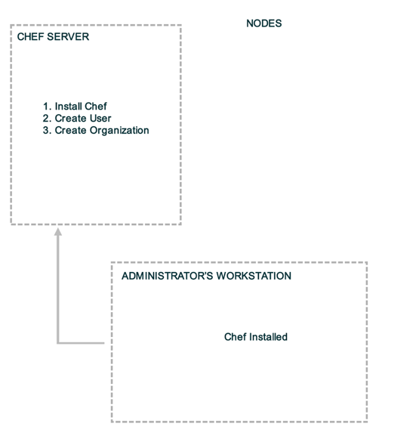
Landscape of a Chef-managed Infrastructure
Notes:
With Chef installed on the workstation, it’s now time to get the Chef Server setup.
We’ll be using Hosted Enterprise Chef for this class.

Slide 119
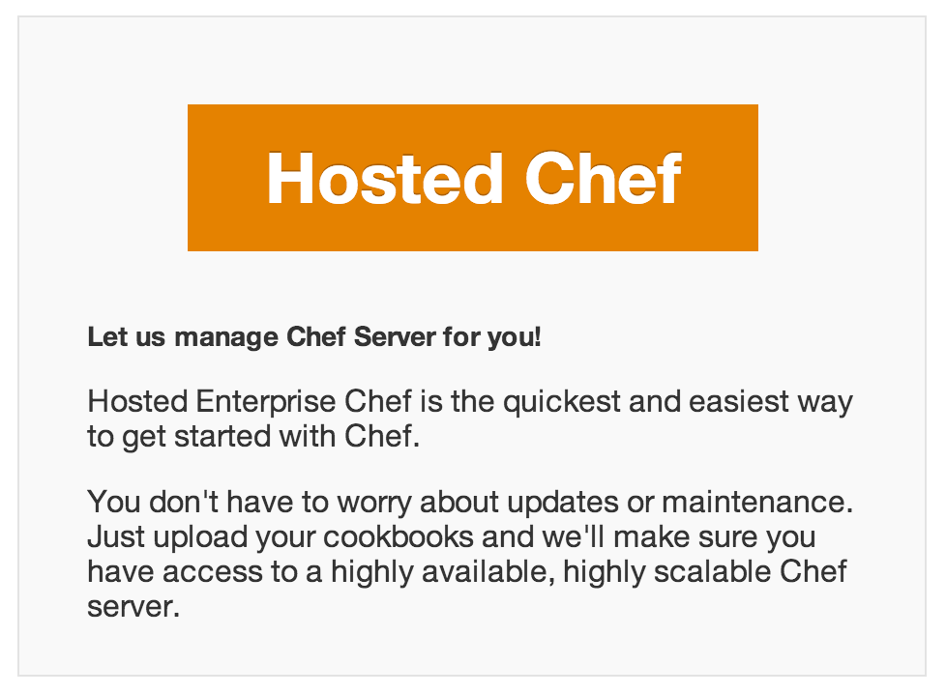
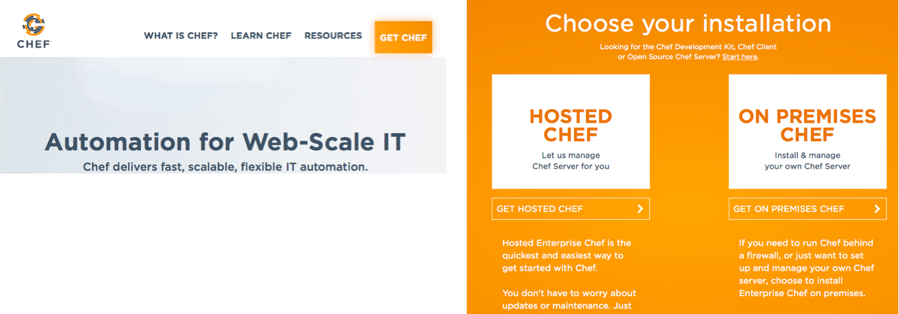

Your Chef Server for this class...
Hosted Enterprise Chef http://www.chef.io
Notes:
These screen shots are likely to fall out of sync with the website easily. It’s best to just demo this live for the students.

Slide 120
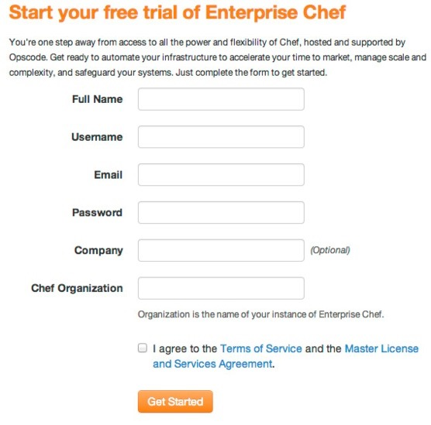
Create new account
Sign up for a new account
Chef Organization
provides multi-tenancy
name must be globally unique
Notes:
NOTE: Chef Organization must have a globally unique value.

Slide 121
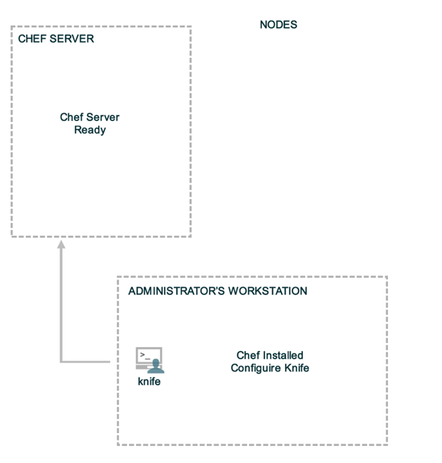
Landscape of a Chef-managed Infrastructure
Notes:
The next step is to configure knife to communicate with our Hosted Enterprise Chef organization. We’ll do so by downloading the starter kit.

Slide 122
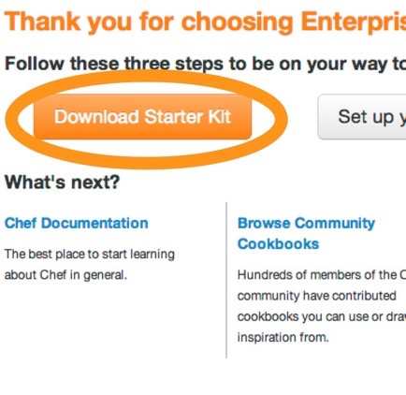
Download "Starter Kit" for your Org
You get a .zip file from clicking this
Unzip the zipfile - you’ll get a "chef-repo"
Put the "chef-repo" somewhere, e.g.:
C:\Users\you\chef-repo (Win)
/Users/you/chef-repo (Mac)
/home/you/chef-repo (Linux)
Notes:
Download the starter kit from the Chef Server
Make a decision about where to store the work from this class.
NOTE: Windows XP users should NOT have spaces in their directory- if they put it in a path with spaces (like C:\Documents and Settings\chef-repo), they will get errors when they try to upload cookbooks.
Unzip the zip file in that directory.
A chef-repo directory, or folder, is now available.
The 'Starter Kit' is a archive file (e.g. chef-starter.zip) that contains
-) A sample chef repository with a sample 'starter' cookbook
-) Configuration files allowing the workstation to talk to the chef server
We'll look at this in detail later...

Slide 123
What is the Starter Kit?
The 'Starter Kit' is a archive file (e.g. chef-starter.zip) that contains
A sample chef repository with a sample 'starter' cookbook
Configuration files allowing the workstation to talk to the chef server using knife
We'll look at this in detail later...

Slide 124
Knife is the command-line tool for Chef
Knife provides an API interface between a local Chef repository and the Chef Server, and lets you manage:
Nodes
Cookbooks and recipes
Roles
Stores of JSON data (data bags), including encrypted data
Environments
Cloud resources, including provisioning
The installation of Chef on management workstations
Searching of indexed data on the Chef Server
Notes:
It is also where you will spend the bulk of your time when working with Chef. Knife is the primary user interface for working with Chef. As a bonus, it very closely mirrors how our actual APIs are structured - so working with knife also gets you familiar with our lower-level abstractions that you may wind up using as you grow.
* This class teaches best practices - and all the pro Chefs use the command line interface almost exclusively.

Slide 125
A quick tour of the chef-repo
Every infrastructure managed with Chef has a Chef Repository ("chef-repo")
Type all commands in this class from the chef-repo directory
Let’s see what’s inside the chef-repo...

Slide 126
Tour the chef-repo
$ cd chef-repo
[~/chef-repo]$

Slide 127
Tour the chef-repo
$ ls -al
total 40
drwxr-xr-x@ 11 opscode opscode 374 Dec 15 09:42 .
drwxr-xr-x+ 92 opscode opscode 3128 Dec 15 09:43 ..
drwxr-xr-x@ 5 opscode opscode 170 Dec 15 2013 .chef
-rw-r--r--@ 1 opscode opscode 495 Dec 15 2013 .gitignore
-rw-r--r--@ 1 opscode opscode 2416 Dec 15 2013 README.md
-rw-r--r--@ 1 opscode opscode 3567 Dec 15 2013 Vagrantfile
-rw-r--r--@ 1 opscode opscode 588 Dec 15 2013 chefignore
drwxr-xr-x@ 3 opscode opscode 102 Dec 15 2013 cookbooks
drwxr-xr-x@ 3 opscode opscode 102 Dec 15 2013 roles

Slide 128
What’s inside the .chef directory?
$ ls .chef
ORGNAME-validator.pem
USERNAME.pem
knife.rb

Slide 129
What’s inside the .chef directory?
knife.rb is the configuration file for Knife.
The other two files are certificates for authentication with the Chef Server
We’ll talk more about that later.

Slide 130
knife.rb
Default location
~/.chef/knife.rb
c:\Users\You\.chef (Windows)
Use a project specific configuration
.chef/knife.rb of the current directory
chef-repo/.chef/knife.rb
http://docs.chef.io/config_rb_knife.html
Notes:
knife will look for it’s configuration (knife.rb) in:
1. current working directory’s .chef/
2. current user’s home directory’s .chef/
3. /etc/chef/knife.rb
Community plugins to help manage knife.rb files:
* knife-block - https://github.com/greenandsecure/knife-block
* ChefVM - https://github.com/trobrock/chefvm
knife.rb should be built in such a way that it can be checked into version control and shared by a team. The docs site as one example of such a knife.rb http://docs.chef.io/config_rb_knife.html#many-users-same-repo
http://docs.chef.io/config_rb_knife.html for additional details

Slide 131
knife.rb
OPEN IN EDITOR:
chef-repo/.chef/knife.rb
current_dir = File.dirname(__FILE__)
log_level :info
log_location STDOUT
node_name "USERNAME"
client_key "#{current_dir}/USERNAME.pem"
validation_client_name "ORGNAME-validator"
validation_key "#{current_dir}/ORGNAME-validator.pem"
chef_server_url "https://api.opscode.com/organizations/ORGNAME"
cache_type 'BasicFile'
cache_options( :path => "#{ENV['HOME']}/.chef/checksums" )
cookbook_path ["#{current_dir}/../cookbooks"]
Notes:
The other files in the .chef directory:
* client_key
* validation_key
The reason your Organization name needs to be globally unique:
* chef_server_url
Want to dig deeper into knife.rb? Check these (possibly outdated) links:
Fully commented knife.rb - https://gist.github.com/jtimberman/1718805
A knife.rb for Our Time - http://dougireton.com/blog/2013/03/17/a-knife-dot-rb-for-our-time/

Slide 132
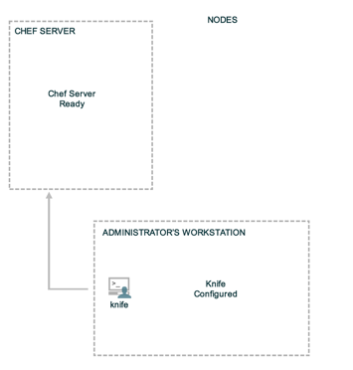
Verify Knife
$ knife --version
Chef: 11.8.2
Your version may be different, that’s ok!
$ knife client list
ORGNAME-validator
Notes:
Make sure every student can successfully run ‘knife client list’, which means they are fully set up.
Note 'Client' means an API Client, which can be either a node or a workstation!

Slide 133
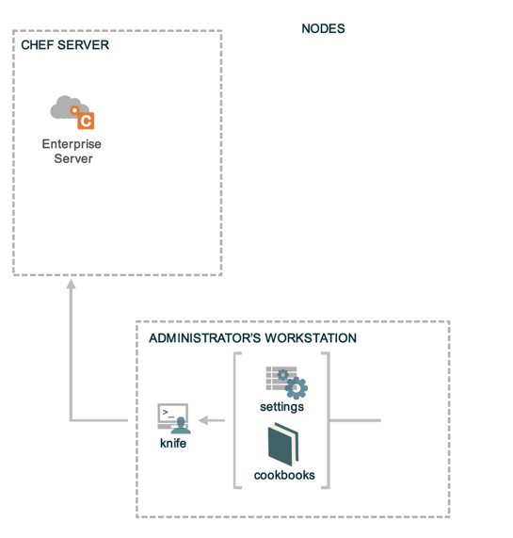
knife client list
knife client list
Reads the chef_server_url from knife.rb
Invokes HTTP GET to #{chef_server_url}/clients
Displays the result
Notes:
What happens when you execute ''?
To find out, run 'knife client list -VV'
$ knife client list -VV
DEBUG: Signing the request as nharveywss01
DEBUG: Sending HTTP Request via GET to api.opscode.com:443/organizations/nhcompany/clients
DEBUG: ---- HTTP Status and Header Data: ----
DEBUG: HTTP 1.1 200 OK
DEBUG: server: ngx_openresty
DEBUG: date: Tue, 22 Oct 2013 17:02:19 GMT
DEBUG: content-type: application/json
DEBUG: content-length: 189
DEBUG: connection: close
DEBUG: x-ops-api-info: flavor=hec;version=11.0.0;oc_erchef=0.21.31
DEBUG: ---- End HTTP Status/Header Data ----
nhcompany-validator

Slide 134
Exercise: Run ‘knife help list’
$ knife help list
Available help topics are:
bootstrap
chef-shell
client
configure
cookbook
cookbook-site
data-bag
delete
deps
diff
download
edit
environment
exec
list
Notes:
This will work on Windows XP only with recent versions of chef.
Also, careful, help pages don’t work very well on Windows.

Slide 135
A few knife tips
Commands are always structured as follows
knife
NOUN (client)
VERB (list)
You can get more help with
knife NOUN help
knife --help just shows options
Notes:
There are exceptions, but this is true for all the core primitives.
(this is true until it isn’t)
(exceptions are things like ssh, search, etc - although you could argue that the noun in question is the search index!)

Slide 136
Best Practice: Use a text editor with a project drawer, or equivalent
Chef is about Infrastructure as Code
People who code for a living use text editors that are designed for the task
Vim, Emacs, Sublime Text, Notepad++, etc.
Notes:
Have a project drawer! Chef organizes code into folders, and using the command line to constantly open/close individual files is maddening
Here is where we see the diff in Ops vs. Devs :-)
Text editors: because that’s how you roll now. Either you are a glutton for punishment or you will realize these tools exist to make your life easier and you will use them.

Slide 137
Benefits of a good text editor
A good editor will
Show line numbers
Highlight syntax
Autocomplete commands
Allow you to open multiple files

Slide 138
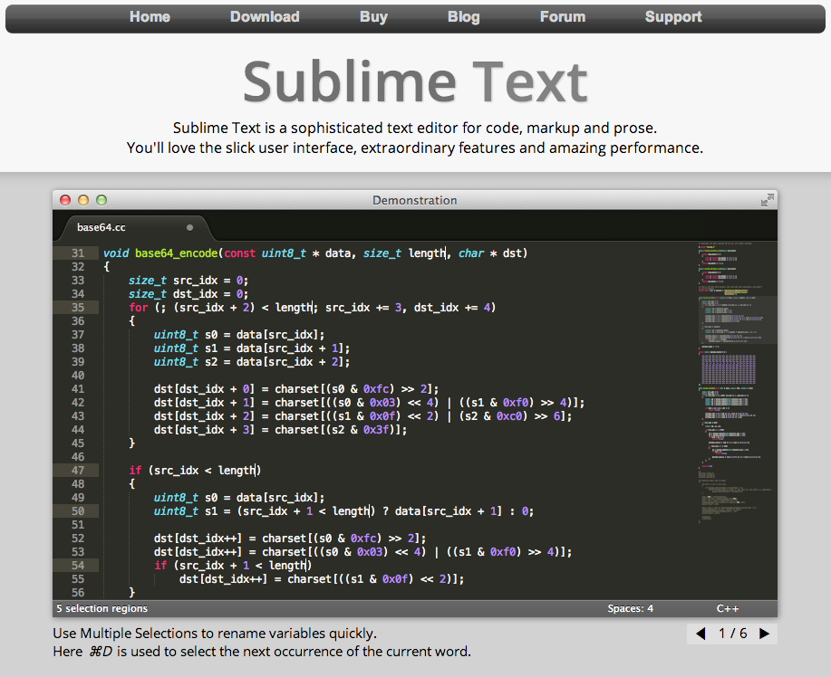
If you do not have a preferred text editor on your workstation already...
Download Sublime Text
Free trial, not time bound
Works on every platform
sublimetext.com
Notes:
Note: If they've made no decision on editor, recommend they use Sublime Text. Point out that Sublime is an unrelated tool although it has a chef plugin to help write chef code (autocomplete etc), however they should NOT install the Chef plugin until at least day 2 of the class!
Common editors:
vim
emacs
nano
textmate
sublime
On windows, the best is wordpad, and you can find it at %ProgramFiles%\Windows NT\Accessories\WORDPAD.EXE
Windows folks using Notepad++: set wait via "multiInst" flag "%ProgramFiles%\blahblah\notepad++.exe -multiInst"

Slide 139
Set Knife’s Editor: Linux/Mac
OPEN IN EDITOR:
~/chef-repo/.chef/knife.rb
# Choose one of the following.
knife[:editor] = "/path/to/editor --flags"
Vim
"/usr/bin/vim"
Emacs
"/usr/bin/emacs"
Nano
"/usr/bin/nano"
Sublime Text
"/Applications/Sublime\\ Text\\ 2.app/Contents/SharedSupport/bin/subl -w"
Text Wrangler
"/Applications/TextWrangler.app/Contents/Helpers/edit -w"
SAVE FILE!
Notes:
ref0004
This is an optional slide!
Of course, students can still set their EDITOR in environment variables and Knife will use that.

Slide 140
Set Knife’s Editor: Windows
OPEN IN EDITOR:
~/chef-repo/.chef/knife.rb
# Choose one of the following.
knife[:editor] = "C:\\path\\to\\editor.exe --flags"
Notepad++
"C:\\progra~2\\notepa~1\\notepad++.exe -nosession -multiInst"
Sublime Text
"C:\\progra~1\\sublim~1\\sublime_text.exe --wait"
Textpad
"C:\\progra~2\\textpa~1\\TextPad.exe"
Vim
"C:\\progra~2\\vim\\vim74\\gvim.exe"
SAVE FILE!
Notes:
ref0005
This is an optional slide!
Most editors only ship as 32-bit versions hence Progra~2 (which maps to "Program Files (x86)")
The ones that don’t go in Progra~1 (which maps to "Program Files")

Slide 141

Using your favorite EDITOR
Linux/OSX/Unix
OPEN IN EDITOR:
~/.bash_profile
export EDITOR='/Applications/Sublime\ Text\ 2.app/Contents/SharedSupport/bin/subl -w'
SAVE FILE!
$ source ~/.bash_profile
Windows in cmd.exe
$ setx EDITOR "\"%ProgramFiles%\Sublime Text 2\sublime_text.exe\" --wait"
close cmd.exe and start a new cmd.exe session
Notes:
ref0006
This is an optional slide!
Common editors:
vim
emacs
nano
textmate
sublime
On windows, the best is wordpad, and you can find it at %ProgramFiles%\Windows NT\Accessories\WORDPAD.EXE
Windows folks using Notepad++: set wait via "multiInst" flag "%ProgramFiles%\blahblah\notepad++.exe -multiInst"
In Windows, quit cmd.exe and start a new cmd.exe to get the EDITOR set. Verify with the 'env' command's output.

Slide 142
Checkpoint
Notes:
Chef Server is up and running
Knife is installed and configured on the workstation

Slide 143
What’s Next?
Notes:
This is an optional slide!
What is the next step towards managing our infrastructure as code?

Slide 144
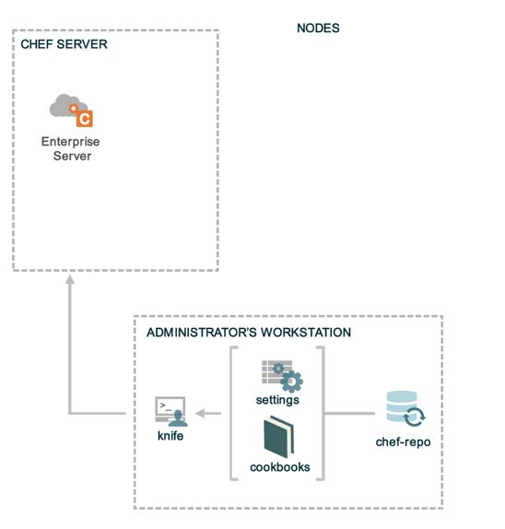
Source Code Repository
Notes:
This is an optional slide!
We should now create a source code repository for our code

Slide 145
Initialize a git repository
$ git init
Initialized empty Git repository in /Users/opscode/chef-repo/.git/
Notes:
This is an optional slide!
If git is installed (it should be), initialize a git repository

Slide 146
Check git status
$ git status
# On branch master
#
# Initial commit
#
# Untracked files:
# (use "git add <file>..." to include in what will be committed)
#
# .berkshelf/
# .chef/
# .gitignore
# Berksfile
# README.md
# Vagrantfile
# chefignore
# cookbooks/
# roles/
nothing added to commit but untracked files present (use "git add" to track)
Notes:
This is an optional slide!
Check the status of the current git repository

Slide 147
Add all files to git
$ git add .
[~/chef-repo]$
Notes:
This is an optional slide!
Add all the files to the git repository.
There is no output

Slide 148
Add files to git
$ git commit -m "add the starter kit from Chef"
[master (root-commit) 2af68fb] add the starter kit from Chef
13 files changed, 360 insertions(+)
create mode 100644 .berkshelf/config.json
create mode 100644 .chef/knife.rb
create mode 100644 .gitignore
create mode 100644 Berksfile
create mode 100644 README.md
create mode 100644 Vagrantfile
create mode 100644 chefignore
create mode 100644 cookbooks/starter/attributes/default.rb
create mode 100644 cookbooks/starter/files/default/sample.txt
create mode 100644 cookbooks/starter/metadata.rb
create mode 100644 cookbooks/starter/recipes/default.rb
create mode 100644 cookbooks/starter/templates/default/sample.erb
create mode 100644 roles/starter.rb
Notes:
This is an optional slide!
Commit the files to the git repository

Slide 149
Checkpoint
Notes:
This is an optional slide!
Chef Server is up and running
Knife is installed and configured
Source Code repository has been created

Slide 150
Review Questions
What is the chef-repo?
What is knife?
What is name of the knife configuration file?
Where is the knife configuration file located?
What is your favorite text editor? :)
Notes:
-)
-)
-) knife.rb
-) <pwd>/.chef/knife.rb or ~/.chef/knife.rb or /etc/chef/knife.rb
-)

Slide 151
Organization Setup
Setup an Organization

Slide 152
Lesson Objectives
After completing the lesson, you will be able to
Explain the purpose of Organizations
Manage your Chef Organization
Invite users into your organization
Accept invitations into other organizations

Slide 153
Checkpoint
Notes:
Chef Server is up and running
Knife is installed and configured
Source Code repository has been created

Slide 154
Organizations
My Infrastructure
Your Infrastructure
Their Infrastructure

Slide 155
Organizations
Provide multi-tenancy in Chef
Nothing is shared between Organizations - they're completely independent
May represent different
Companies
Business Units
Departments

Slide 156
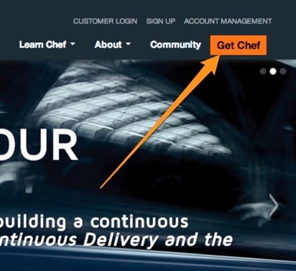
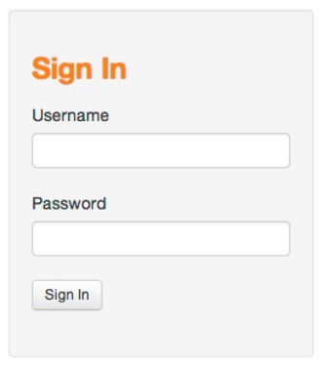
Manage Organizations
Login to your Hosted Enterprise Chef
Notes:
http://manage.chef.io

Slide 157
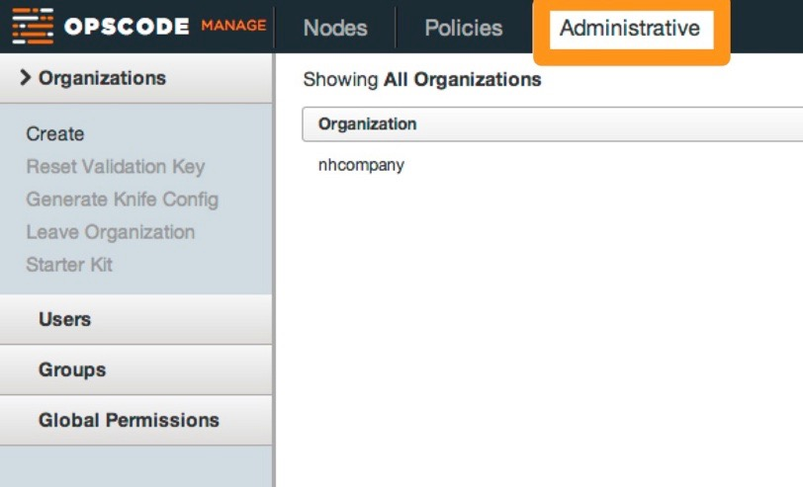

Organizations
Notes:
Click the Administrative tab to see the Organizations
The name of your organization was specified when signing up for Enterprise Chef.

Slide 158
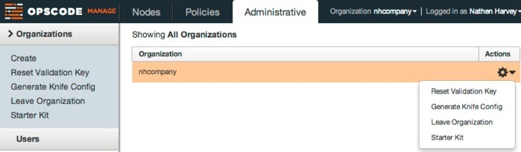
Manage Organizations
Reset Validation Key
Generate Knife Config
Leave Organization
Download the 'Starter Kit'
Notes:
From the Organizations page you can:
Reset the organization’s validation key
Generate a knife.rb
Leave the Organization
Recreate and download the starter kit

Slide 159
Manage Organizations
Each Organization may have multiple Users
Manage an Organization’s Users via the Enterprise Server interface
https://manage.chef.io

Slide 160
Exercise: Invite users into your org
The Problem: You need assistance from a colleague on one of your chef projects
Proposed Solution: Invite the colleague into your organization so they can log into the chef server with their own credentials, but can see your organization

Slide 161
Exercise: Invite Users into your Org
For the Lab Exercise you can team up with one other person in the class, then you will
Invite your classmate into your organization
Accept your classmate's invite into their org
Look around your classmate's organization while they look around yours
Finally remove your classmate's access from your account

Slide 162
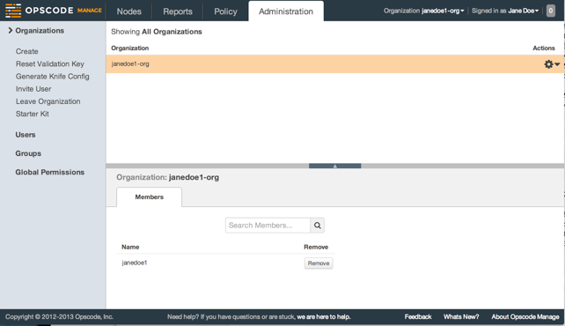
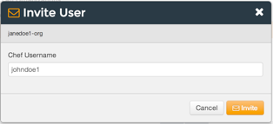
Exercise: Invite a classmate into your org
Navigate to http://manage.chef.io
Click the "Administration" tab,
Select the appropriate Organization
Click "Invite User" from the left menu
Enter your classmate's 'Chef Username' and click Invite

Slide 163
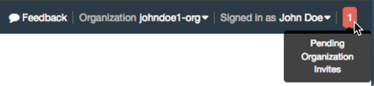
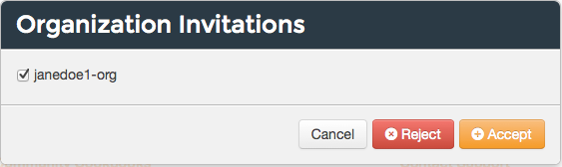
Exercise: Accept an invite
You will get a notification once your classmate has invited you into their account
Click the notification, select the Organization and click 'Accept'

Slide 164
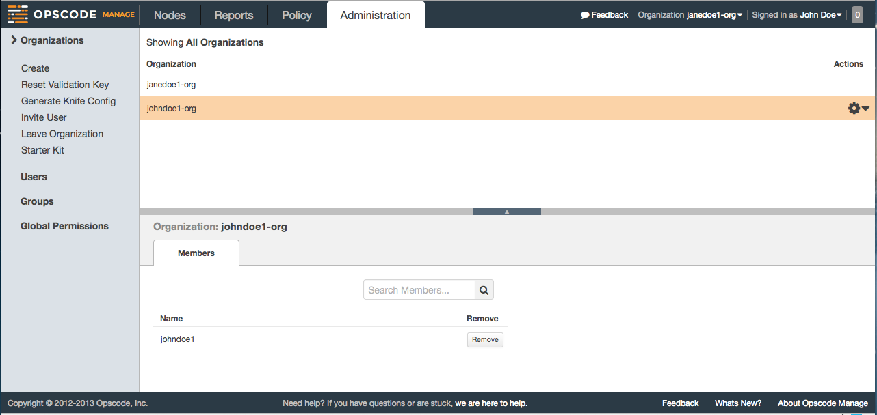
Exercise: View classmate's org
Select your classmate's organization from the drop down list and peruse their org

Slide 165
Exercise: Revoke access
Now either 'Leave Organization' you've been invited into, or remove your classmate from your organization

Slide 166
Review Questions
What is an Organization?
How do you regenerate the Starter Kit for your Organization?

Slide 167
Node Setup
Setup a Node to manage

Slide 168
Lesson Objectives
After completing the lesson, you will be able to
Install Chef nodes using "knife bootstrap"
Explain how knife bootstrap configures a node to use the Organization created in the previous section
Explain the basic configuration needed to run chef-client

Slide 169
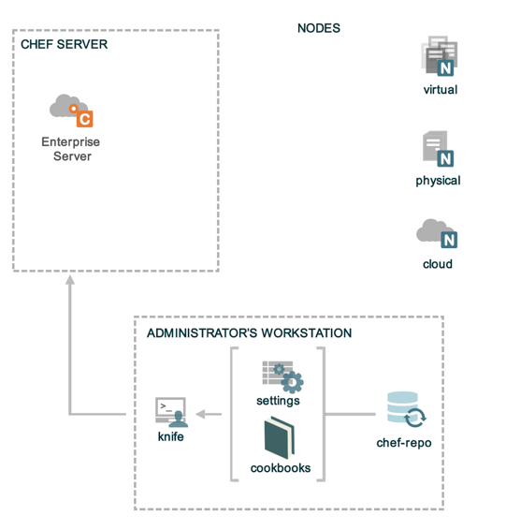
Nodes
Notes:
Chef Server is up and running
Knife is installed and configured
Source Code repository has been created

Slide 170
Nodes
Nodes represent the servers in your infrastructure these may be
Physical or virtual servers
Hardware that you own
Compute instances in a public or private cloud
Could also be network hardware - switches, routers, etc
Notes:
network device support for some vendors - Arista, Juniper, Cisco

Slide 171
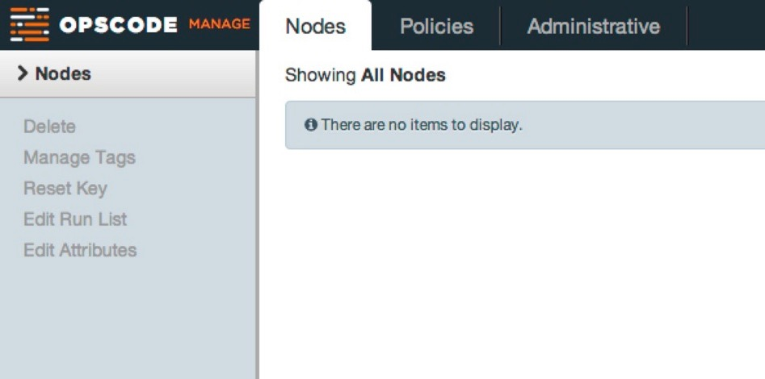
We Have No Nodes Yet
Notes:
Just to show there aren’t any nodes yet

Slide 172
Training Node
The labs require a node to be managed
We allow for two different options
Bring your own Node
Use the CloudShare training environment
Notes:
Use this if cloudshare or some other on-demand training lab / environment are unavailable.
There is also an EC2 AMI ‘oc-training-public’, but its Ubuntu, and the labs are based around CentOS (Apache lab will not work as the configuration is different between RHEL & Ubuntu)

Slide 173
Bring Your Own Node
Use your own Virtual Machine (VM) or Server
Required for the labs:
CentOS 6+
512 MB RAM
15 GB Disk
sudo or root level permissions

Slide 174

EC2 Public AMI
Opscode publishes a public AMI on EC2 that may be used
Search for ‘oc-training-public’
m1.small should be sufficient
Open ports 22, 80-90 in security group
SSH Credentials
Login: opscode
Password: opscode
Never use this for anything other than this class!

Slide 175
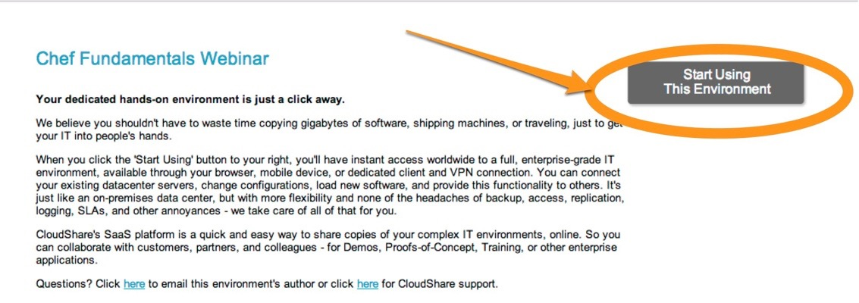
CloudShare Node
Register and login to CloudShare (see invite)
Start Using This Environment

Slide 176
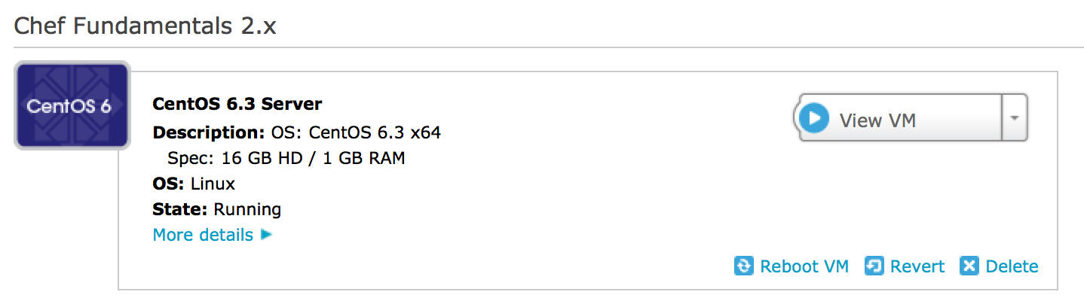
CloudShare Node

Slide 177
CloudShare Node
Notes:
Copy the External Address. This will be used to ssh into the server.

Slide 178
Lab - Login
$ ssh chef@<EXTERNAL_ADDRESS>
The authenticity of host 'uvo1qrwls0jdgs3blvt.vm.cld.sr (69.195.232.110)' can't be established.
RSA key fingerprint is d9:95:a3:b9:02:27:e9:cd:74:e4:a2:34:23:f5:a6:8b.
Are you sure you want to continue connecting (yes/no)? yes
Warning: Permanently added 'uvo1qrwls0jdgs3blvt.vm.cld.sr,69.195.232.110' (RSA) to the list of known hosts.
chef@uvo1qrwls0jdgs3blvt.vm.cld.sr's password:
Last login: Mon Jan 6 16:26:24 2014 from host86-145-117-53.range86-145.btcentralplus.com
[chef@CentOS63 ~]$
Notes:
<EXTERNAL_ADDRESS> is what you'll see in the CloudShare UI - can be IP Address or FQDN

Slide 179
Checkpoint
At this point you should have
One virtual machine (VM) or server that you’ll use for the lab exercises
The IP address or public hostname
An application for establishing an ssh connection
'sudo' or 'root' permissions on the VM

Slide 180
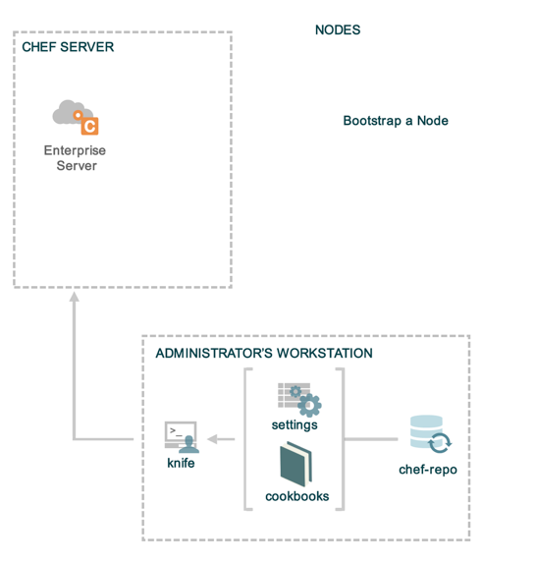
Checkpoint
Notes:
The bootstrap process installs chef-client on a target node so it can communicate with a chef server.
Chef Server is up and running
Knife is installed and configured
Source Code repository has been created

Slide 181
"Bootstrap" the Target Instance
$ knife bootstrap <EXTERNAL_ADDRESS> -x root -P <PASSWORD> -N "node1"
Bootstrapping Chef on uvo1qrwls0jdgs3blvt.vm.cld.sr
...
...
uvo1qrwls0jdgs3blvt.vm.cld.sr Creating a new client identity for node1 using the validator key.
uvo1qrwls0jdgs3blvt.vm.cld.sr resolving cookbooks for run list: []
uvo1qrwls0jdgs3blvt.vm.cld.sr Synchronizing Cookbooks:
uvo1qrwls0jdgs3blvt.vm.cld.sr Compiling Cookbooks...
uvo1qrwls0jdgs3blvt.vm.cld.sr [2014-01-28T11:03:14-05:00] WARN: Node node2 has an empty run list.
uvo1qrwls0jdgs3blvt.vm.cld.sr Converging 0 resources
uvo1qrwls0jdgs3blvt.vm.cld.sr Chef Client finished, 0 resources updated
Notes:
>>> NH - use root, not chef
<<<WIP Update this: change 'node2' and no password now req'd
This command should be entered on a single line.
(using the EC2 fqdn sucks. Have your students name the node.)
The IPADDRESS is your VM's IP or external name
If you get prompted for the password again, this is *sudo* not Chef. The -P is passed to the SSH connection.
It will take a few minutes for this command to run, so let's talk about what it is doing.

Slide 182








$ knife bootstrap IPADDRESS --sudo -x USERNAME -P PASSWORD -N node1
local workstation
SSH!
managed node (VM)
chef_server_url
validation_client_name
validation_key
bash -c '
install chef
configure client
run chef'
chef-client
Opscode Hosted Chef
Notes:
What does this bootstrap command do?
1. Connect to the VM via SSH, using the specified user (chef) and password (chef)
2. Renders the specified template (chef-full) with the chef_server_url, validation_client_name for the Chef Server and the contents of the validation_key from the knife.rb file.
3. We have the Hosted Enterprise Chef server defined as the server url.
4. The template is executed as a script under sudo on the VM, the script: installs chef-full package, configures the system to connect to the server, and runs chef-client with the specified run list (-r '[..]').

Slide 183
What just happened?
Chef and all of its dependencies installed via an operating system-specific package ("omnibus installer")
Installation includes
The Ruby language - used by Chef
knife - Command line tool for administrators
chef-client - Client application
ohai - System profiler
...and more
Notes:
A quick mention that we just used the omnibus installer which puts Chef and all of its dependencies on the workstation. The tools are installed under /opt/chef (linux/mac) or C:\Chef (Windows).
Also mention that ‘gem install chef’ is also a valid installation method if students are already using rvm, rbevn, or chruby to manage their Ruby installations or if they’d prefer to use the system ruby (which should be at version 1.9 or better to use this method).
Opscode manages an open source project called "Omnibus". Use omnibus to create OS-specific packages.

Slide 184
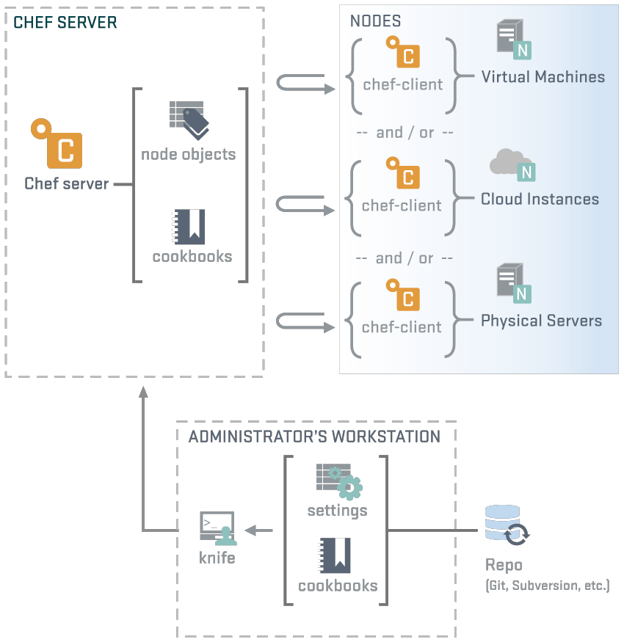
Workstation or Node?
NODES
chef-client
ohai
knife
Notes:
We've just installed chef-client, knife, ohai and ruby along with any supporting ruby gems. This is exactly the same as gets installed on a node during bootstrap. Difference is the node does not use knife, while the workstation client does not use chef-client - but each could be configured to perform either role!

Slide 185
Verify Your Target Instance’s Chef-Client is Configured Properly
$ ssh chef@<EXTERNAL_ADDRESS>
chef@node1:~$ ls /etc/chef
client.pem client.rb first-boot.json validation.pem
chef@node1:~$ which chef-client
/usr/bin/chef-client

Slide 186
Examine /etc/chef/client.rb
chef@node1:~$ cat /etc/chef/client.rb
log_level :auto
log_location STDOUT
chef_server_url "https://api.opscode.com/organizations/ORGNAME"
validation_client_name "ORGNAME-validator"
node_name "node1"

Slide 187
Change the log level on your test node
chef@node1:~$ sudo vim /etc/chef/client.rb
log_level :info
log_location STDOUT
chef_server_url "https://api.opscode.com/organizations/ORGNAME"
validation_client_name "ORGNAME-validator"
node_name "node1"
Set the default log level for chef-client to :info
More configuration options can be found on the docs site: http://docs.chef.io/config_rb_client.html
Notes:
We change the log_level so that later sessions have more detailed log outputs. The automatic setting for logging since Chef 11 has minimal output that hides some of the lesson information. If you are using Chef 10, then the log level will be :info by default.

Slide 188
"Bootstrap" the Target Instance
$ knife bootstrap <EXTERNAL_ADDRESS> --sudo -x chef -P chef -N "node1"
Bootstrapping Chef on uvo1qrwls0jdgs3blvt.vm.cld.sr
uvo1qrwls0jdgs3blvt.vm.cld.sr knife sudo password:
Enter your password:
...
...
uvo1qrwls0jdgs3blvt.vm.cld.sr Creating a new client identity for node1 using the validator key.
uvo1qrwls0jdgs3blvt.vm.cld.sr resolving cookbooks for run list: []
uvo1qrwls0jdgs3blvt.vm.cld.sr Synchronizing Cookbooks:
uvo1qrwls0jdgs3blvt.vm.cld.sr Compiling Cookbooks...
uvo1qrwls0jdgs3blvt.vm.cld.sr [2014-01-28T11:03:14-05:00] WARN: Node node2 has an empty run list.
uvo1qrwls0jdgs3blvt.vm.cld.sr Converging 0 resources
uvo1qrwls0jdgs3blvt.vm.cld.sr Chef Client finished, 0 resources updated
Notes:
(using the EC2 fqdn sucks. Have your students name the node.)
The IPADDRESS is your VM's IP or external name
If you get prompted for the password again, this is *sudo* not Chef. The -P is passed to the SSH connection.
It will take a few minutes for this command to run, so let's talk about what it is doing.

Slide 189
knife bootstrap
Chef Server
Workstation
Node

Slide 190
knife bootstrap
knife bootstrap HOSTNAME --sudo -x chef -P chef -N "node1"
Chef Server
Workstation
Node

Slide 191

knife bootstrap
knife bootstrap HOSTNAME --sudo -x chef -P chef -N "node1"
Chef Server
Workstation
chef_server_url
validation_client_name
validation_client_key
ssh / scp
Node

Slide 192

knife bootstrap
knife bootstrap HOSTNAME --sudo -x chef -P chef -N "node1"
Chef Server
Workstation
chef_server_url
validation_client_name
validation_client_key
ssh / scp
install chef-client
configure chef-client
run chef-client
Node

Slide 193

knife bootstrap
knife bootstrap HOSTNAME --sudo -x chef -P chef -N "node1"
Chef Server
Workstation
register node
save node details
chef_server_url
validation_client_name
validation_client_key
ssh / scp
install chef-client
configure chef-client
run chef-client
Node

Slide 194

knife bootstrap
knife bootstrap HOSTNAME --sudo -x chef -P chef -N "node1"
Chef Server
Workstation
register node
save node details
chef_server_url
validation_client_name
validation_client_key
ssh / scp
install chef-client
configure chef-client
run chef-client
Node

Slide 195
knife bootstrap
knife bootstrap HOSTNAME --sudo -x chef -P chef -N "node1"
Chef Server
Workstation
register node
save node details
chef_server_url
validation_client_name
validation_client_key
ssh / scp
install chef-client
configure chef-client
run chef-client
Node

Slide 196
What just happened?
Chef and all of its dependencies installed via an operating system-specific package ("omnibus installer")
Installation includes
The Ruby language - used by Chef
knife - Command line tool for administrators
chef-client - Client application
ohai - System profiler
...and more
Notes:
A quick mention that we just used the omnibus installer which puts Chef and all of its dependencies on the workstation. The tools are installed under /opt/chef (linux/mac) or C:\Chef (Windows).
Also mention that ‘gem install chef’ is also a valid installation method if students are already using rvm, rbevn, or chruby to manage their Ruby installations or if they’d prefer to use the system ruby (which should be at version 1.9 or better to use this method).
Opscode manages an open source project called "Omnibus". Use omnibus to create OS-specific packages.

Slide 197
Workstation or Node?
NODES
chef-client
ohai
knife
Notes:
We've just installed chef-client, knife, ohai and ruby along with any supporting ruby gems. This is exactly the same as gets installed on a node during bootstrap. Difference is the node does not use knife, while the workstation client does not use chef-client - but each could be configured to perform either role!

Slide 198
Verify Your Target Instance’s Chef-Client is Configured Properly
$ ssh chef@<EXTERNAL_ADDRESS>
chef@node1:~$ ls /etc/chef
client.pem client.rb first-boot.json validation.pem
chef@node1:~$ which chef-client
/usr/bin/chef-client

Slide 199
Examine /etc/chef/client.rb
chef@node1:~$ cat /etc/chef/client.rb
log_location STDOUT
chef_server_url "https://api.opscode.com/organizations/ORGNAME"
validation_client_name "ORGNAME-validator"
node_name "node1"

Slide 200
Exercise: Change the log level on your test node
chef@node1:~$ sudo vim /etc/chef/client.rb
log_level :info
log_location STDOUT
chef_server_url "https://api.opscode.com/organizations/ORGNAME"
validation_client_name "ORGNAME-validator"
node_name "node1"
Set the default log level for chef-client to :info
More configuration options can be found on the docs site: http://docs.chef.io/config_rb_client.html
Notes:
We change the log_level so that later sessions have more detailed log outputs. The automatic setting for logging since Chef 11 has minimal output that hides some of the lesson information. If you are using Chef 10, then the log level will be :info by default.
In Chef 12, log_level is :auto by default.

Slide 201
View Node on Chef Server
Login to your Hosted Enterprise Chef
Notes:
Login to Enterprise Chef to view your nodes

Slide 202
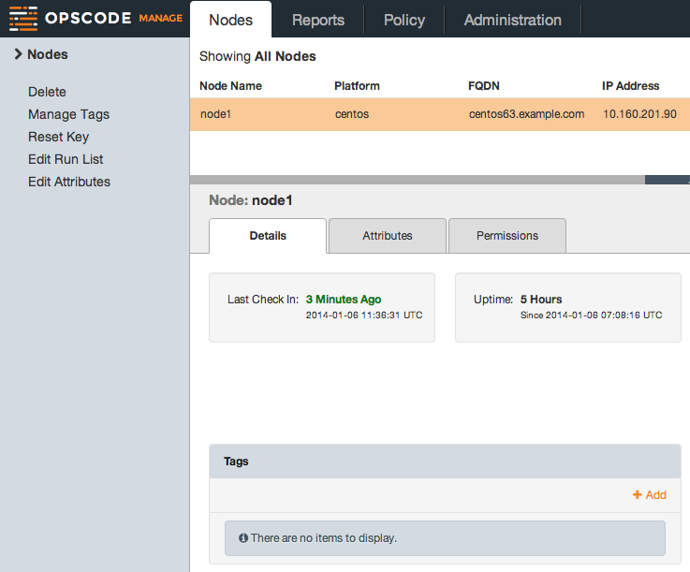
View Node on Chef Server
Click the 'Details' tab

Slide 203
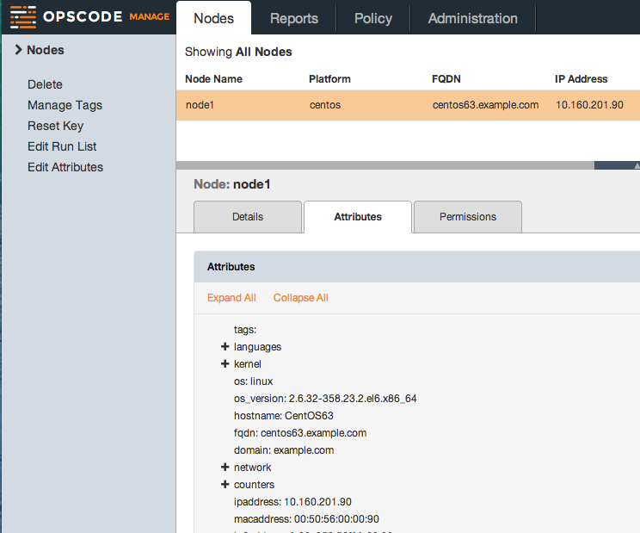
View Node on Chef Server
Click the 'Attributes' tab

Slide 204
Node
The node is registered with Chef Server
The Chef Server displays information about the node
This information comes from Ohai - we'll see Ohai later.....
Notes:
We'll be looking at ohai in a later section...

Slide 205
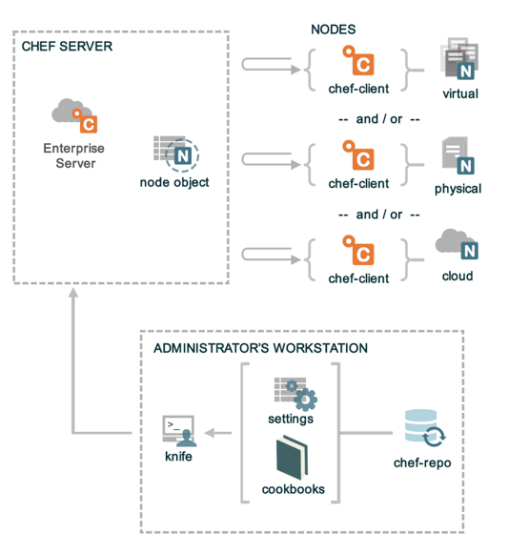
Checkpoint
Notes:
Chef Server is up and running
Knife is installed and configured
Source Code repository has been created

Slide 206
Review Questions
Where is the chef-client configuration file?
What is the command to run chef?
What does a knife bootstrap do?
Notes:
-) /etc/chef
-) chef-client
-) Installs the chef-client on a target system so that it can run as a chef-client and communicate with a server.

Slide 207
Chef Resources and Recipes
Writing an Apache cookbook

Slide 208
Lesson Objectives
After completing the lesson, you will be able to
Describe in detail what a cookbook is
Create a new cookbook
Explain what a recipe is
Describe how to use the package, service, and cookbook_file resources
Upload a cookbook to the Chef Server
Explain what a run list is, and how to set it for a node via knife
Explain the output of a chef-client run

Slide 209
What is a cookbook?
A cookbook is like a “package” for Chef recipes.
It contains all the recipes, files, templates, libraries, etc. required to configure a portion of your infrastructure
Typically they map 1:1 to a piece of software or functionality.
Notes:
Example: “apache”, “mysql”, “mongodb”, “tomcat”, “jboss” - all of these things are software style cookbooks, and they would contain all the different ways you work with each. (A “mysql client”, “mysql server”, “mysql slave”, etc.)
Functional cookbooks might be something like “users”, “security”, etc.
We are going to write a lot of cookbooks - so you’re going to get comfortable with them.

Slide 210
The Problem and the Success Criteria
The Problem: We need a web server configured to serve up our home page.
Success Criteria: We can see the homepage in a web browser.

Slide 211
Required steps
Install Apache
Start the service, and make sure it will start when the machine boots
Write out the home page
Please note in this course we're teaching Chef primitives, not web server management
This is probably not the Apache HTTP server configuration you would use in production
Notes:
"This section will teach you the basics of cookbooks and convergence via code"
In EC2, iptables is almost always on… so probably disable it (easiest option).

Slide 212
Exercise: Create a new Cookbook
$ knife cookbook create apache
** Creating cookbook apache
** Creating README for cookbook: apache
** Creating CHANGELOG for cookbook: apache
** Creating metadata for cookbook: apache

Slide 213
Exercise: Explore the cookbook
$ ls -la cookbooks/apache
total 24
drwxr-xr-x 13 opscode opscode 442 Jan 24 21:25 .
drwxr-xr-x 5 opscode opscode 170 Jan 24 21:25 ..
-rw-r--r-- 1 opscode opscode 412 Jan 24 21:25 CHANGELOG.md
-rw-r--r-- 1 opscode opscode 1447 Jan 24 21:25 README.md
drwxr-xr-x 2 opscode opscode 68 Jan 24 21:25 attributes
drwxr-xr-x 2 opscode opscode 68 Jan 24 21:25 definitions
drwxr-xr-x 3 opscode opscode 102 Jan 24 21:25 files
drwxr-xr-x 2 opscode opscode 68 Jan 24 21:25 libraries
-rw-r--r-- 1 opscode opscode 276 Jan 24 21:25 metadata.rb
drwxr-xr-x 2 opscode opscode 68 Jan 24 21:25 providers
drwxr-xr-x 3 opscode opscode 102 Jan 24 21:25 recipes
drwxr-xr-x 2 opscode opscode 68 Jan 24 21:25 resources
drwxr-xr-x 3 opscode opscode 102 Jan 24 21:25 templates

Slide 214
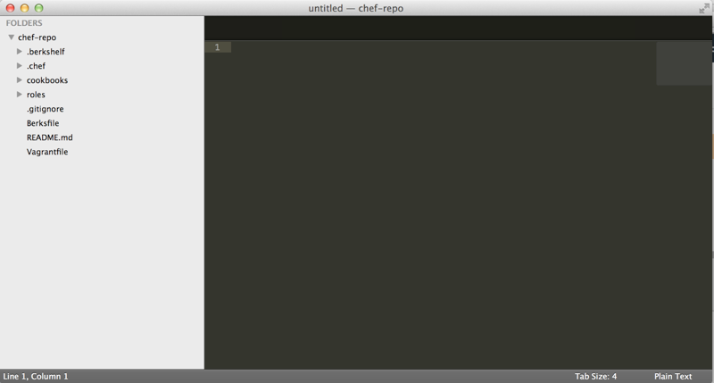
Exercise: Open a project drawer if you're using Sublime Text
If you're using Sublime, then File>Open the chef-repo directory you created earlier
Access the cookbook files from the left menu
Notes:
Note: If they've made no decision on editor, recommend they use Sublime Text. Point out that Sublime is an unrelated tool although it has a chef plugin to help write chef code (autocomplete etc), however they should NOT install the Chef plugin until at least day 2 of the class!
Say something like "If you're using Sublime, then....", If they're not using it then gloss over it. In
You can access all files in the cookbook from the left menu
i.e.:
C:\Users\you\chef-repo (Win)
/Users/you/chef-repo (Mac)
/home/you/chef-repo (Linux)

Slide 215
Exercise: Edit the default recipe
OPEN IN EDITOR:
cookbooks/apache/recipes/default.rb
#
# Cookbook Name:: apache
# Recipe:: default
#
# Copyright 2013, YOUR_COMPANY_NAME
#
# All rights reserved - Do Not Redistribute
#

Slide 216
Chef Resources
package "haproxy" do
action :install
end
template "/etc/haproxy/haproxy.cfg" do
source "haproxy.cfg.erb"
owner "root"
group "root"
mode "0644"
notifies :restart, "service[haproxy]"
end
service "haproxy" do
supports :restart => true
action [:enable, :start]
end
Notes:
Let's take a moment to discuss resources. This is the structure of a Chef resource.
Point out that resource parameters live between the “DO..END”.

Slide 217
Chef Resources
Have a type
package "haproxy" do
action :install
end
template "/etc/haproxy/haproxy.cfg" do
source "haproxy.cfg.erb"
owner "root"
group "root"
mode "0644"
notifies :restart, "service[haproxy]"
end
service "haproxy" do
supports :restart => true
action [:enable, :start]
end
Notes:
All resources have:
A type (e.g. package, template, service)

Slide 218
Chef Resources
Have a type
Have a name
package "haproxy" do
action :install
end
template "/etc/haproxy/haproxy.cfg" do
source "haproxy.cfg.erb"
owner "root"
group "root"
mode "0644"
notifies :restart, "service[haproxy]"
end
service "haproxy" do
supports :restart => true
action [:enable, :start]
end
Notes:
A name (e.g. path to a file, name of a package, name of a service)

Slide 219
Chef Resources
Have a type
Have a name
Have parameters
package "haproxy" do
action :install
end
template "/etc/haproxy/haproxy.cfg" do
source "haproxy.cfg.erb"
owner "root"
group "root"
mode "0644"
notifies :restart, "service[haproxy]"
end
service "haproxy" do
supports :restart => true
action [:enable, :start]
end
Notes:
Resource parameters like owners of files, what commands a service supports

Slide 220
Chef Resources
Have a type
Have a name
Have parameters
Take action to put the resource into the desired state
package "haproxy" do
action :install
end
template "/etc/haproxy/haproxy.cfg" do
source "haproxy.cfg.erb"
owner "root"
group "root"
mode "0644"
notifies :restart, "service[haproxy]"
end
service "haproxy" do
supports :restart => true
action [:enable, :start]
end
Notes:
The action that describes the state the resource should be in; resources can notify other resources to take action.

Slide 221
Chef Resources
Have a type
Have a name
Have parameters
Take action to put the resource into the desired state
Can send notifications to other resources
package "haproxy" do
action :install
end
template "/etc/haproxy/haproxy.cfg" do
source "haproxy.cfg.erb"
owner "root"
group "root"
mode "0644"
notifies :restart, "service[haproxy]"
end
service "haproxy" do
supports :restart => true
action [:enable, :start]
end

Slide 222
Exercise: Add a package resource to install Apache to the default recipe
OPEN IN EDITOR:
cookbooks/apache/recipes/default.rb
#
# Cookbook Name:: apache
# Recipe:: default
#
# Copyright 2013, YOUR_COMPANY_NAME
#
# All rights reserved - Do Not Redistribute
#
package "httpd" do
action :install
end
SAVE FILE!
Notes:
Demo autocompletion in Sublime while writing this recipe, and have those in the class using Sublime do the same
Three concepts while they are typing: 1: Strings in ruby are enclosed in double quotes. (Can use singles)
2: :install is a Symbol - symbols in ruby are strings that live in only one place in memory. (No matter how many times you type :install, it refers to the same place.) In our material, anywhere we use a symbol, it is required - you can’t replace it with a string.
3: Idiomatic ruby uses two SPACES for indentation, not four, and no tabs.

Slide 223
So the resource we just wrote...
package "httpd" do
action :install
end

Slide 224
So the resource we just wrote...
Is a package resource
package "httpd" do
action :install
end

Slide 225
So the resource we just wrote...
Is a package resource
Whose name is httpd
package "httpd" do
action :install
end

Slide 226
So the resource we just wrote...
Is a package resource
Whose name is httpd
With an install action
package "httpd" do
action :install
end

Slide 227
Notice we didn’t say how to install the package
Resources are declarative - that means we say what we want to have happen, rather than how
Resources take action through Providers - providers perform the how
Chef uses the platform the node is running to determine the correct provider for a resource
Notes:
Declarative resources inspect the system state, and do whatever they need to do to make the system conform with the declared state.
Chef automatically knows that we should use “apt” on ubuntu, “yum” on red hat by looking up the correct PROVIDER based on the platform.

Slide 228
Provider Example
def install_package(name, version)
package_name = "#{name}-#{version}"
package_name = name if @is_virtual_package
run_command_with_systems_locale(
:command => "apt-get -q -y
#{expand_options(@new_resource.options)}
install #{package_name}",
:environment => {
"DEBIAN_FRONTEND" => "noninteractive"
}
)
end

Slide 229

Package Resource
{
package "git"
Providers are determined
by node's platform
yum install git
apt-get install git
pacman sync git
pkg_add -r git
Notes:
We write "package git", Chef knows which one of these commands to run.
'pacman' is a facet of Arch Linux, & 'pkg_add' is from openBSD & freeBSD

Slide 230
Exercise: Add a service resource to ensure the service is started and enabled at boot
OPEN IN EDITOR:
cookbooks/apache/recipes/default.rb
...
# All rights reserved - Do Not Redistribute
#
package "httpd" do
action :install
end
service "httpd" do
action [ :enable, :start ]
end
SAVE FILE!

Slide 231
So the resource we just wrote...
service "httpd" do
action [ :enable, :start ]
end
Notes:
You can have more than one action, and they are evaluated in order. So we first will make sure this service is running, and that it is enabled at boot

Slide 232
So the resource we just wrote...
Is a service resource
service "httpd" do
action [ :enable, :start ]
end

Slide 233
So the resource we just wrote...
Is a service resource
Whose name is httpd
service "httpd" do
action [ :enable, :start ]
end

Slide 234
So the resource we just wrote...
Is a service resource
Whose name is httpd
With two actions:
enable
start
service "httpd" do
action [ :enable, :start ]
end

Slide 235
Order Matters
Resources are executed in order
Body Level One
Body Level Two
Body Level Three
Body Level Four
Body Level Five
package "haproxy" do
action :install
end
template "/etc/haproxy/haproxy.cfg" do
source "haproxy.cfg.erb"
owner "root"
group "root"
mode "0644"
notifies :restart, "service[haproxy]"
end
service "haproxy" do
supports :restart => true
action [:enable, :start]
end
1st
2nd
3rd
Notes:
Order matters because the operating system was designed to be managed by hand
Think about adding a user, where the user ids are dynamically generated - if they aren’t added in the same order, you can’t guarantee that the system will be the same.

Slide 236
Exercise: Add a cookbook_file resource to copy the home page in place
OPEN IN EDITOR:
cookbooks/apache/recipes/default.rb
...
service "httpd" do
action [ :enable, :start ]
end
cookbook_file "/var/www/html/index.html" do
source "index.html"
mode "0644"
end
SAVE FILE!
Notes:
We are leaving the action off intentionally, in case anyone asks.

Slide 237
So the resource we just wrote...
cookbook_file "/var/www/html/index.html" do
source "index.html"
mode "0644"
end
Notes:
Hammer home this stuff, because later in the deck, we are going to force them to write resources without the syntax on the right at all.

Slide 238
So the resource we just wrote...
Is a cookbook_file resource
cookbook_file "/var/www/html/index.html" do
source "index.html"
mode "0644"
end
Notes:
Hammer home this stuff, because later in the deck, we are going to force them to write resources without the syntax on the right at all.

Slide 239
So the resource we just wrote...
Is a cookbook_file resource
Whose name is: /var/www/html/index.html
cookbook_file "/var/www/html/index.html" do
source "index.html"
mode "0644"
end
Notes:
Hammer home this stuff, because later in the deck, we are going to force them to write resources without the syntax on the right at all.

Slide 240
So the resource we just wrote...
Is a cookbook_file resource
Whose name is: /var/www/html/index.html
With two parameters:
source of index.html
mode of “0644”
cookbook_file "/var/www/html/index.html" do
source "index.html"
mode "0644"
end
Notes:
Hammer home this stuff, because later in the deck, we are going to force them to write resources without the syntax on the right at all.

Slide 241
Best Practice: Omit the action if it's the default
Has no action!
If you omit the action in Chef, we default to the most common positive action. In this case, it is the :create action.
cookbook_file "/var/www/html/index.html" do
source "index.html"
mode "0644"
end
Notes:
ref0010

Slide 242
Full contents of the apache recipe
#
# Cookbook Name:: apache
# Recipe:: default
#
# Copyright 2013, YOUR_COMPANY_NAME
#
# All rights reserved - Do Not Redistribute
#
package "httpd" do
action :install
end
service "httpd" do
action [ :enable, :start ]
end
cookbook_file "/var/www/html/index.html" do
source "index.html"
mode "0644"
end
Notes:
Note: do/end, no squiggly brackets -- idiomatic leave off unnecessary bits
If the only action you need from a resource is the default action, then you can omit it from the recipe, e.g. just "package httpd"

Slide 243
Question!
Using what we have learned so far, can we make the recipe shorter?
Notes:
ref0011
Answer: omit the action on the package resource.
Don’t have them do it - just point it out. :)

Slide 244
Best Practice: Omit the default action
If the only action you need from a resource is the default action - omit it from the recipe
Notes:
ref0012
In Ruby, it is common to not type characters you don’t need.
In Chef, we carry that forward - since the rule is that we default to the most common positive action, we don’t type it if we don’t have to.
The rule of least surprise!

Slide 245
Exercise: Add index.html to your cookbook’s files/default directory
OPEN IN EDITOR:
cookbooks/apache/files/default/index.html
<html>
<body>
<h1>Hello, world!</h1>
</body>
</html>
SAVE FILE!
Notes:
Reflect on the fact that, yeah, we’re not a class about HTML - but we are doing things the hard way, and part of that is getting used to putting files in the right places in cookbooks, and typing them in. If they’ve never written HTML before, congratulate them on their first web site. :)

Slide 246
What’s with the ‘default’ subdirectory?
Chef allows you to select the most appropriate file (or template) within a cookbook according to the node's platform
host node name (e.g. foo.bar.com)
platform-version (e.g. redhat-6.2.1)
platform-version_components (e.g. redhat-6.2, redhat-6)
platform (e.g. redhat)
default
99% of the time, you will just use default
Notes:
The version string is split on decimals and searched from greatest specificity to least; for example, if the location from the last rule was centos-6.2.1, then centos-6.2 and centos-6 would also be searched.
Thing to remember here is node[:platform]="centos" and node[:platform_version]="6.4" so the syntax node[:platform]-node[:platform_version] means "centos-6.4"

Slide 247
Exercise: Upload the cookbook
$ knife cookbook upload apache
Uploading apache [0.1.0]
Uploaded 1 cookbook.
Notes:
This checks for syntax errors, bundles the cookbook up, and uploads it to the chef server for distribution to the chef clients.
If they have syntax errors in the recipe, it will get caught here.
If you get a ‘ruby’ error on Windows, you need to make the Chef repo live in a path without spaces in it. (Seriously.)

Slide 248
The Run List
The Run List is the ordered set of recipes and roles that the Chef Client will execute on a node
Recipes are specified by “recipe[name]”
Roles are specified by “role[name]”
Notes:
We talk about Roles sometime in day two, for now , just get the reference out
(Run lists are represented by an array)

Slide 249
Exercise: Add apache recipe to test node’s run list
$ knife node run_list add node1 "recipe[apache]"
node1:
run_list: recipe[apache]

Slide 250
Exercise: Run Chef Client
chef@node1:~$ sudo chef-client
[2014-01-21T12:22:40-05:00] INFO: Forking chef instance to converge...
Starting Chef Client, version 11.8.2
[2014-01-21T12:22:41-05:00] INFO: *** Chef 11.8.2 ***
[2014-01-21T12:22:41-05:00] INFO: Chef-client pid: 16346
[2014-01-21T12:22:41-05:00] INFO: Run List is [recipe[apache]]
[2014-01-21T12:22:41-05:00] INFO: Run List expands to [apache]
[2014-01-21T12:22:41-05:00] INFO: Starting Chef Run for node1
[2014-01-21T12:22:41-05:00] INFO: Running start handlers
[2014-01-21T12:22:41-05:00] INFO: Start handlers complete.
[2014-01-21T12:22:42-05:00] INFO: HTTP Request Returned 404 Object Not Found:
resolving cookbooks for run list: ["apache"]
[2014-01-21T12:22:42-05:00] INFO: Loading cookbooks [apache]
Synchronizing Cookbooks:
[2014-01-21T12:22:42-05:00] INFO: Storing updated
cookbooks/apache/recipes/default.rb in the cache.
[2014-01-21T12:22:42-05:00] INFO: Storing updated
cookbooks/apache/CHANGELOG.md in the cache.
[2014-01-21T12:22:43-05:00] INFO: Storing updated
cookbooks/apache/metadata.rb in the cache.
[2014-01-21T12:22:43-05:00] INFO: Storing updated
cookbooks/apache/README.md in the cache.
- apache
Compiling Cookbooks...
Converging 3 resources
Recipe: apache::default
httpd-2.2.15-29.el6.centos from base repository
...
Notes:
Point out the 3 resources getting processed

Slide 251
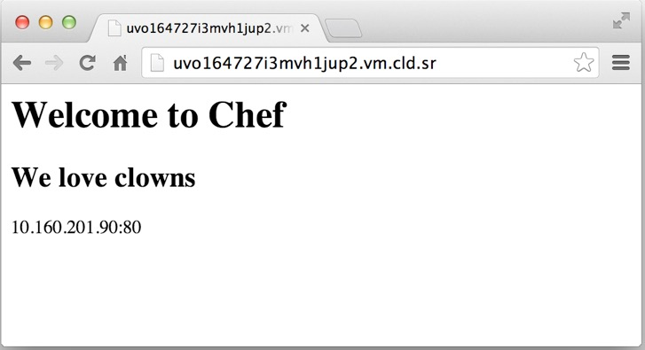

Exercise: Verify that the home page works
Open a web browser
Type in the the URL for your test node
Notes:
If it’s not working at all - check the firewall rules. You can disable them. If you can’t reach your test node from your workstation, use ‘curl http://localhost’ from the command line on the test node.

Slide 252
Congratulate yourself!
You have just written your first Chef cookbook!
(clap!)
Notes:
Note that they have just used packages, services, and templates: three resources which are the trinity of config mgmt!

Slide 253
Reading the output of a chef-client run
Starting Chef Client, version 11.8.2
[2014-01-06T07:06:00-05:00] INFO: *** Chef 11.8.2 ***
[2014-01-06T07:06:00-05:00] INFO: Chef-client pid: 10781
[2014-01-06T07:06:01-05:00] INFO: Run List is [recipe[apache]]
[2014-01-06T07:06:01-05:00] INFO: Run List expands to [apache]
[2014-01-06T07:06:01-05:00] INFO: Starting Chef Run for node1
[2014-01-06T07:06:01-05:00] INFO: Running start handlers
[2014-01-06T07:06:01-05:00] INFO: Start handlers complete.
The run list is shown
The expanded Run List is the complete list, after nested roles are expanded
Notes:
We tell you the nodes run list, as set on the object itself We tell you what the nodes run list *expands* to, which comes in to play when roles are nested
We cover expansion in much more depth later.

Slide 254
Reading the output of a chef-client run
resolving cookbooks for run list: ["apache"]
[2014-01-06T07:06:02-05:00] INFO: Loading cookbooks [apache]
Synchronizing Cookbooks:
[2014-01-06T07:06:02-05:00] INFO: Storing updated cookbooks/apache/recipes/default.rb in the cache.
[2014-01-06T07:06:02-05:00] INFO: Storing updated cookbooks/apache/metadata.rb in the cache.
- apache
Compiling Cookbooks...
Loads the cookbooks in the order specified by the run list
Downloads any files that are missing from the server

Slide 255
Reading the output of a chef-client run
Converging 3 resources
Recipe: apache::default
* package[httpd] action install[2014-01-06T07:51:48-05:00] INFO: Processing package[httpd] action install (apache::default line 9)
[2014-01-06T07:51:55-05:00] INFO: package[httpd] installing httpd-2.2.15-29.el6.centos from base repository
- install version 2.2.15-29.el6.centos of package httpd
Checks to see if the package httpd is installed
Notes:
Talk about the Processing lines - this means we are evaluating this resource for the “install” action. You will see these lines for every resource.

Slide 256
Reading the output of a chef-client run
* service[httpd] action enable[2014-01-06T07:52:06-05:00] INFO: Processing service[httpd] action enable (apache::default line 13)
[2014-01-06T07:52:06-05:00] INFO: service[httpd] enabled
- enable service service[httpd]
* service[httpd] action start[2014-01-06T07:52:06-05:00] INFO: Processing service[httpd] action start (apache::default line 13)
[2014-01-06T07:52:07-05:00] INFO: service[httpd] started
- start service service[httpd]
Checks to see if httpd is already enabled to run at boot - it is, take no further action
Checks to see if httpd is already started - it is, take no further action
Notes:
Take this moment to talk about the differences between operating systems. Ubuntu policy says applications should be installed, configured, and started on package installation. Red Hat says they should be installed and configured, but not started.
Putting “start” into the recipe is an Ubuntu systems quirk. This is why you bring your systems knowledge, and we bring the framework = unicorns!

Slide 257
Idempotence
Actions on resources in Chef are designed to be idempotent
I.e. they can be applied multiple times but the end result is still the same - like multiplying by 1 in math!
Or in mathematical terms, F(F(x))=F(x) ∀x
Chef is a "desired state configuration" system - if a resource is already configured, no action is taken. This is called convergence
Notes:
Warning: pompous slide
Idempotence, in math, means an operation can be applied multiple times without changing the result. 1 x 1 = 1 is an idempotent operation of multiplication.
F(F(x))=F(x) ∀x is read as "the F of the F of x equals the F of x for all x" - Mathematicians will understand, and they'll 'get' chef!
Chef is a "desired state configuration" system and that if the current state == desired state, it won't do anything.

Slide 258
Reading the output of a chef-client run
* cookbook_file[/var/www/html/index.html] action create[2014-01-06T07:52:07-05:00] INFO: Processing cookbook_file[/var/www/html/index.html] action create (apache::default line 17)
[2014-01-06T07:52:07-05:00] INFO: cookbook_file[/var/www/html/index.html] created file /var/www/html/index.html
- create new file /var/www/html/index.html[2014-01-06T07:52:07-05:00] INFO: cookbook_file[/var/www/html/index.html] updated file contents /var/www/html/index.html
- update content in file /var/www/html/index.html from none to 03fb1d
--- /var/www/html/index.html 2014-01-06 07:52:07.285214202 -0500
+++ /tmp/.index.html20140106-10796-1kxknbg 2014-01-06 07:52:07.868365963 -0500
@@ -1 +1,6 @@
+<html>
+<body>
+ <h1>Hello, world!</h1>
+</body>
+</html>[2014-01-06T07:52:07-05:00] INFO: cookbook_file[/var/www/html/index.html] mode changed to 644
- change mode from '' to '0644'
- restore selinux security context
Checks for an index.html file
There is already one in place, backup the file
Set permissions on the file
A diff of the written file is shown with the modified lines called out
Notes:
Make note that we back up files we change If a student asks about what happens if they have local changes, have them modify index.html, and run it again - and we put it back
If nobody asks, bring it up, and have someone do it. Once you manage something with Chef, it is managed - period.
If anyone fights with you, the story is easy - if you want to be able to make any kind of sane statement about whether your servers are correct, you can’t have managed and un-managed changes. You might fix a single machine by hand, but the final fix goes back into Chef.

Slide 259
Reading the output of a chef-client run
[2014-01-06T07:52:08-05:00] INFO: Chef Run complete in 23.477837576 seconds
[2014-01-06T07:52:08-05:00] INFO: Running report handlers
[2014-01-06T07:52:08-05:00] INFO: Report handlers complete
Chef Client finished, 4 resources updated
[2014-01-06T07:52:08-05:00] INFO: Sending resource update report (run-id: 952a8431-0994-468e-836c-0f7de7aa656e)
Notice that a complete Chef-Run displays:
The time the client took to complete convergence
Status of report and exception handlers
Notes:
We don’t really get to reports and exception handlers - the gist is, you use them to send statistics about the run to all sorts of places - email, splunk, etc.

Slide 260
Exercise: Re-run the Chef Client
chef@node1:~$ sudo chef-client
...
resolving cookbooks for run list: ["apache"]
[2014-01-06T07:57:13-05:00] INFO: Loading cookbooks [apache]
Synchronizing Cookbooks:
- apache
Compiling Cookbooks...
Converging 3 resources
Recipe: apache::default
* package[httpd] action install[2014-01-06T07:57:13-05:00] INFO: Processing package[httpd] action install (apache::default line 9)
(up to date)
* service[httpd] action enable[2014-01-06T07:57:17-05:00] INFO: Processing service[httpd] action enable (apache::default line 13)
(up to date)
* service[httpd] action start[2014-01-06T07:57:17-05:00] INFO: Processing service[httpd] action start (apache::default line 13)
(up to date)
* cookbook_file[/var/www/html/index.html] action create[2014-01-06T07:57:17-05:00] INFO: Processing cookbook_file[/var/www/html/index.html] action create (apache::default line 17)
(up to date)
[2014-01-06T07:57:17-05:00] INFO: Chef Run complete in 4.707139533 seconds
[2014-01-06T07:57:17-05:00] INFO: Removing cookbooks/apache/files/default/index.html from the cache; it is no longer needed by chef-client.
[2014-01-06T07:57:17-05:00] INFO: Running report handlers
[2014-01-06T07:57:17-05:00] INFO: Report handlers complete
Chef Client finished, 0 resources updated
[2014-01-06T07:57:17-05:00] INFO: Sending resource update report (run-id: 1c201d2c-797f-43ab-a904-1ba329b9aab8)
Notes:
Note that it didn’t do anything - idempotency at its best

Slide 261
Recap - So resources are grouped into recipes
package "httpd" do
action :install
end
service "httpd" do
action [ :enable, :start ]
end
cookbook_file "/var/www/html/index.html" do
source "index.html"
mode "0644"
end
resource one
resource two
resource three

Slide 262

Recap - So resources are grouped into recipes
package "httpd" do
action :install
end
service "httpd" do
action [ :enable, :start ]
end
cookbook_file "/var/www/html/index.html" do
source "index.html"
mode "0644"
end
intention

Slide 263
Recap - So resources are grouped into recipes
package "httpd" do
action :install
end
service "httpd" do
action [ :enable, :start ]
end
cookbook_file "/var/www/html/index.html" do
source "index.html"
mode "0644"
end
recipe[apache::default]

Slide 264
Cookbooks contain recipes and supporting files
& pwd
/Users/you/chef-repo
$ tree
...
├── cookbooks
│ ├── apache
│ │ ├── recipes
│ │ │ ├── default.rb
│ │ │ └── server.rb
│ │ ├── files
│ │ │ └── default
│ │ │ └── index.html
│ │ ├── metadata.rb
│ │ ├── attributes
│ │ │ └── default
...
Recipes
Supporting File

Slide 265
Recap - So resources are grouped into recipes
package "httpd" do
action :install
end
cookbook_file "/var/www/html/index.html" do
source "index.html"
mode "0644"
end
service "httpd" do
action [ :enable, :start ]
end
recipe[apache::default]

Slide 266


Cookbooks are installed as artifacts on Chef Server
Enterprise Chef
(org)
apache v0.1.0
ntp v0.2.0
openssh v2.4.7

Slide 267

Nodes have run_lists made of recipes
Enterprise Chef
(org)
recipe[ntp::client]
recipe[openssh::server]
recipe[apache::server]

Slide 268
Questions
What makes up a cookbook?
How do you create a new cookbook?
What is a recipe?
What is a resource?
How do you upload a cookbook to the Chef Server?
What is a run list?

Slide 269
Dissecting Your First chef-client Run
The Anatomy of a Chef run

Slide 270
Lesson Objectives
After completing the lesson, you will be able to
List all the steps taken by a chef-client during a run
Explain the basic security model of Chef
Explain the concepts of the Resource Collection

Slide 271









build node
authenticate
Ohai!
node_name
platform
platform_version
converge
load cookbooks
sync cookbooks
expanded run list
(recipes)
chef-client
node.save
success?
Yes
notification
handlers
exception
No
Notes:
1. Chef client starts up.
2. Chef builds the node object, where it runs ohai to find out the node_name (fqdn) and the node's platform/platform_version
3. Chef authenticates with the server as the node_name, using the API client key. We'll cover the authentication cycle in detail shortly.
4. All the cookbooks required for the node's expanded run list are synchronized to the node.
5. All the cookbooks Ruby components are loaded, recipes are included as well.
6. Node is converged, which is when it configures the resources contained in the recipes.
7. Was the convergence successful? If so, the node is saved.
8. If not the run ends with an exception and a message is printed about the error, and the stack trace file path is included in this.
9. Any notification handlers are run, which can do different things depending on whether the run was successful or not, such as send email or connect to an external service like IRC or Campfire.

Slide 272
chef-client
Notes:
1. Chef client starts up.
2. Chef builds the node object, where it runs ohai to find out the node_name (fqdn) and the node's platform/platform_version
3. Chef authenticates with the server as the node_name, using the API client key. We'll cover the authentication cycle in detail shortly.
4. All the cookbooks required for the node's expanded run list are synchronized to the node.
5. All the cookbooks Ruby components are loaded, recipes are included as well.
6. Node is converged, which is when it configures the resources contained in the recipes.
7. Was the convergence successful? If so, the node is saved.
8. If not the run ends with an exception and a message is printed about the error, and the stack trace file path is included in this.
9. Any notification handlers are run, which can do different things depending on whether the run was successful or not, such as send email or connect to an external service like IRC or Campfire.

Slide 273
chef-client
build node
Notes:
1. Chef client starts up.
2. Chef builds the node object, where it runs ohai to find out the node_name (fqdn) and the node's platform/platform_version
3. Chef authenticates with the server as the node_name, using the API client key. We'll cover the authentication cycle in detail shortly.
4. All the cookbooks required for the node's expanded run list are synchronized to the node.
5. All the cookbooks Ruby components are loaded, recipes are included as well.
6. Node is converged, which is when it configures the resources contained in the recipes.
7. Was the convergence successful? If so, the node is saved.
8. If not the run ends with an exception and a message is printed about the error, and the stack trace file path is included in this.
9. Any notification handlers are run, which can do different things depending on whether the run was successful or not, such as send email or connect to an external service like IRC or Campfire.

Slide 274
chef-client
build node
Ohai!
node_name
platform
platform_version
Notes:
1. Chef client starts up.
2. Chef builds the node object, where it runs ohai to find out the node_name (fqdn) and the node's platform/platform_version
3. Chef authenticates with the server as the node_name, using the API client key. We'll cover the authentication cycle in detail shortly.
4. All the cookbooks required for the node's expanded run list are synchronized to the node.
5. All the cookbooks Ruby components are loaded, recipes are included as well.
6. Node is converged, which is when it configures the resources contained in the recipes.
7. Was the convergence successful? If so, the node is saved.
8. If not the run ends with an exception and a message is printed about the error, and the stack trace file path is included in this.
9. Any notification handlers are run, which can do different things depending on whether the run was successful or not, such as send email or connect to an external service like IRC or Campfire.

Slide 275
chef-client
build node
authenticate
Notes:
1. Chef client starts up.
2. Chef builds the node object, where it runs ohai to find out the node_name (fqdn) and the node's platform/platform_version
3. Chef authenticates with the server as the node_name, using the API client key. We'll cover the authentication cycle in detail shortly.
4. All the cookbooks required for the node's expanded run list are synchronized to the node.
5. All the cookbooks Ruby components are loaded, recipes are included as well.
6. Node is converged, which is when it configures the resources contained in the recipes.
7. Was the convergence successful? If so, the node is saved.
8. If not the run ends with an exception and a message is printed about the error, and the stack trace file path is included in this.
9. Any notification handlers are run, which can do different things depending on whether the run was successful or not, such as send email or connect to an external service like IRC or Campfire.

Slide 276
chef-client
build node
authenticate
sync cookbooks
expanded run list
(recipes)
Notes:
1. Chef client starts up.
2. Chef builds the node object, where it runs ohai to find out the node_name (fqdn) and the node's platform/platform_version
3. Chef authenticates with the server as the node_name, using the API client key. We'll cover the authentication cycle in detail shortly.
4. All the cookbooks required for the node's expanded run list are synchronized to the node.
5. All the cookbooks Ruby components are loaded, recipes are included as well.
6. Node is converged, which is when it configures the resources contained in the recipes.
7. Was the convergence successful? If so, the node is saved.
8. If not the run ends with an exception and a message is printed about the error, and the stack trace file path is included in this.
9. Any notification handlers are run, which can do different things depending on whether the run was successful or not, such as send email or connect to an external service like IRC or Campfire.

Slide 277

chef-client
build node
authenticate
load cookbooks
sync cookbooks
Notes:
1. Chef client starts up.
2. Chef builds the node object, where it runs ohai to find out the node_name (fqdn) and the node's platform/platform_version
3. Chef authenticates with the server as the node_name, using the API client key. We'll cover the authentication cycle in detail shortly.
4. All the cookbooks required for the node's expanded run list are synchronized to the node.
5. All the cookbooks Ruby components are loaded, recipes are included as well.
6. Node is converged, which is when it configures the resources contained in the recipes.
7. Was the convergence successful? If so, the node is saved.
8. If not the run ends with an exception and a message is printed about the error, and the stack trace file path is included in this.
9. Any notification handlers are run, which can do different things depending on whether the run was successful or not, such as send email or connect to an external service like IRC or Campfire.

Slide 278
chef-client
build node
authenticate
converge
load cookbooks
sync cookbooks
Notes:
1. Chef client starts up.
2. Chef builds the node object, where it runs ohai to find out the node_name (fqdn) and the node's platform/platform_version
3. Chef authenticates with the server as the node_name, using the API client key. We'll cover the authentication cycle in detail shortly.
4. All the cookbooks required for the node's expanded run list are synchronized to the node.
5. All the cookbooks Ruby components are loaded, recipes are included as well.
6. Node is converged, which is when it configures the resources contained in the recipes.
7. Was the convergence successful? If so, the node is saved.
8. If not the run ends with an exception and a message is printed about the error, and the stack trace file path is included in this.
9. Any notification handlers are run, which can do different things depending on whether the run was successful or not, such as send email or connect to an external service like IRC or Campfire.

Slide 279
chef-client
build node
authenticate
converge
load cookbooks
sync cookbooks
success?
Notes:
1. Chef client starts up.
2. Chef builds the node object, where it runs ohai to find out the node_name (fqdn) and the node's platform/platform_version
3. Chef authenticates with the server as the node_name, using the API client key. We'll cover the authentication cycle in detail shortly.
4. All the cookbooks required for the node's expanded run list are synchronized to the node.
5. All the cookbooks Ruby components are loaded, recipes are included as well.
6. Node is converged, which is when it configures the resources contained in the recipes.
7. Was the convergence successful? If so, the node is saved.
8. If not the run ends with an exception and a message is printed about the error, and the stack trace file path is included in this.
9. Any notification handlers are run, which can do different things depending on whether the run was successful or not, such as send email or connect to an external service like IRC or Campfire.

Slide 280
chef-client
build node
authenticate
converge
load cookbooks
sync cookbooks
node.save
success?
Yes
Notes:
1. Chef client starts up.
2. Chef builds the node object, where it runs ohai to find out the node_name (fqdn) and the node's platform/platform_version
3. Chef authenticates with the server as the node_name, using the API client key. We'll cover the authentication cycle in detail shortly.
4. All the cookbooks required for the node's expanded run list are synchronized to the node.
5. All the cookbooks Ruby components are loaded, recipes are included as well.
6. Node is converged, which is when it configures the resources contained in the recipes.
7. Was the convergence successful? If so, the node is saved.
8. If not the run ends with an exception and a message is printed about the error, and the stack trace file path is included in this.
9. Any notification handlers are run, which can do different things depending on whether the run was successful or not, such as send email or connect to an external service like IRC or Campfire.

Slide 281
chef-client
build node
authenticate
converge
load cookbooks
sync cookbooks
node.save
success?
Yes
exception
No
Notes:
1. Chef client starts up.
2. Chef builds the node object, where it runs ohai to find out the node_name (fqdn) and the node's platform/platform_version
3. Chef authenticates with the server as the node_name, using the API client key. We'll cover the authentication cycle in detail shortly.
4. All the cookbooks required for the node's expanded run list are synchronized to the node.
5. All the cookbooks Ruby components are loaded, recipes are included as well.
6. Node is converged, which is when it configures the resources contained in the recipes.
7. Was the convergence successful? If so, the node is saved.
8. If not the run ends with an exception and a message is printed about the error, and the stack trace file path is included in this.
9. Any notification handlers are run, which can do different things depending on whether the run was successful or not, such as send email or connect to an external service like IRC or Campfire.

Slide 282
chef-client
build node
authenticate
converge
load cookbooks
sync cookbooks
node.save
success?
Yes
notification
handlers
exception
No
Notes:
1. Chef client starts up.
2. Chef builds the node object, where it runs ohai to find out the node_name (fqdn) and the node's platform/platform_version
3. Chef authenticates with the server as the node_name, using the API client key. We'll cover the authentication cycle in detail shortly.
4. All the cookbooks required for the node's expanded run list are synchronized to the node.
5. All the cookbooks Ruby components are loaded, recipes are included as well.
6. Node is converged, which is when it configures the resources contained in the recipes.
7. Was the convergence successful? If so, the node is saved.
8. If not the run ends with an exception and a message is printed about the error, and the stack trace file path is included in this.
9. Any notification handlers are run, which can do different things depending on whether the run was successful or not, such as send email or connect to an external service like IRC or Campfire.

Slide 283
Private Keys
Chef Server requires keys to authenticate.
client.pem - private key for API client
validation.pem - private key for ORGNAME-validator
Next, let’s see how those are used...
Notes:
You can "cat" these if you want :).
There are two .pem private key files on the system. The client.pem was created during the authentication cycle we just discussed. It is the private key for *this* node. The public key is stored on the Chef server.
The validation.pem is the private key for the validation client, also called the organization key. The validation.pem file can be deleted.

Slide 284






/etc/chef/client.pem?
/etc/chef/validation.pem?
No
No
401!
Yes
Request API Client
Yes
Sign Requests
client.pem
Notes:
Take a minute to talk about how chef does authentication:
* We digitally sign each request with a private key
* We verify that signature
* We protect against replay attacks as well
* There is no central store for Private Keys - meaning you have to keep them safe. It also means no attacker can compromise your security credentials centrally.
Lets take a detailed look at the authentication cycle. When Chef client starts, it first looks for /etc/chef/client.pem.
1. If the client.pem exists, chef will use it to sign requests with the chef server API.
2. If the client.pem does not exist, chef looks for /etc/chef/validation.pem, the validation_key.
3. If the validation key does not exist, then chef exits, or if the key does not match for the validation API client, chef reports a 401 and exits.
4. If the validation key exists, and it matches for the validation API client, chef requests a new API client for this node_name and writes this to /etc/chef/client.pem
5. Chef will use the newly created client to sign requests with the chef server API for all further requests.
If key lost: must delete node & regenerate

Slide 285
/etc/chef/client.pem?
Notes:
Take a minute to talk about how chef does authentication:
* We digitally sign each request with a private key
* We verify that signature
* We protect against replay attacks as well
* There is no central store for Private Keys - meaning you have to keep them safe. It also means no attacker can compromise your security credentials centrally.
Lets take a detailed look at the authentication cycle. When Chef client starts, it first looks for /etc/chef/client.pem.
1. If the client.pem exists, chef will use it to sign requests with the chef server API.
2. If the client.pem does not exist, chef looks for /etc/chef/validation.pem, the validation_key.
3. If the validation key does not exist, then chef exits, or if the key does not match for the validation API client, chef reports a 401 and exits.
4. If the validation key exists, and it matches for the validation API client, chef requests a new API client for this node_name and writes this to /etc/chef/client.pem
5. Chef will use the newly created client to sign requests with the chef server API for all further requests.
If key lost: must delete node & regenerate

Slide 286
/etc/chef/client.pem?
Yes
Sign Requests
Notes:
Take a minute to talk about how chef does authentication:
* We digitally sign each request with a private key
* We verify that signature
* We protect against replay attacks as well
* There is no central store for Private Keys - meaning you have to keep them safe. It also means no attacker can compromise your security credentials centrally.
Lets take a detailed look at the authentication cycle. When Chef client starts, it first looks for /etc/chef/client.pem.
1. If the client.pem exists, chef will use it to sign requests with the chef server API.
2. If the client.pem does not exist, chef looks for /etc/chef/validation.pem, the validation_key.
3. If the validation key does not exist, then chef exits, or if the key does not match for the validation API client, chef reports a 401 and exits.
4. If the validation key exists, and it matches for the validation API client, chef requests a new API client for this node_name and writes this to /etc/chef/client.pem
5. Chef will use the newly created client to sign requests with the chef server API for all further requests.
If key lost: must delete node & regenerate

Slide 287
/etc/chef/client.pem?
/etc/chef/validation.pem?
No
Yes
Sign Requests
Notes:
Take a minute to talk about how chef does authentication:
* We digitally sign each request with a private key
* We verify that signature
* We protect against replay attacks as well
* There is no central store for Private Keys - meaning you have to keep them safe. It also means no attacker can compromise your security credentials centrally.
Lets take a detailed look at the authentication cycle. When Chef client starts, it first looks for /etc/chef/client.pem.
1. If the client.pem exists, chef will use it to sign requests with the chef server API.
2. If the client.pem does not exist, chef looks for /etc/chef/validation.pem, the validation_key.
3. If the validation key does not exist, then chef exits, or if the key does not match for the validation API client, chef reports a 401 and exits.
4. If the validation key exists, and it matches for the validation API client, chef requests a new API client for this node_name and writes this to /etc/chef/client.pem
5. Chef will use the newly created client to sign requests with the chef server API for all further requests.
If key lost: must delete node & regenerate

Slide 288
/etc/chef/client.pem?
/etc/chef/validation.pem?
No
No
401!
Yes
Sign Requests
Notes:
Take a minute to talk about how chef does authentication:
* We digitally sign each request with a private key
* We verify that signature
* We protect against replay attacks as well
* There is no central store for Private Keys - meaning you have to keep them safe. It also means no attacker can compromise your security credentials centrally.
Lets take a detailed look at the authentication cycle. When Chef client starts, it first looks for /etc/chef/client.pem.
1. If the client.pem exists, chef will use it to sign requests with the chef server API.
2. If the client.pem does not exist, chef looks for /etc/chef/validation.pem, the validation_key.
3. If the validation key does not exist, then chef exits, or if the key does not match for the validation API client, chef reports a 401 and exits.
4. If the validation key exists, and it matches for the validation API client, chef requests a new API client for this node_name and writes this to /etc/chef/client.pem
5. Chef will use the newly created client to sign requests with the chef server API for all further requests.
If key lost: must delete node & regenerate

Slide 289
/etc/chef/client.pem?
/etc/chef/validation.pem?
No
No
401!
Yes
Request API Client
Yes
Sign Requests
Notes:
Take a minute to talk about how chef does authentication:
* We digitally sign each request with a private key
* We verify that signature
* We protect against replay attacks as well
* There is no central store for Private Keys - meaning you have to keep them safe. It also means no attacker can compromise your security credentials centrally.
Lets take a detailed look at the authentication cycle. When Chef client starts, it first looks for /etc/chef/client.pem.
1. If the client.pem exists, chef will use it to sign requests with the chef server API.
2. If the client.pem does not exist, chef looks for /etc/chef/validation.pem, the validation_key.
3. If the validation key does not exist, then chef exits, or if the key does not match for the validation API client, chef reports a 401 and exits.
4. If the validation key exists, and it matches for the validation API client, chef requests a new API client for this node_name and writes this to /etc/chef/client.pem
5. Chef will use the newly created client to sign requests with the chef server API for all further requests.
If key lost: must delete node & regenerate

Slide 290
/etc/chef/client.pem?
/etc/chef/validation.pem?
No
No
401!
Yes
Request API Client
Yes
Sign Requests
client.pem
Notes:
Take a minute to talk about how chef does authentication:
* We digitally sign each request with a private key
* We verify that signature
* We protect against replay attacks as well
* There is no central store for Private Keys - meaning you have to keep them safe. It also means no attacker can compromise your security credentials centrally.
Lets take a detailed look at the authentication cycle. When Chef client starts, it first looks for /etc/chef/client.pem.
1. If the client.pem exists, chef will use it to sign requests with the chef server API.
2. If the client.pem does not exist, chef looks for /etc/chef/validation.pem, the validation_key.
3. If the validation key does not exist, then chef exits, or if the key does not match for the validation API client, chef reports a 401 and exits.
4. If the validation key exists, and it matches for the validation API client, chef requests a new API client for this node_name and writes this to /etc/chef/client.pem
5. Chef will use the newly created client to sign requests with the chef server API for all further requests.
If key lost: must delete node & regenerate

Slide 291
/etc/chef/client.pem?
/etc/chef/validation.pem?
No
No
401!
Yes
Request API Client
Yes
Sign Requests
client.pem
Notes:
Talk about NTP sensitivity
Take a minute to talk about how chef does authentication:
* We digitally sign each request with a private key
* We verify that signature
* We protect against replay attacks as well
* There is no central store for Private Keys - meaning you have to keep them safe. It also means no attacker can compromise your security credentials centrally.
Lets take a detailed look at the authentication cycle. When Chef client starts, it first looks for /etc/chef/client.pem.
1. If the client.pem exists, chef will use it to sign requests with the chef server API.
2. If the client.pem does not exist, chef looks for /etc/chef/validation.pem, the validation_key.
3. If the validation key does not exist, then chef exits, or if the key does not match for the validation API client, chef reports a 401 and exits.
4. If the validation key exists, and it matches for the validation API client, chef requests a new API client for this node_name and writes this to /etc/chef/client.pem
5. Chef will use the newly created client to sign requests with the chef server API for all further requests.
If key lost: must delete node & regenerate

Slide 292
About the resource collection

Slide 293
Multiphase Execution - Compile Phase
During the compile phase, Chef
Loads all cookbooks from the run list
Reads each recipe to build the resource collection

Slide 294
Multiphase Execution - Execute Phase
During the execute phase chef takes the resource collection and for each resource it will
Check if the resource is in the required state
If 'yes' - do nothing
If 'no' - bring resource in line with required state
Move on to next resource

Slide 295
Resource Collection Phase 1 - Compile Phase
Recipe
Resource Collection
package "httpd" do
action :install
end
cookbook_file "/var/www/html/index.html" do
source "index.html"
mode "0644"
end
service "httpd" do
action [ :enable, :start ]
end
resource_collection = [
package["httpd"],
cookbook_file["/var/www/html/index.html"],
service ["httpd"]
]
Notes:
I.e. we end up with an "array" of resources
Instructor Note: This is a building slide - to illustrate the resource collection that was build in the previous section!
Important to note that this resource collection shown here is quite simple, and will become more complicated later in the course as we iterate in a recipe, and include notifications (especially immediate notifications)

Slide 296
Resource Collection Phase 2 - Execute Phase
Recipe
Execution
package "httpd" do
action :install
end
cookbook_file "/var/www/html/index.html" do
source "index.html"
mode "0644"
end
service "httpd" do
action [ :enable, :start ]
end
Do nothing
Yes
Is httpd package currently installed?
No
Install httpd package
Next
Yes
Is '/var/www/html/index.html' identical to cookbook version?
No
Copy index.html file into place
Do nothing
Next
Yes
Does 'index.html' have correct permissions?
No
Set permissions to 0644
Do nothing
Next
Resource Collection
Yes
Is the service 'httpd' enabled to start on boot
No
Enable httpd to start on boot
Do nothing
resource_collection = [
package["httpd"],
cookbook_file["/var/www/html/index.html"],
service ["httpd"]
]
Next
Yes
Is the service 'httpd' currently started?
No
Do nothing
Start httpd
Notes:
Instructor Note: This is a building slide - to illustrate the resource collection that was build in the previous section!
Instructor Note: This is a building slide!
Question: What would happen if Apache was installed on the node, but was not running?

Slide 297
Recipe order is important!
Recipes are executed in the order they appear in the run list
These recipes are invoked in the following order
Run List: recipe[ntp::client], recipe[openssh::server], recipe[apache::server]
1. recipe[ntp::client]
2. recipe[openssh::server]
3. recipe[apache::server]

Slide 298
Resource Collection - Multiple Recipes
1. recipe[ntp::client]
Resource Collection
package "ntp" do
action :install
end
resource_collection [
package[ntp],
template[/etc/ntp.conf],
service[ntp]
template "/etc/ntp.conf" do
source "ntp.conf.erb"
owner "root"
mode "0644"
end
service "ntp" do
action :start
end
Notes:
All attributes are passed to the resource collection along with the resource
NOTE: The next 3 slides are building slides and advance automatically

Slide 299
Resource Collection - Multiple Recipes
2. recipe[openssh::client]
Resource Collection
package "openssh" do
action :install
end
resource_collection [
package[ntp],
template[/etc/ntp.conf],
service[ntp],
template "/etc/sshd/sshd_config" do
source "sshd_config.erb"
owner "root"
mode "0644"
end
package[openssh],
template[/etc/sshd/sshd_config],
service[openssh]
service "openssh" do
action :start
end
Notes:
All attributes are passed to the resource collection along with the resource

Slide 300
Resource Collection - Multiple Recipes
3. recipe[httpd::server]
Resource Collection
package "httpd" do
action :install
end
resource_collection [
package[ntp],
template[/etc/ntp.conf],
service[ntp],
service "httpd" do
action [ :enable, :start ]
end
package[openssh],
template[/etc/sshd/sshd_config],
service[openssh],
package[httpd],
service[httpd],
cookbook_file "/var/www/html/index.html" do
source "index.html"
mode "0644"
end
cookbook_file[/var/www/html/index.html]
]

Slide 301
The final resource collection
So the resources are invoked in the following order during the execute phase
package[ntp]
template[/etc/ntp.conf]
service[ntp]
package[openssh]
template[/etc/sshd/sshd_config]
service[openssh]
package[httpd]
service[httpd]
cookbook_file[/var/www/html/index.html]

Slide 302
Multiphase Execution
Plain ruby is executed in the compile phase
Chef DSL is executed in the execute phase
Recipe
Resource Collection
resource_collection [
directory["/var/www/sites-available"],
directory["/var/www/sites-enabled"],
directory["/var/www/mods-available"],
]
%w[sites-available sites-enabled mods-available].each do |dir|
directory "/var/www/#{dir}" do
action :create
mode '0755'
owner 'root'
group node["apache"]["root_group"]
end
end
Notes:
Point out:
- that Chef has a compile phase and an execute phase - during the compile phase, it compiles resources into a “resource collection” and then executes them. You can use arbitrary Ruby (as seen here) to create the resources in the resource collection

Slide 303

Remember - Resource order is important!
Resources are invoked in the order they appear in the recipe
recipe-1
recipe-2
recipe-3
[------------ resource collection ----------]

Slide 304
Review Questions
What are the steps in a Chef Client run?
How does a new machine get a private key with which to authenticate requests?
If you have the right credentials in place, why else might you not be able to authenticate?
In which phase of a chef-client run do plain Ruby statements get evaluated?
Notes:
-)
-)
-) Chef API requests are time sensitive. Check your NTP drift.

Slide 305
Introducing the Node object
Attributes & Search

Slide 306
Lesson Objectives
After completing the lesson, you will be able to
Explain what the Node object represents in Chef
List the Nodes in an organization
Show details about a Node
Describe what Node Attributes are
Retrieve a node attribute directly, and via search

Slide 307
What is the Node object
A node is any physical, virtual, or cloud machines that is configured to be maintained by a Chef
The 'node object' is the representation of that physical node within Chef (e.g. in JSON)
When you are writing Recipes, the Node object is always available to you.
Notes:
The node object is the global context in which recipes, attribute files, etc are operating in

Slide 308
Node
The node is registered with Chef Server
The Chef Server displays information about the node
This information comes from Ohai

Slide 309
View Node on Chef Server

Slide 310
View Node on Chef Server

Slide 311
Exercise: List nodes
$ knife node list
node1

Slide 312
Exercise: List clients
$ knife client list
ORGNAME-validator
node1
Notes:
Reinforce that the node has both an object for itself as well as the API client.
When you last ran this there was one client - your workstation. Now there's two - remember the node has an API client also (chef-client)

Slide 313
Each node must have a unique name
Every node must have a unique name within an organization
Chef defaults to the Fully Qualified Domain Name of the server, i.e. in the format server.domain.com
We overrode it to "node1" to make typing easier
Notes:
Simply using the likes of ‘node1’ is not recommended in real life, but should be something more descriptive and meaningful
Note that many of the students, if they are using a pre-made virtual machine, have the same hostname - this is one of the reasons we have them using separate organizations

Slide 314
Exercise: Show node details
$ knife node show node1
Node Name: node1
Environment: _default
FQDN: centos63.example.com
IP: 10.160.201.90
Run List: recipe[apache]
Roles:
Recipes: apache
Platform: centos 6.4
Tags:

Slide 315
What is the Node object
Nodes are made up of Attributes
Many are discovered automatically (platform, ip address, number of CPUs)
Many other objects in Chef can also add Node attributes (Cookbooks, Roles and Environments, Recipes, Attribute Files)
Nodes are stored and indexed on the Chef Server

Slide 316
Ohai
"languages": {
"ruby": {
},
"perl": {
"version": "5.14.2",
"archname": "x86_64-linux-gnu-thread-multi"
},
"python": {
"version": "2.6.6",
"builddate": "Jul 10 2013, 22:48:45"
},
"perl": {
"version": "version",
"archname": "x86_64-linux-thread-multi"
},
"lua": {
"version": "5.1.4"
},
"kernel": {
"name": "Linux",
"release": "3.2.0-32-virtual",
"version": "#1 SMP Wed Oct 16 18:37:12 UTC 2013",
"machine": "x86_64",
"modules": {
"isofs": {
"size": "70066",
"refcount": "2"
},
"des_generic": {
"size": "16604",
"refcount": "0"
}
},
"os": "GNU/Linux"
},
"os": "linux",
"os_version": "2.6.32-358.23.2.el6.x86_64",
"ohai_time": 1389105685.7735305,
"network": {
"interfaces": {
"lo": {
"mtu": "16436",
"flags": [
"LOOPBACK", "UP","LOWER_UP"
],
"encapsulation": "Loopback",
"addresses": {
"127.0.0.1": {
"family": "inet",
"netmask": "255.0.0.0",
"scope": "Node"
},
"::1": {
"family": "inet6",
"scope": "Node"
}
},
},
"eth0": {
"type": "eth",
"number": "0",

Slide 317
Exercise: Run Ohai on node
chef@node1:~$ ohai | less
{
"languages": {
"ruby": {
},
"java": {
"version": "1.6.0_24",
"runtime": {
"name": "OpenJDK Runtime Environment (IcedTea6 1.11.13)",
"build": "rhel-1.65.1.11.13.el6_4-x86_64"
},
"hotspot": {
"name": "OpenJDK 64-Bit Server VM",
"build": "20.0-b12, mixed mode"
}
},
"perl": {
"version": "5.10.1",
"archname": "x86_64-linux-thread-multi"
},
"lua": {
"version": "5.1.4"
},
"python": {
"version": "2.6.6",
"builddate": "Jul 10 2013, 22:48:45"
}
},
"kernel": {
Notes:
Hammer home that ohai collects a ton of data.
We’re using 'less' here as it allows backward movement in the file as well as forward movement, but does not have to read the entire input file before starting, so it starts up faster than text editors like vi with large input files
We are going to get all the way through to the many, many ways you set attributes on a node attribute, but we do it throughout the course - steer people away from a long discussion of precedence or merge order.
They can also run it on their workstations just to see how it differs.

Slide 318
Exercise: Show all the node attributes
$ knife node show node1 -l
Node Name: node1
Environment: _default
FQDN: centos63.example.com
IP: 10.160.201.90
Run List: recipe[apache]
Roles:
Recipes: apache
Platform: centos 6.4
Tags:
Attributes:
tags:
Default Attributes:
Override Attributes:
Automatic Attributes (Ohai Data):
block_device:
dm-0:
removable: 0
size: 28393472

Slide 319
Exercise: Show the raw node object
$ knife node show node1 -Fj
{
"name": "node1",
"chef_environment": "_default",
"run_list": ["recipe[apache]"],
"normal": {"tags":[]}
}
Notes:
Also yaml formatter too with -Fy if people want to try that.
Dont need to worry about Tags for now. More information on Tags here http://docs.chef.io/essentials_cookbook_recipes.html#use-tags

Slide 320
Exercise: Show only the fqdn attribute
$ knife node show node1 -a fqdn
node1:
fqdn: centos63.example.com

Slide 321
Exercise: Use search to find the same data
$ knife search node "*:*" -a fqdn
1 items found
node1:
fqdn: centos63.example.com

Slide 322
Review Questions
What is the Node object?
What is a Node Attribute?
How do you display all the attributes of a Node?
Can you search for the cpu attribute of your node?

Slide 323
Setting Node Attributes
Setting attributes in recipes and attribute files

Slide 324
Lesson Objectives
After completing the lesson, you will be able to
Describe where and how attributes are set
Explain the attribute merge order and precedence rules
Declare an attribute with a recipe and set its value
Notes:
http://docs.chef.io/chef_overview_attributes.html

Slide 325
What are Attributes?
Attributes represent information about your node
The information can be auto-detected from the node (e.g. # of CPUs, amount of RAM) & populated by Ohai
You can also set attributes on your node using cookbook recipes & attribute files, roles, environments, etc
Attributes keep the program code separate from data
All attributes are set on the "node object", and are indexed for search on the server

Slide 326
Attribute Sources
Attributes can be set at various levels (in increasing order of precedence)
Automagically on the node itself (by Ohai)
In roles
In environments
In cookbook recipes
In cookbook attribute files
Notes:
This is bit of a fudge as there are 15 level of precedence, but we dont want to go into that right now!

Slide 327
Ohai - set automatically
"languages": {
"ruby": {
},
"perl": {
"version": "5.14.2",
"archname": "x86_64-linux-gnu-thread-multi"
},
"python": {
"version": "2.6.6",
"builddate": "Jul 10 2013, 22:48:45"
},
"perl": {
"version": "5.10.1",
"archname": "x86_64-linux-thread-multi"
}
},
"kernel": {
"name": "Linux",
"release": "3.2.0-32-virtual",
"version": "#1 SMP Wed Oct 16 18:37:12 UTC 2013",
"machine": "x86_64",
"modules": {
"isofs": {
"size": "70066",
"refcount": "2"
},
"des_generic": {
"size": "16604",
"refcount": "0"
}
},
"os": "GNU/Linux"
},
"os": "linux",
"os_version": "2.6.32-358.23.2.el6.x86_64",
"ohai_time": 1389105685.7735305,
"network": {
"interfaces": {
"lo": {
"mtu": "16436",
"flags": [
"LOOPBACK", "UP","LOWER_UP"
],
"encapsulation": "Loopback",
"addresses": {
"127.0.0.1": {
"family": "inet",
"netmask": "255.0.0.0",
"scope": "Node"
},
"::1": {
"family": "inet6",
"scope": "Node"
}
},
},
"eth0": {
"type": "eth",
"number": "0",

Slide 328
Setting attributes in attribute files
Attributes can be set in the cookbook's attributes file
./cookbooks/<cookbook>/attributes/default.rb
Format is
We'll look at precedence later....
precedence
attribute name
attribute value
default["apache"]["dir"] = "/etc/apache2"
Notes:
'default' filename can be replaced with 'platform' (e.g. 'centos'), or 'platform_version' (e.g. '6.3')
Note the attribute can be an array or a hash

Slide 329
Setting Attributes in Recipes
They can also be set directly in Recipes
Precede attribute name with 'node.' as follows
precedence
attribute name
attribute value
node.default["apache"]["dir"] = "/etc/apache2"
declares it a node attribute
Notes:
Instructor Note: We don't talk about attribute precedence in detail here, however just FYI, the 'default' could be replaced w/ 'override' in the attribute file, which trumps the value set in a recipe, e.g. override["apache"]["dir"] = "/opt/apache2"

Slide 330
More on attributes - Advanced!
An attribute value can be an array
Or it can be a hash
default["apache"]["listen_ports"] = [ "80","443" ]
default["apache"]["site1"] = { "port" => 80 }
default["apache"]["site2"] = { "port" => 81 }
Notes:
ref0016
Optional/advanced slide

Slide 331
The Problem and the Success Criteria
The Problem: We have defined our 'index.html' homepage in the recipe, but we may want to change that without altering the recipe
Success Criteria: We can change the homepage by changing an attribute value

Slide 332
Exercise: Set attribute in attributes file
OPEN IN EDITOR:
cookbooks/apache/attributes/default.rb
default["apache"]["indexfile"] = "index1.html"
SAVE FILE!
Set an attribute to a specific value in the attributes file

Slide 333
Exercise: Add index1.html to cookbook’s files/default directory
OPEN IN EDITOR:
cookbooks/apache/files/default/index1.html
<html>
<body>
<h1>Hello, world!</h1>
<h2>This is index1.html</h2>
<p>We configured this in the attributes file</p>
</body>
</html>
SAVE FILE!
Notes:
Reflect on the fact that, yeah, we’re not a class about HTML - but we are doing things the hard way, and part of that is getting used to putting files in the right places in cookbooks, and typing them in. If they’ve never written HTML before, congratulate them on their first web site. :)

Slide 334
Exercise: Set attribute in a recipe
OPEN IN EDITOR:
cookbooks/apache/recipes/default.rb
service "httpd" do
action [:enable, :start]
end
cookbook_file "/var/www/html/index.html" do
source node["apache"]["indexfile"]
mode "0644"
end
SAVE FILE!
Notes:
node[:apache][:indexfile] interpolates to the value of the attribute, which is set in two places - 'index1.html' in attributes file and 'index2.html' in recipe

Slide 335
Exercise: Upload the cookbook
$ knife cookbook upload apache
Uploading apache [0.1.0]
Uploaded 1 cookbook.
Notes:
This checks for syntax errors, bundles the cookbook up, and uploads it to the chef server for distribution to the chef clients.
If they have syntax errors in the recipe, it will get caught here.
If you get a ‘ruby’ error on Windows, you need to make the Chef repo live in a path without spaces in it. (Seriously.)

Slide 336
Exercise: Re-run Chef Client
chef@node1:~$ sudo chef-client
Starting Chef Client, version 11.8.2
resolving cookbooks for run list: ["apache"]
...
Recipe: apache::default
* package[httpd] action install (up to date)
* service[httpd] action enable (up to date)
* service[httpd] action start (up to date)
* cookbook_file[/var/www/html/index.html] action create
- update content in file /var/www/html/index.html from 03fb1d to 478a29
--- /var/www/html/index.html 2014-01-07 04:28:34.994965341 -0500
+++ /tmp/.index.html20140107-12128-a6czsl 2014-01-07 04:31:24.049155232 -0500
@@ -1,6 +1,8 @@
<html>
-<body>
+ <body>
<h1>Hello, world!</h1>
-</body>
+ <h2>This is index1.html</h2>
+ <p>We configured this in the attributes file</p>
+ </body>
</html>
- restore selinux security context
Chef Client finished, 1 resources updated
Notes:
Which index.html was used - index1.html or index2.html?

Slide 337
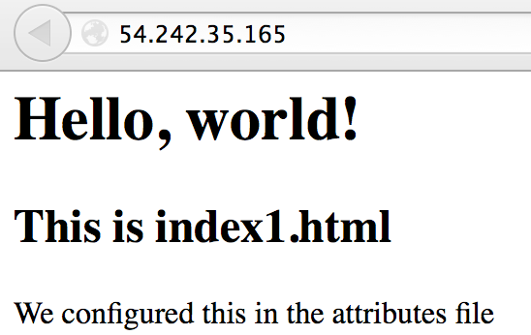
Exercise: Verify new homepage works
Open a web browser
The homepage takes the attribute file value
Notes:
You should see the new index.html from the attributes file.

Slide 338
Exercise: Set attribute in the recipe
OPEN IN EDITOR:
cookbooks/apache/recipes/default.rb
service "apache2" do
action [:enable, :start]
end
node.default["apache"]["indexfile"] = "index2.html"
cookbook_file "/var/www/html/index.html" do
source node["apache"]["indexfile"]
mode "0644"
end
SAVE FILE!
Notes:
node["apache"]["indexfile"] is the value of the attribute, which is set in two places - 'index1.html' in attributes file and 'index2.html' in recipe

Slide 339
Exercise: Add index2.html to cookbook’s files/default directory
OPEN IN EDITOR:
cookbooks/apache/files/default/index2.html
<html>
<body>
<h1>Hello, world!</h1>
<h2>This is index2.html</h2>
<p>We configured this in the recipe</p>
</body>
</html>
SAVE FILE!

Slide 340
Exercise: Upload the cookbook
$ knife cookbook upload apache
Uploading apache [0.1.0]
Uploaded 1 cookbook.
Notes:
This checks for syntax errors, bundles the cookbook up, and uploads it to the chef server for distribution to the chef clients.
If they have syntax errors in the recipe, it will get caught here.
If you get a ‘ruby’ error on Windows, you need to make the Chef repo live in a path without spaces in it. (Seriously.)

Slide 341
Exercise: Re-run Chef Client
chef@node1:~$ sudo chef-client
Starting Chef Client, version 11.8.2
resolving cookbooks for run list: ["apache"]
...
Recipe: apache::default
* package[httpd] action install (up to date)
* service[httpd] action enable (up to date)
* service[httpd] action start (up to date)
* cookbook_file[/var/www/html/index.html] action create
- update content in file /var/www/html/index.html from 478a29 to 153183
--- /var/www/html/index.html 2014-01-07 04:31:24.049155232 -0500
+++ /tmp/.index.html20140107-12296-11u8kv7 2014-01-07 04:32:45.605669431 -0500
@@ -1,8 +1,8 @@
<html>
<body>
<h1>Hello, world!</h1>
- <h2>This is index1.html</h2>
- <p>We configured this in the attributes file</p>
+ <h2>This is index2.html</h2>
+ <p>We configured this in the recipe</p>
</body>
</html>
- restore selinux security context
Chef Client finished, 1 resources updated
Notes:
Which index.html was used - index1.html or index2.html?

Slide 342
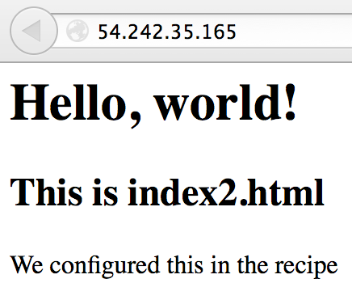
Exercise: Verify new homepage works
Open a web browser
Recipe value has taken precedence
Notes:
The attribute and the file 'index1.html' is still in place - but specifying it in the recipe takes precedence!

Slide 343
Exercise: Viewing Attributes via WebUI

Slide 344
Exercise: Viewing attributes using knife
$ knife node show node1 -l | more
...
Attributes:
tags:
Default Attributes:
apache:
indexfile: index2.html
Override Attributes:
Automatic Attributes (Ohai Data):
block_device:
dm-0:
removable: 0
size: 31563776
...
Notes:
Which index.html was used - index1.html or index2.html?

Slide 345
Setting Attributes in Roles and Environments
Attributes can also be set in Roles and Environments
These use raw JSON or Ruby format
More later in Roles and Environments sections...
default_attributes({"apache" => {"port" => 80}})
Notes:
Ruby format (with '=>') shown.

Slide 346
Default Attribute Merge Order
Highest Priority
Defined in a Role
Defined in the Environment
Defined in a Recipe
Lowest Priority
Defined in an Attribute File
Please note this is a simplified diagram, and the merge order shown can be overridden
Notes:
Note this is not the full list, and is over simplified here so not to confuse. See the following (hidden) slide if Q's arise. This slide shows the precedence for the 'default' attribute - just doesn't show overrides, force-defaults etc etc

Slide 347
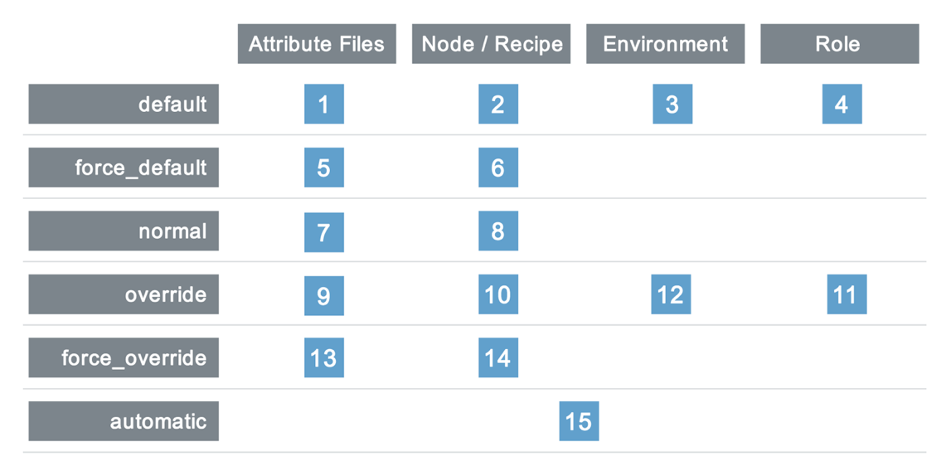
Merge Order and Precedence

Slide 348
Questions
What is an attribute?
Where can attributes be set?
What knife command can you use to view attributes?
How many levels of attribute precedence are there?
Which takes precedence, a default attribute set in the attribute file or in a recipe?

Slide 349
Attributes, Templates, and Cookbook Dependencies
Writing an MOTD Cookbook

Slide 350
Lesson Objectives
After completing the lesson, you will be able to
Describe Cookbook Attribute files
Use ERB Templates in Chef
Explain Attribute Precedence
Describe Cookbook Metadata
Specify cookbook dependencies
Perform the cookbook creation, upload, and test loop

Slide 351
The Problem and the Success Criteria
The Problem: We need to add a message that appears at login that states:
"This server is property of COMPANY"
"This server is in-scope for PCI compliance" if the server is, in fact, in scope.
Success Criteria: We see the message when we log in to the test node

Slide 352
Possible Solutions
We could use an MOTD cookbook to supply the 'Company' name as a node attribute and write out the message
The line on PCI compliance only gets written if a 'PCI Compliance' attribute is set to 'true' for that Company

Slide 353
We have a small problem...
We don’t have a node attribute for ‘Company’, nor if the server is in scope for 'PCI Compliance'
Also, well factored cookbooks only contain the information relevant to their domain
We know we will likely have other things related to PCI (security settings, for example)
So the best thing to do is create a separate PCI cookbook, and add our attribute there
Notes:
Tiresome because we would wind up evaluating each one, and there are probably rules
We could add node attributes for Company name and PCI Compliance, but that will become very tiresome at scale

Slide 354
Solution
We'll create an MOTD cookbook to write out the MOTD - this cookbook configures 'Company' name as a node attribute
We'll also create a PCI cookbook which configures a 'PCI compliance' attribute - this attribute is then read by MOTD cookbook
We'll create the MOTD cookbook first, then we'll create the PCI cookbook

Slide 355
Exercise: Create a cookbook named ‘motd’
$ knife cookbook create motd
** Creating cookbook motd
** Creating README for cookbook: motd
** Creating CHANGELOG for cookbook: motd
** Creating metadata for cookbook: motd

Slide 356
Exercise: Create a default.rb attribute file
OPEN IN EDITOR:
cookbooks/motd/attributes/default.rb
default["motd"]["company"] = "Chef"
SAVE FILE!
Creates a new Node attribute: node["motd"]["company"]
Sets the values to the string "Chef"
Note: there is no space between 'default' and '['
The 'motd' in the attribute is just convention so you know the cookbook the attribute was set in. This is not an enforced syntax
Notes:
We introduce new syntax here - the first is our node attribute syntax, which lets you create:
* A attribute named ["motd"]["company"] whose value is the string ‘Chef’
The 'motd' in the attribte
We will introduce the PCI compliance attribute a little later
If there are ruby people in the room, make note of the fact that we just auto-vivified a hash (we didn’t have to create the interstitial hash for ‘in_scope’ - chef did that for us.)
Talk about truth/false. The bareword ‘false’ means false, as does ‘nil’. True is any other value, including the literal bareword ‘true’. Unlike some languages, in ruby, 0 is not false.
Reiterate there is no space before the [ in attributes!

Slide 357
Exercise: Open the default recipe in your editor
OPEN IN EDITOR:
cookbooks/motd/recipes/default.rb
#
# Cookbook Name:: motd
# Recipe:: default
#
# Copyright 2013, YOUR_COMPANY_NAME
#
# All rights reserved - Do Not Redistribute
#

Slide 358
What resource should we use?
We could try and use a cookbook_file here, and rely on the file copy rules
Create a file per server, basically
Obviously, that’s dramatically inefficient
Instead, we will render a template - a file that is a mixture of the contents we want, and embedded Ruby code
Notes:
cookbook_file is a static file (i.e. hardcoded!!). A Template allows us the flexibility to dynamically change the file contents

Slide 359
Exercise: Add template resource for /etc/motd
Use a template resource
The name is "/etc/motd"
The resource has two parameters
source is "motd.erb"
mode is "0644"
Notes:
Talk about the hard way again!
We are going to WAIT for the big reveal. Students will walk out of here confident that they can make their own recipes.
See if they can do it without a syntax hint - if they need help, ask another student, the teacher, or use the apache recipe we wrote earlier as a reference.
(On Debian systems, the system message of the day is rebuilt at each startup, in order to display an accurate information. So /etc/motd is the file to edit permanent changes to the message of the day)

Slide 360
The template[/etc/motd] resource
OPEN IN EDITOR:
cookbooks/motd/recipes/default.rb
#
# Cookbook Name:: motd
# Recipe:: default
#
# Copyright 2013, YOUR_COMPANY_NAME
#
# All rights reserved - Do Not Redistribute
#
template "/etc/motd" do
source "motd.erb"
mode "0644"
end
SAVE FILE!
Notes:
The big reveal! Watch for how many got it right.
Congrats, you just learned some Ruby!

Slide 361
Exercise: Open motd.erb in your Editor
OPEN IN EDITOR:
cookbooks/motd/templates/default/motd.erb
This server is property of <%= node["motd"]["company"] %>
<% if node["pci"]["in_scope"] -%>
This server is in-scope for PCI compliance
<% end -%>
SAVE FILE!
"erb" stands for "Embedded Ruby"
Notes:
This is the "source" file we referenced in our template resource.
It is the same templating language used in Ruby on Rails, and should be familiar to users of PHP, Perl’s Mason, etc.
We will add the attribute ‘node["pci"]["in_scope"]’ shortly

Slide 362
Exercise: Open motd.erb in your Editor
OPEN IN EDITOR:
cookbooks/motd/templates/default/motd.erb
This server is property of <%= node["motd"]["company"] %>
<% if node["pci"]["in_scope"] -%>
This server is in-scope for PCI compliance
<% end -%>
To embed a value within an ERB template:
Start with <%=
Write your Ruby expression - most commonly a node attribute
End with %>
Notes:
We introduce new syntax here - node attributes, de-referenced with a square bracket.

Slide 363
Exercise: Open motd.erb in your Editor
OPEN IN EDITOR:
cookbooks/motd/templates/default/motd.erb
This server is property of <%= node["motd"]["company"] %>
<% if node["pci"]["in_scope"] -%>
This server is in-scope for PCI compliance
<% end -%>
You can use any Ruby construct in a template
Starting with <% will evaluate the expression, but not insert the result
Ending with -%> will not insert a line in the resulting file
Note there are no spaces in 'node["pci"]["in_scope"]'
Notes:
We introduce new syntax here - node attributes, de-referenced with a square bracket.

Slide 364
Templates Are Used For Almost All Configuration Files
Templates are very flexible ways to create your configuration files
Coupled with Chef’s attribute precedence rules, you can create very effective, data-driven cookbooks
Notes:
Once again: the holy trinity - package, service, template

Slide 365
Best Practice: Recipes contain the pattern, attributes supply the details
Recipes contain the pattern for how to do something. ("How we deploy Tomcat")
Attributes contain the details. ("What port do we run tomcat on?")
Notes:
We repeat this a lot in this deck. Drive it home.
Best practice = abstraction for portability. If you couple desired attributes into your recipes, disaster will befall you later!

Slide 366
Exercise: Upload the motd cookbook
$ knife cookbook upload motd
Uploading motd [0.1.0]
Uploaded 1 cookbook.
Notes:
Testing for syntax
Uploading files to the Chef Server

Slide 367
Exercise: Create a cookbook named ‘pci’
$ knife cookbook create pci
** Creating cookbook pci
** Creating README for cookbook: pci
** Creating CHANGELOG for cookbook: pci
** Creating metadata for cookbook: pci
Notes:
Note: knife cmds no longer automatically appear in the deck presentation from here on out. Encourage students to help each other. The "big reveal" will happen after they’ve had ample time to figure it out.

Slide 368
Exercise: Create a default.rb attribute file
OPEN IN EDITOR:
cookbooks/pci/attributes/default.rb
default["pci"]["in_scope"] = true
SAVE FILE!
Creates a new Node attribute: node["pci"]["in_scope"]
Sets the value to the Ruby 'true' literal
Notes:
We introduce new syntax here - the first is our node attribute syntax, which lets you create:
* A top level attribute named ‘pci’
* Whose value is a hash
* With a key named ‘in_scope’
* Whose value is the ruby literal ‘false’
If there are ruby people in the room, make note of the fact that we just auto-vivified a hash (we didn’t have to create the interstitial hash for ‘in_scope’ - chef did that for us.)
Talk about truth/false. The bareword ‘false’ means false, as does ‘nil’. True is any other value, including the literal bareword ‘true’. Unlike some langauges, in ruby, 0 is not false.

Slide 369
Node Attributes have several levels of precedence
Automatic attributes are those discovered by Ohai
Override attributes are the strongest way to set an attribute - use sparingly
Normal attributes are persistent between chef-client runs
Default attributes are typically set in Cookbooks, Roles and Environments
"rsyslog": {
"log_dir": "/srv/rsyslog",
"server": false,
"protocol": "tcp",
"port": 1514,
"conf": {}
}
"rsyslog": {
"log_dir": "/srv/rsyslog",
"server": false,
"protocol": "tcp",
"port": 1514,
"conf": {}
}
"rsyslog": {
"log_dir": "/srv/rsyslog",
"server": false,
"protocol": "tcp",
"port": 1514,
"conf": {}
}
"rsyslog": {
"log_dir": "/srv/rsyslog",
"server": false,
"protocol": "tcp",
"port": 1514,
"conf": {}
}
Automatic
Override
Normal
Default
Notes:
We explain the fullness of precedence throughout the deck. We also hit hard on the fact that you should, in almost all cases, be using default attributes. The only exception is environments, where we encourage you to use overrides, for reasons that will become clear in the environments section.

Slide 370
Best Practice: Always use ‘default’ attributes in your cookbooks
When setting an attribute in a cookbook, it should (almost) always be a default attribute
Notes:
We actually will describe, in depth, why this is - but we’ll use object lessons throughout the class to do it. Have folks sit tight.

Slide 371
Exercise: Upload the PCI cookbook
$ knife cookbook upload pci
Uploading pci [0.1.0]
Uploaded 1 cookbook.
Notes:
Reiterate what happens here:
* Syntax check
* Upload to Chef Server

Slide 372
Exercise: Add the motd recipe to your test node’s run list
$ knife node run_list add node1 "recipe[motd]"
node1:
run_list:
recipe[apache]
recipe[motd]
Notes:
Could use the -a switch to place the recipe after a specific recipe
$ knife node run_list add node1 'recipe[motd]' -a 'recipe[apache]'
We are leaving out the pci cookbook on purpose, as we are going to cause a failure due to the missing attribute, and fix with cookbook dependencies
If someone spots them, congratulate them on their good eye, and keep going.

Slide 373
Exercise: Add the motd recipe to your test node’s run list
$ knife node show node1
Node Name: node1
Environment: _default
FQDN: centos63.example.com
IP: 10.160.201.90
Run List: recipe[apache], recipe[motd]
Roles:
Recipes: apache
Platform: centos 6.4
Tags:
Notes:
JSON syntax rules for this class: use double quotes around strings, no trailing commas. Stick to that and you will survive Chef Bootcamp! No trailing commas in JSON! Most common syntax error.
We are leaving out the pci cookbook on purpose, as we are going to cause a failure due to the missing attribute, and fix with cookbook dependencies
If someone spots them, congratulate them on their good eye, and keep going.

Slide 374
Exercise: Re-run the Chef Client
chef@node1:~$ sudo chef-client
Starting Chef Client, version 11.8.2
...
- motd
Compiling Cookbooks...
Converging 4 resources
Recipe: apache::default
* package[httpd] action install[2014-01-06T09:14:33-05:00] INFO: Processing package[httpd] action install (apache::default line 9)
(up to date)
* service[httpd] action enable[2014-01-06T09:14:36-05:00] INFO: Processing service[httpd] action enable (apache::default line 13)
(up to date)
* service[httpd] action start[2014-01-06T09:14:36-05:00] INFO: Processing service[httpd] action start (apache::default line 13)
(up to date)
* cookbook_file[/var/www/html/index.html] action create[2014-01-06T09:14:36-05:00] INFO: Processing cookbook_file[/var/www/html/index.html] action create (apache::default line 19)
(up to date)
Recipe: motd::default
* template[/etc/motd] action create[2014-01-06T09:14:36-05:00] INFO: Processing template[/etc/motd] action create (motd::default line 9)
[2014-01-06T09:14:37-05:00] INFO: template[/etc/motd] created file /etc/motd
- create new file /etc/motd
================================================================================
Error executing action `create` on resource 'template[/etc/motd]'
================================================================================
Chef::Mixin::Template::TemplateError
------------------------------------
undefined method `[]' for nil:NilClass
FAIL!
Notes:
What went wrong!

Slide 375
You probably see this at the bottom of your screen...
Template Context:
-----------------
on line #2
1: This server is property of <%= node["motd"]["company"] %>
2: <% if node["pci"]["in_scope"] -%>
3: This server is in-scope for PCI compliance
4: <% end -%>
[2014-01-06T09:14:37-05:00] INFO: Running queued delayed notifications before re-raising exception
[2014-01-06T09:14:37-05:00] ERROR: Running exception handlers
[2014-01-06T09:14:37-05:00] ERROR: Exception handlers complete
[2014-01-06T09:14:37-05:00] FATAL: Stacktrace dumped to /var/chef/cache/chef-stacktrace.out
Chef Client failed. 0 resources updated
[2014-01-06T09:14:37-05:00] INFO: Sending resource update report (run-id: c001b9d5-c2f6-4026-9cc6-ff0901aa563c)
[2014-01-06T09:14:37-05:00] ERROR: "\xE2" from ASCII-8BIT to UTF-8
[2014-01-06T09:14:37-05:00] FATAL: Chef::Exceptions::ChildConvergeError: Chef run process exited unsuccessfully (exit code 1)
Notes:
So there seems to be an issue with "node["pci"]["in_scope"]"
From previous slide:-
undefined method `[]' for nil:NilClass
Ruby is object oriented and functional, and everything you do has a return code. So
we do:
* node (this is the node object)
* ["pci"] (this is the method [], with an argument "pci")
** this returns ‘nil’, because there is no ‘pci’ attribute on the node, because we haven’t evaluated the pci cookbook
* ["in_scope"] gets called on ‘nil’, because that was the last return code
Hence - ‘undefined method [] for nil:NilClass’. When you see this, it most often means you tried to look up a Node attribute that does not exist.

Slide 376
Stack Traces
A stack trace tells you where in a program an error occurred
They can (obviously) be very detailed
They can also be intensely useful, as they supply the data you need to find a problem

Slide 377
Scroll up
In this case, Chef actually knows exactly what went wrong.
Scroll up to find out.
================================================================================
Error executing action `create` on resource 'template[/etc/motd]'
================================================================================
Chef::Mixin::Template::TemplateError
------------------------------------
undefined method `[]' for nil:NilClass
Resource Declaration:
---------------------
# In /var/chef/cache/cookbooks/motd/recipes/default.rb
10: template "/etc/motd" do
11: source "motd.erb"
12: mode "0644"
13: end
Notes:
Wait for reveal

Slide 378
We do not have the attribute we are using in the conditional
INFO: Run List is [recipe[apache], recipe[motd]]
INFO: Run List expands to [apache, motd]
INFO: Starting Chef Run for node1.local
INFO: Running start handlers
INFO: Start handlers complete.
resolving cookbooks for run list: ["apache", "motd"]
INFO: Loading cookbooks [apache, motd]
Can anyone guess why?
We did not load the PCI cookbook!

Slide 379
What is the nil:NilClass error anyhow?
Firstly, in chef if something is "undefined", it returns "nil"
Also, in chef everything is an object of a given class (or type) - even "nil"
5.class => Fixnum
5.1.class => Float
"foo".class => String
[2,3,5].class => Array
{"foo"=>"bar"}.class => Hash
nil.class => NilClass
Notes:
you can find the methods available to an object by calling the .methods method. So "foo".methods would return an array of all the methods that string supports (including the .class method). You could demo this in an IRB session.
http://lukaszwrobel.pl/blog/ruby-is-nil
A hash is a list of key-value pairs. Hashes can contain other hashes as the value, so they allow you to construct arbitrarily complex data structures to model your infrastructure. Example: node["mysql"]["server"]["tunables"]["log_slow_queries"] = true
"undefined" in Ruby is "nil" (in same way Perl calls it "undef")
From Julian
1. A hash is a list of key-value pairs
2. A hash can contain other hashes as the value, so they allow you to construct arbitrarily complex data structures to model your infrastructure. Example: node["mysql"]["server"]["tunables"]["log_slow_queries"] = true
3. "undefined" in Ruby is "nil", in same way Perl has "undef".
4. Everything in Ruby is object-oriented, so "nil" is actually an object too (of type NilClass)
5. If some component of the leading hash (e.g. "node["mysql"]) isn't defined, then it will evaluate to nil. Then when you try to access the inner hash ("server"), you're calling the [] operation on nil, which obviously won't work.

Slide 380
Classes and Methods
All classes have 'Methods' (or 'actions') that can be performed on them
In fact 'class' itself is a method
"foo".length => 3
"foo".class => String
"foo".bar
NoMethodError: undefined method `bar' for "foo":String
nil.class => NilClass
nil.length
NoMethodError: undefined method `length' for nil:NilClass

Slide 381
So what is our nil:NilClass error?
So in our case its trying to evaluate
In ["pci"], the method is [], with an argument ‘pci’
This returns nil, because there is no pci attribute
So ["in_scope"] gets called on nil, because that was the last return code, hence the error
<% if node["pci"]["in_scope"] -%>
undefined method `[]' for nil:NilClass
Notes:
We haven’t evaluated the pci cookbook yet, so no 'pci' attribute

Slide 382
nil:NilClass error
The bottom line is when you see this error
It most often means you tried to look up a node attribute that does not exist!
undefined method `[]' for nil:NilClass

Slide 383
Best Practice: Make sure cookbooks have default values
If a cookbook needs an attribute to exist, it should
Define a default value for it in an attribute file, or
Depend on another cookbook that does
Never rely on an attribute being created manually
Notes:
This is important.
This is especially important in community cookbooks. When sharing code, if you depend on it make sure it is defined somewhere.

Slide 384
Exercise: Add a dependency on the PCI cookbook to the MOTD cookbook
OPEN IN EDITOR:
cookbooks/motd/metadata.rb
maintainer "YOUR_COMPANY_NAME"
maintainer_email "YOUR_EMAIL"
license "All rights reserved"
description "Installs/Configures motd"
long_description IO.read(File.join(File.dirname(__FILE__), ‘README.md‘))
version "0.1.0"

Slide 385
Exercise: Add a dependency on the PCI cookbook to the MOTD cookbook
OPEN IN EDITOR:
cookbooks/motd/metadata.rb
maintainer "YOUR_COMPANY_NAME"
maintainer_email "YOUR_EMAIL"
license "All rights reserved"
description "Installs/Configures motd"
long_description IO.read(File.join(File.dirname(__FILE__), ‘README.md‘))
version "0.1.0"
depends "pci"
Cookbooks that depend on other cookbooks will cause the dependent cookbook to be downloaded to the client, and evaluated

Slide 386
Cookbook Metadata
OPEN IN EDITOR:
cookbooks/motd/metadata.rb
maintainer "YOUR_COMPANY_NAME"
maintainer_email "YOUR_EMAIL"
license "All rights reserved"
description "Installs/Configures motd"
long_description IO.read(File.join(File.dirname(__FILE__), ‘README.md‘))
version "0.1.0"
depends "pci"

Slide 387
Cookbook Attributes are applied for all downloaded cookbooks!
Cookbooks downloaded as dependencies will have their attribute files evaluated
Even if there is no recipe from the cookbook in the run-list

Slide 388
Exercise: Upload the motd cookbook
$ knife cookbook upload motd
Uploading motd [0.1.0]
Uploaded 1 cookbook.

Slide 389
Exercise: Re-run the Chef Client
chef@node1:~$ sudo chef-client
Forking chef instance to converge...
Starting Chef Client, version 11.8.2
*** Chef 11.8.2 ***
Chef-client pid: 15152
Run List is [recipe[apache], recipe[motd]]
Run List expands to [apache, motd]
Starting Chef Run for node1
…
- update content in file /etc/motd from e3b0c4 to 62ebb9
(new content is binary, diff output suppressed)
- restore selinux security context
Chef Run complete in 6.81035877 seconds
Removing cookbooks/apache/files/default/index2.html from the cache; it is no longer needed by chef-client.
Running report handlers
Report handlers complete
Chef Client finished, 1 resources updated
Sending resource update report (run-id: f923449e-cc7b-45f7-a9fb-ac1da3653557)
WIN!
Notes:
Notice we downloaded the pci cookbook, and we rendered motd

Slide 390
Exercise: Check your work
chef@node1:~$ cat /etc/motd
This server is property of Chef
This server is in-scope for PCI compliance

Slide 391
Exercise: Show your test node’s pci attribute
$ knife search node "pci:*" -a pci
1 items found
node1:
pci:
in_scope: true
Notes:
Think about what just happened - if you needed a report about being in/out of scope, you can generate it trivially with Chef’s search features.
In this example, a simple primitive has been turned into a powerful reporting tool.

Slide 392
Exercise: Set attribute to false
OPEN IN EDITOR:
cookbooks/pci/attributes/default.rb
default["pci"]["in_scope"] = false
SAVE FILE!
Set the attribute to false
Notes:
Use this slide to talk about "sane" defaults.

Slide 393
Exercise: Upload the PCI cookbook
$ knife cookbook upload pci
Uploading pci [0.1.0]
Uploaded 1 cookbook.
Notes:
Reiterate what happens here:
* Syntax check
* Upload to Chef Server

Slide 394
Exercise: Re-run the Chef Client
chef@node1:~$ sudo chef-client
Forking chef instance to converge...
Starting Chef Client, version 11.8.2
*** Chef 11.8.2 ***
Chef-client pid: 15350
Run List is [recipe[apache], recipe[motd]]
Run List expands to [apache, motd]
Starting Chef Run for node1
…
template[/etc/motd] updated file contents /etc/motd
- update content in file /etc/motd from 62ebb9 to d36e1f
(current file is binary, diff output suppressed)
- restore selinux security context
Chef Run complete in 5.634796214 seconds
Running report handlers
Report handlers complete
Chef Client finished, 1 resources updated
Sending resource update report (run-id: 06efc909-6740-49bb-971d-82657e066236)
Notes:
Notice we downloaded the pci cookbook, and we rendered motd

Slide 395
Exercise: Check your work
chef@node1:~$ cat /etc/motd
This server is property of Chef

Slide 396
Exercise: Show your test node’s pci attribute
$ knife node show node1 -a pci
1 items found
node1:
pci:
in_scope: false

Slide 397
Congratulations!
You now know the 3 most important resources in the history of configuration management
Package
Template
Service
Notes:
These 3 are the holy trinity, and they are the most important because almost all work you do to configure an application uses them. Install the service, render its configuration, and restart/reload the service.

Slide 398
The resource collection
Run List
Resource Collection
package "httpd" do
action :install
end
service "httpd" do
action [ :enable, :start ]
end
cookbook_file "/var/www/html/index.html" do
source "index.html"
mode "0644"
end
template "/etc/motd" do
source "motd.erb"
mode "0644"
end
resource_collection = [
package[http],
service[http],
cookbook_file[/var/www/html/index.html],
template[/etc/motd]
]
Notes:
This slide to illustrate the resource collection thats is being built in this section!!!!

Slide 399
Review Questions
What goes in a cookbook’s attribute files?
What are the 3 different levels of precedence?
When do you need to specify a cookbook dependency?
What does <%= mean, and where will you encounter it?
What are the 3 most important resources in configuration management?

Slide 400
Template Variables, Notifications, and Controlling Idempotency
Refactoring the Apache Cookbook
Notes:
This section has a significant jump in complexity from the last two. Make sure you take a break before you start it, and get a cup of coffee.
AKA "I really hate that cookbook I wrote six months ago"

Slide 401
Lesson Objectives
After completing the lesson, you will be able to
Use the execute resource
Control idempotence manually with not_if and only_if
Navigate the Resources page on docs.chef.io
Describe the Directory resource
Implement resource notifications
Explain what Template Variables are, and how to use them
Use Ruby variables, loops, and string expansion

Slide 402
The Problem and the Success Criteria
The Problem: We need to deploy multiple custom home pages running on different ports
Success Criteria: Be able to view our custom home page
Notes:
Warn students not to skip ahead to saving their cookbook in this module. They don’t always have to follow along exactly. But here, if they save early, they will see inconsistencies in later modules. Hold off on uploading your cookbook until we get there together.

Slide 403
Exercise: Change the cookbook’s version number in the metadata
OPEN IN EDITOR:
cookbooks/apache/metadata.rb
maintainer "YOUR_COMPANY_NAME"
maintainer_email "YOUR_EMAIL"
license "All rights reserved"
description "Installs/Configures apache"
long_description IO.read(File.join(File.dirname(__FILE__), ‘README.md‘))
version "0.2.0"
SAVE FILE!
Major, Minor, Patch
Semantic Versioning Policy: http://semver.org
Notes:
Major refactoring, so we should bump the cookbook version # first.
We want students to do this first, so they don’t wreck their known-good-state 0.1.0 apache cookbook by uploading in the middle.
Also, we are going to use this version bump to show off environments and illustrate that Chef requires you to declare *all* your desired state, even contra state. This will happen later. :)

Slide 404
Exercise: Edit the attribute file default.rb
OPEN IN EDITOR:
cookbooks/apache/attributes/default.rb
default["apache"]["sites"]["clowns"] = { "port" => 80 }
default["apache"]["sites"]["bears"] = { "port" => 81 }
SAVE FILE!
We add information about the sites we need to deploy
One about Clowns, running on port 80
One about Bears, running on port 81
Notes:
The marketing department loves clowns and bears.
In case the syntax is confusing here, you can illustrate it using pry and a console, along with the "awesome_print" gem. Here's how you'd create this same data structure "by hand"
# gem install awesome_print
# pry
1] pry(main)> require "awesome_print"
=> true
[2] pry(main)> default = {}
=> {}
[3] pry(main)> default["apache"] = { 'sites' => { 'clowns' => { 'port' => 80 }, 'bears' => { 'port' => 81 } } }
=> {"sites"=>{"clowns"=>{"port"=>80}, "bears"=>{"port"=>81}}}
[4] pry(main)> ap default
{
"apache" => {
"sites" => {
"clowns" => {
"port" => 80
},
"bears" => {
"port" => 81
}
}
}
}
=> nil

Slide 405
Exercise: Open the default apache recipe in your editor
OPEN IN EDITOR:
cookbooks/apache/recipes/default.rb
package "httpd" do
action :install
end
service "httpd" do
action [:enable, :start]
end
cookbook_file "/var/www/html/index.html" do
source "index.html"
mode "0644"
end
# Disable the default virtual host
# Iterate over the apache sites
# Set the document root
# Add a template for Apache virtual host configuration
# Add a directory resource to create the document_root
# Add a template resource for the virtual host's index.html
SAVE FILE!
Notes:
A lot is about to change here - its worth warning folks that we’re going to do a significant refactor.
Comments on this slide show what changes are about to be made
Also, we are going to force a likely bug. The refactored recipe will have the apache configuration rendered after the service - which means that, if the user makes a mistake in writing the template, they will wind up in a state that cannot be recovered from with chef (because the service httpd should be running, and the broken config means it cannot start.)
The fix is to move the service “httpd” resource to the bottom of the recipe, which, if they encounter it, you should encourage them to do.
Use it as an object lesson about why order matters, and a best practice illustration that starting services should always happen at the end of a recipe, not at the beginning.

Slide 406
Exercise: Open the default apache recipe in your editor
OPEN IN EDITOR:
cookbooks/apache/recipes/default.rb
package "httpd" do
action :install
end
service "httpd" do
action [:enable, :start]
end
node.default["apache"]["indexfile"] = "index2.html"
cookbook_file "/var/www/html/index.html" do
source node["apache"]["indexfile"]
mode "0644"
end
# Tasks:-
# Disable the default virtual host
# Iterate over the apache sites
# Set the document root
# Add a template for Apache virtual host configuration
# Add a directory resource to create the document_root
# Add a template resource for the virtual host's index.html
Notes:
1) force a typo in the recipe or template,
2) have it bomb out,
3) then fix typo,
4) still fails,
5) troubleshoot by moving the 'service' resource to the end
A lot is about to change here - its worth warning folks that we’re going to do a significant refactor.
Comments on this slide show what changes are about to be made
Also, we are going to force a likely bug. The refactored recipe will have the apache configuration rendered after the service - which means that, if the user makes a mistake in writing the template, they will wind up in a state that cannot be recovered from with chef (because the service httpd should be running, and the broken config means it cannot start.)
The fix is to move the service “httpd” resource to the bottom of the recipe, which, if they encounter it, you should encourage them to do.
Use it as an object lesson about why order matters, and a best practice illustration that starting services should always happen at the end of a recipe, not at the beginning.

Slide 407
Exercise: Use the 'execute' resource to disable the default Apache virtual host
OPEN IN EDITOR:
cookbooks/apache/recipes/default.rb
service "httpd" do
action [ :enable, :start ]
end
# Disable the default virtual host
execute "mv /etc/httpd/conf.d/welcome.conf /etc/httpd/conf.d/welcome.conf.disabled" do
only_if do
File.exist?("/etc/httpd/conf.d/welcome.conf")
end
notifies :restart, "service[httpd]"
end
cookbook_file "/var/www/html/index.html" do
SAVE FILE!
Renames the default site config file, but only if the file exists
If the action succeeds, restart Apache
Notes:
We encounter 3 new pieces of syntax here:
* do..end being used as a block. depending on the crowd, explain anonymous functions and lambdas, or just explain that it means “execute this code and return the result”.
* File - this is a class name
* File.exist? is a class method, which returns true/false based on whether the file exists. In idiomatic Ruby, methods that end with a ? return true or false.
http://www.ruby-doc.org/core-2.0.0/File.html#method-c-exist-3F
The next 5 or 6 slides go into greater detail.

Slide 408
Execute resources are generally not idempotent
Chef will stop your run if a resource fails
Most command line utilities are not idempotent and can only be run once - they assume a human being is interacting with, and understands, the state of the system
e.g. 'mv /foo/file1 /bar' will work the first time its run, but will fail the second time
The result is - it’s up to you to make execute resources idempotent
Notes:
If you have to color outside the lines, it's up to you to make stuff work.

Slide 409
Enter the not_if and only_if metaparameters
only_if do
File.exist?("/etc/httpd/conf.d/welcome.conf")
end
The only_if parameter causes the resources actions to be taken only if its argument returns true
The not_if parameter is the opposite of only_if - the actions are taken only if its argument returns false
Notes:
only_if and not_if are part of Chef, not part of Ruby
We don’t use “If” and “Unless” because they are reserved for the language that is hosting the DSL
File is a class, exist is the method. It returns either true or false.
http://www.ruby-doc.org/core-2.0.0/File.html#method-c-exist-3F

Slide 410
Building the resource collection - revisited
It is important to understand the difference between these two pieces of code
execute "start-apache" do
not_if <code to check if apache is running>
notifies :start, "service[httpd]"
end
This code is placed in the resource collection during the 'compile' phase and executed during the 'execute' phase
if !<code to check if apache is running>
execute "start-apache" do
notifies :start, "service[httpd]"
end
end
This code is executed during the 'compile' phase before any Chef DSL
Executing code during the compile phase could potentially prevent the resource from getting added to the resource collection
Notes:
Resource collection is created during the compile phase.
Pure Ruby code is executed in the 'compile' phase - Chef DSL is executed in the 'execute' phase
The first one means the resource will only be invoked if the condition exists, whereas the second means the resource will only get added to the resource collection if the condition exists.
The impact of the code executing during the compile phase is that it could potentially prevent the resource from getting added to the resource collection.

Slide 411
Best Practice: The Chef Docs Site
The Chef Docs Site is the home for all of the documentation about Chef.
It is very comprehensive
It has a page on every topic
http://docs.chef.io
Let’s use the docs to learn more about not_if and only_if
Notes:
How the heck are you supposed to know the valid parameters for these?
This class is teaching you how people who are good with chef use chef. Therefore... docs!

Slide 412
Exercise: Search for more information about Resources
Search for "Resources"

Slide 413
Exercise: Search for more information about Resources
Find "Resources and Providers Reference"

Slide 414
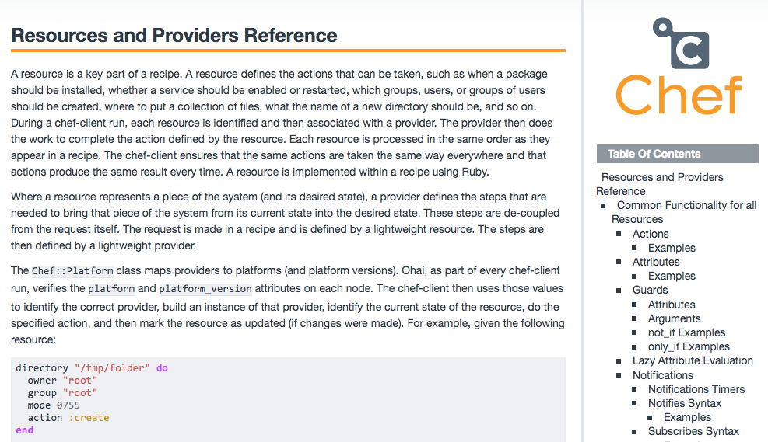
The Resources Page
Notes:
Let them know that this is how professionals work - they have their editor open, a command line, and the docs open all the time.
The rest of the deck tells them to look up more information in the Docs, and at this stage I start answering questions with "where can you look that up?"
Note: The docs has an easier way to run the nested check we just talked about. We did it to have the conversation.

Slide 415
Notifications
notifies :restart, "service[httpd]"
Resource Notifications in Chef are used to trigger an action on a resource when the current resources actions are successful.
"If we delete the site, restart apache"
The first argument is an action, and the second argument is the string representation of a given resource
Like not_if and only_if, notifies is a resource metaparameter - any resource can notify any other
Notes:
Direct the students to read more about notifications on the wiki (notifies resource)
Important to talk about the fact that we batch notifications up, and run them at the end
The :immediately flag is a good question to see if they know how to use the wiki - ask them if they can figure out how to not wait for the end of the run for a notification to fire

Slide 416
Exercise: Iterate over each apache site
OPEN IN EDITOR:
cookbooks/apache/recipes/default.rb
execute "mv /etc/httpd/conf.d/welcome.conf /etc/httpd/conf.d/welcome.conf.disabled" do
only_if do
File.exist?("/etc/httpd/conf.d/welcome.conf")
end
notifies :restart, "service[httpd]"
end
node.default["apache"]["indexfile"] = "index2.html"
cookbook_file "/var/www/index.html" do
source node["apache"]["indexfile"]
mode "0644"
end
Delete the cookbook_file resource
Notes:
We will explain the new syntax in the next few slides

Slide 417
Exercise: Iterate over each apache site
OPEN IN EDITOR:
cookbooks/apache/recipes/default.rb
execute "mv /etc/httpd/conf.d/welcome.conf /etc/httpd/conf.d/welcome.conf.disabled" do
only_if do
File.exist?("/etc/httpd/conf.d/welcome.conf")
end
notifies :restart, "service[httpd]"
end
cookbook_file "/var/www/index.html" do
source "index.html"
mode "0644"
end
Delete the cookbook_file resource
Notes:
We will explain the new syntax in the next few slides

Slide 418
Exercise: Iterate over each apache site and set document_root
OPEN IN EDITOR:
cookbooks/apache/recipes/default.rb
# Disable the default virtual host
execute "mv /etc/httpd/conf.d/welcome.conf /etc/httpd/conf.d/welcome.conf.disabled" do
only_if do
File.exist?("/etc/httpd/conf.d/welcome.conf")
end
notifies :restart, "service[httpd]"
end
# Iterate over the apache sites
node["apache"]["sites"].each do |site_name, site_data|
# Set the document root
document_root = "/srv/apache/#{site_name}"
SAVE FILE!
node["apache"]["sites"] is a ruby hash, with keys and values
Notes:
We will explain the new syntax in the next few slides

Slide 419
Exercise: Iterate over each apache site
node["apache"]["sites"].each do |site_name, site_data|
document_root = "/srv/apache/#{site_name}"
Calling .each loops over each site
default["apache"]["sites"]["clowns"] = { "port" => 80 }
default["apache"]["sites"]["bears"] = { "port" => 81 }
First pass
site_name = ‘clowns’
site_data = { "port" => 80 }
Second pass
site_name = ‘bears’
site_data = { "port" => 81 }
Notes:
Line 25, using the hash we wrote earlier, ".each" is (more or less) a for loop. For every item, iterate the function. Works just like a for loop. Ruby does have a "for" loop, but it is rarely used. Instead, we use "iterators" to yield values to blocks.
In this case, we are walking all the sites we defined earlier, and assigning two pieces of data between the "|" (arms) - site_name for the key, and site_data for the value.
We are breaking up arrays and hashes.

Slide 420
Exercise: Iterate over each apache site
node["apache"]["sites"].each do |site_name, site_data|
document_root = "/srv/apache/#{site_name}"
Create a variable called document_root
#{site_name} means "insert the value of site_name here"
First pass
The value is the string "/srv/apache/clowns"
Second pass
The value is the string "/srv/apache/bears"
Notes:
More syntax. Variables within blocks use the "=" for assignment, and are locally scoped.
#{..} in a string

Slide 421
Exercise: Add a template for Apache virtual host configuration
# Iterate over the apache sites
node["apache"]["sites"].each do |site_name, site_data|
# Set the document root
document_root = "/srv/apache/#{site_name}"
# Add a template for Apache virtual host configuration
template "/etc/httpd/conf.d/#{site_name}.conf" do
source "custom.erb"
mode "0644"
variables(
:document_root => document_root,
:port => site_data["port"]
)
notifies :restart, "service[httpd]"
end
Notes:
New resource parameter for templates, in the “variables” parameter. Explained in future slides.

Slide 422
Template Variables
Not all data you might need in a template is necessarily node attributes
The variables parameter lets you pass in custom data for use in a template
Notes:
We will show how to use these variables when we write the template in a few slides

Slide 423
Exercise: Add a directory resource to create the document_root
Use a directory resource
The name is document_root
The resource has two parameters
mode is "0755"
recursive is true
Use the Resources page on the Docs Site to read more about what recursive does.
Notes:
Make them use the wiki, and let them sweat a bit. The next slide has the answer.
If students want to check their syntax, encourage them to use "knife cookbook test [cookbook]" rather than uploading their changes just yet. Typically, they can apply updates as often as needed in uploading cookbooks. But if we do that now, our later examples will be off.

Slide 424
Exercise: Add the directory resource
# Add a template for Apache virtual host configuration
template "/etc/httpd/conf.d/#{site_name}.conf" do
source "custom.erb"
mode "0644"
variables(
:document_root => document_root,
:port => site_data["port"]
)
notifies :restart, "service[httpd]"
end
# Add a directory resource to create the document_root
directory document_root do
mode "0755"
recursive true
end

Slide 425
Variables and interpolation
Given the following variable for 'document_root'
document_root="/srv/apache/foobar"
What directory will be created in each of the following?
directory document_root do ...
directory "document_root" do ...
directory "#{document_root}" do ...
/srv/apache/foobar
/document_root
/srv/apache/foobar
Notes:
Wait for the big reveal!
This is a building slide. Ask the class for answer to each one, and reveal one at a time
Answer:-
Case1 - /srv/apache/foobar
Case2 - /document_root
Case3 - /srv/apache/foobar

Slide 426
Exercise: Add a template resource to supply the index.html for the virtual host
# Add a directory resource to create the document_root
directory document_root do
mode "0755"
recursive true
end
# Add a template resource for the virtual host's index.html
template "#{document_root}/index.html" do
source "index.html.erb"
mode "0644"
variables(
:site_name => site_name,
:port => site_data["port"]
)
end
end

Slide 427
Don’t forget the last “end”
# Add a template resource for the virtual host's index.html
template "#{document_root}/index.html" do
source "index.html.erb"
mode "0644"
variables(
:site_name => site_name,
:port => site_data["port"]
)
end
end
See the correct, whole file at https://gist.github.com/8954699
Notes:
Do not let anyone download that file in advance. Save the file, but don’t upload it yet.

Slide 428
Exercise: Add custom.erb to your templates directory
OPEN IN EDITOR:
cookbooks/apache/templates/default/custom.erb
<% if @port != 80 -%>
Listen <%= @port %>
<% end -%>
<VirtualHost *:<%= @port %>>
ServerAdmin webmaster@localhost
DocumentRoot <%= @document_root %>
<Directory />
Options FollowSymLinks
AllowOverride None
</Directory>
<Directory <%= @document_root %>
Options Indexes FollowSymLinks MultiViews
AllowOverride None
Order allow,deny
allow from all
</Directory>
</VirtualHost>
Note the two template variables are prefixed with an @ symbol
If you are feeling hardcore, type it
https://gist.github.com/8955103
SAVE FILE!
Notes:
Breaking lab slide (1/6). Note missing ">" after '<Directory <%= @document_root %>'
We are forcefully introducing a bug. Any student using a "proper" text editor will likely catch that this is a mistake.
New syntax here:
* Ruby has "instance" variables, which are bound to the instance of an object. When we render templates and pass in the variables parameter, we are adding instance variables to the context of the template render. Hence, we prefix them with an "@" symbol. The node, on the other hand, is supplied as part of the context itself, and so requires no @ symbol.
* Conditional if - ruby has the pretty standard set of operators for checking equality.
Re-affirm the ERB syntax, of -%> on the end and <%= on the front

Slide 429
Exercise: Add custom.erb to your templates directory
OPEN IN EDITOR:
cookbooks/apache/templates/default/custom.erb
<% if @port != 80 -%>
Listen <%= @port %>
<% end -%>
<VirtualHost *:<%= @port %>>
ServerAdmin webmaster@localhost
DocumentRoot <%= @document_root %>
<Directory />
Options FollowSymLinks
AllowOverride None
</Directory>
<Directory <%= @document_root %>>
Options Indexes FollowSymLinks MultiViews
AllowOverride None
Order allow,deny
allow from all
</Directory>
</VirtualHost>
Note the two template variables are prefixed with an @ symbol
Our first conditional if!
If you are feeling hardcore, type it.
https://gist.github.com/2866454
SAVE FILE!
Notes:
This is the original non-breaking lab slide
This is a teaching style choice. If you use the "breaking" slide, most text editors catch the bug and students notice.
If you give them the gist, no one hits the bug because they all copied and pasted.
If you let them type it all out, it's almost certain that someone in your 15 person class (who didn't listen to you about proper text editors) fat fingered a portion of it.

Slide 430
Exercise: Add index.html.erb to your templates directory
OPEN IN EDITOR:
cookbooks/apache/templates/default/index.html.erb
<html>
<body>
<h1>Welcome to <%= node["motd"]["company"] %></h1>
<h2>We love <%= @site_name %></h2>
<%= node["ipaddress"] %>:<%= @port %>
</body>
</html>
SAVE FILE!
Note the two template variables are prefixed with an @ symbol
https://gist.github.com/8955080
Notes:
When we render templates and pass in the variables parameter, we are adding instance variables to the context of the template render. Hence, we prefix them with an "@" symbol. The node, on the other hand, is supplied as part of the context itself, and so requires no @ symbol.

Slide 431
Exercise: Upload the Apache cookbook
$ knife cookbook upload apache
Uploading apache [0.2.0]
Uploaded 1 cookbook.

Slide 432
Exercise: Re-run the Chef Client
chef@node1:~$ sudo chef-client
Compiling Cookbooks...
Converging 11 resources
Recipe: apache::default
* package[httpd] action install[2014-01-07T05:13:37-05:00] INFO: Processing package[httpd] action install (apache::default line 9)
(up to date)
* service[httpd] action enable[2014-01-07T05:13:40-05:00] INFO: Processing service[httpd] action enable (apache::default line 13)
(up to date)
* service[httpd] action start[2014-01-07T05:13:40-05:00] INFO: Processing service[httpd] action start (apache::default line 13)
(up to date)
* execute[mv /etc/httpd/conf.d/welcome.conf /etc/httpd/conf.d/welcome.conf.disabled] action run[2014-01-07T05:13:41-05:00] INFO: Processing execute[mv /etc/httpd/conf.d/welcome.conf /etc/httpd/conf.d/welcome.conf.disabled] action run (apache::default line 17)
[2014-01-07T05:13:41-05:00] INFO: execute[mv /etc/httpd/conf.d/welcome.conf /etc/httpd/conf.d/welcome.conf.disabled] ran successfully
- execute mv /etc/httpd/conf.d/welcome.conf /etc/httpd/conf.d/welcome.conf.disabled
Notes:
Troubleshooting Tip: If the learner has a typo in their custom.erb file or any other config file in this lab, then the chef-client run may fail because the apache service tries to start before the the template is changed, i.e. the " `node["apache"]["sites"]` loop is AFTER the `service['httpd']` resource. The fix is to move the `service['httpd']` resource to after the loop.

Slide 433
Exercise: Re-run the Chef Client
chef@node1:~$ sudo chef-client
...
================================================================================
Error executing action `restart` on resource 'service[httpd]'
================================================================================
Mixlib::ShellOut::ShellCommandFailed
------------------------------------
Expected process to exit with [0], but received '1'
---- Begin output of /sbin/service httpd start ----
STDOUT: Starting httpd: [FAILED]
STDERR: Syntax error on line 11 of /etc/httpd/conf.d/admin.conf:
<Directory> directive missing closing '>'
---- End output of /sbin/service httpd start ----
Ran /sbin/service httpd start returned 1
Resource Declaration:
---------------------
# In /var/chef/cache/cookbooks/apache/recipes/default.rb
43: service "httpd" do
44: action [ :enable, :start ]
45: end
...
FAIL!
Notes:
Why did it fail???? Give them a few mins to read the output and figure it out
Fix the typo introduced in custom.erb file, and rerun chef-client.

Slide 434
Exercise: Fix typo in custom.erb
OPEN IN EDITOR:
cookbooks/apache/templates/default/custom.erb
<% if @port != 80 -%>
Listen <%= @port %>
<% end -%>
<VirtualHost *:<%= @port %>>
ServerAdmin webmaster@localhost
DocumentRoot <%= @document_root %>
<Directory />
Options FollowSymLinks
AllowOverride None
</Directory>
<Directory <%= @document_root %>>
Options Indexes FollowSymLinks MultiViews
AllowOverride None
Order allow,deny
allow from all
</Directory>
</VirtualHost>
SAVE FILE!

Slide 435
Exercise: Upload the Apache cookbook
$ knife cookbook upload apache
Uploading apache [0.2.0]
Uploaded 1 cookbook.

Slide 436
Exercise: Re-run the Chef Client
chef@node1:~$ sudo chef-client
...
================================================================================
Error executing action `restart` on resource 'service[httpd]'
================================================================================
Mixlib::ShellOut::ShellCommandFailed
------------------------------------
Expected process to exit with [0], but received '1'
---- Begin output of /sbin/service httpd start ----
STDOUT: Starting httpd: [FAILED]
STDERR: Syntax error on line 11 of /etc/httpd/conf.d/admin.conf:
<Directory> directive missing closing '>'
---- End output of /sbin/service httpd start ----
Ran /sbin/service httpd start returned 1
Resource Declaration:
---------------------
# In /var/chef/cache/cookbooks/apache/recipes/default.rb
43: service "httpd" do
44: action [ :enable, :start ]
45: end
...
FAIL!
Notes:
Why does it still fail with the same error about the missing '>' ????
Troubleshooting Tip: Look at the order of the resources in the recipe! Remember "package, template, service."
If the learner has a typo in their custom.erb file or any other config file in this lab, then the chef-client run may fail because the apache service tries to start before the the template is changed, i.e. the " `node["apache"]["sites"]` loop is AFTER the `service['httpd']` resource. The fix is to move the `service['httpd']` resource to after the loop.

Slide 437
Exercise: Move the service resource to end of recipe
# Add a template resource for the virtual host's index.html
template "#{document_root}/index.html" do
source "index.html.erb"
mode "0644"
variables(
:site_name => site_name,
:port => site_data["port"]
)
end
end
service "httpd" do
action [ :enable, :start ]
end

Slide 438
Exercise: Open the default apache recipe in your editor
OPEN IN EDITOR:
cookbooks/apache/recipes/default.rb
package "httpd" do
action :install
end
service "httpd" do
action [:enable, :start]
end
node.default["apache"]["indexfile"] = "index2.html"
cookbook_file "/var/www/html/index.html" do
source node["apache"]["indexfile"]
mode "0644"
end
# Tasks:-
# Disable the default virtual host
# Iterate over the apache sites
# Set the document root
# Add a template for Apache virtual host configuration
# Add a directory resource to create the document_root
# Add a template resource for the virtual host's index.html
Notes:
This slide is in here (hidden) in case an instructor wants to reference exactly why this bug exists and why moving the service resource to the end is the fix.

Slide 439
Exercise: Re-run the Chef Client
chef@node1:~$ sudo chef-client
- start service service[httpd]
Recipe: motd::default
* template[/etc/motd] action create[2014-02-11T04:34:23-05:00] INFO: Processing template[/etc/motd] action create (motd::default line 9)
(up to date)
[2014-02-11T04:34:23-05:00] INFO: template[/etc/httpd/conf.d/clowns.conf] sending restart action to service[httpd] (delayed)
Recipe: apache::default
* service[httpd] action restart[2014-02-11T04:34:23-05:00] INFO: Processing service[httpd] action restart (apache::default line 42)
[2014-02-11T04:34:25-05:00] INFO: service[httpd] restarted
- restart service service[httpd]
[2014-02-11T04:34:26-05:00] INFO: Chef Run complete in 9.567724215 seconds
[2014-02-11T04:34:26-05:00] INFO: Running report handlers
[2014-02-11T04:34:26-05:00] INFO: Report handlers complete
Chef Client finished, 5 resources updated
[2014-02-11T04:34:26-05:00] INFO: Sending resource update report (run-id: d1e6c73e-9406-46b8-b022-d7bdf0868432)
WIN!

Slide 440
Exercise: Re-run the Chef Client
chef@node1:~$ sudo chef-client
[2014-01-07T05:13:43-05:00] INFO: execute[mv /etc/httpd/conf.d/welcome.conf /etc/httpd/conf.d/welcome.conf.disabled] sending restart action to service[httpd] (delayed)
Recipe: apache::default
* service[httpd] action restart[2014-01-07T05:13:43-05:00] INFO: Processing service[httpd] action restart (apache::default line 13)
[2014-01-07T05:13:45-05:00] INFO: service[httpd] restarted
- restart service service[httpd]
[2014-01-07T05:13:46-05:00] INFO: Chef Run complete in 10.389166164 seconds
[2014-01-07T05:13:46-05:00] INFO: Removing cookbooks/apache/files/default/index2.html from the cache; it is no longer needed by chef-client.
[2014-01-07T05:13:46-05:00] INFO: Running report handlers
[2014-01-07T05:13:46-05:00] INFO: Report handlers complete
Chef Client finished, 8 resources updated
[2014-01-07T05:13:46-05:00] INFO: Sending resource update report (run-id: b929bc5f-4465-4669-8027-b7d7b44741d9)
Notes:
Triggered the restart
Again, service starts, are typically the last resource executed.

Slide 441
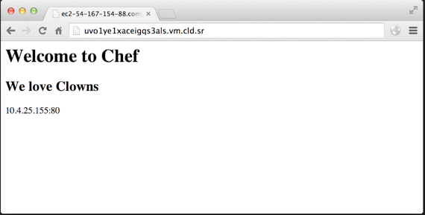
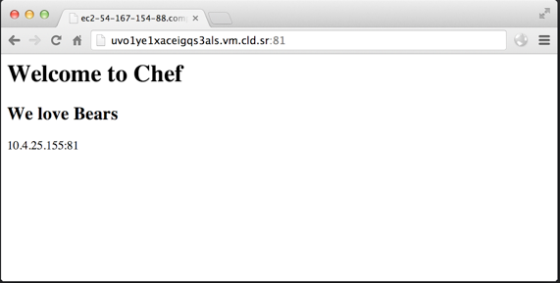
Exercise: Verify the two sites are working!
Notes:
Again, if they have trouble getting to them with a web browser, whip out curl on the command line
curl http://localhost:80
curl http://localhost:81

Slide 442
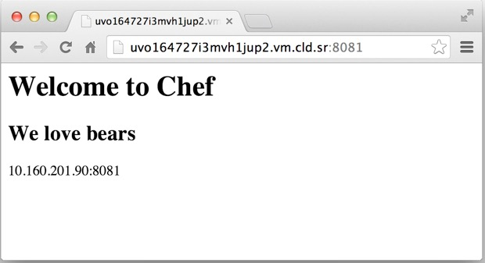
Exercise: Verify the two sites are working!
Notes:
Again, if they have trouble getting to them with a web browser, whip out curl on the command line
curl http://localhost:80
curl http://localhost:81

Slide 443
Best Practice: Recipes contain the pattern, attributes supply the details
Recipes contain the pattern for how to do something. ("How we deploy apache virtual hosts")
Attributes contain the details. ("What virtual hosts should we deploy?")
Notes:
This is a re-iteration from earlier, but it’s one of the most important things to understand about Chef.

Slide 444
The resource collection
Recipe
Resource Collection
package "httpd" do
action :install
end
service "httpd" do
action [ :enable, :start ]
end
execute "mv /etc/httpd/conf.d/welcome.conf /etc/httpd/conf.d/welcome.conf.disabled" do
only_if do
File.exist?("/etc/httpd/conf.d/welcome.conf")
end
notifies :restart, "service[httpd]"
end
node["apache"]["sites"].each do |site_name, site_data|
document_root = "/srv/apache/#{site_name}"
template "/etc/httpd/conf.d/#{site_name}.conf" do
source "custom.erb"
mode "0644"
variables(:document_root => document_root, :port => site_data["port"])
notifies :restart, "service[httpd]"
end
directory document_root do
mode "0755"
recursive true
end
template "#{document_root}/index.html" do
source "index.html.erb"
mode "0644"
variables(:site_name => site_name, :port => site_data['port'])
end
end
resource_collection = [
package[httpd],
service[httpd],
execute[mv](only_if[File.exist]),
template["/etc/httpd/conf.d/clowns.conf"],
directory["/srv/apache/clowns"],
template["/srv/apache/clowns/index.html"],
template["/etc/httpd/conf.d/bears.conf"],
directory["/srv/apache/bears"],
template["/srv/apache/clowns/bears.html"]
]
<-- Bears
<-- Clowns
Notes:
Instructor Note: This is a building slide - click to move forward!
This slide to illustrate the resource collection thats is being built in this section - based on the refactored cookbook, having iterated over the apache sites, and including 'not_if'

Slide 445
What about the notifications in the resource collection?
Notifications are queued and executed at the end of the chef run
Unless they configured as :immediately

Slide 446
Execution phase and notifications
Resource Collection
Notifications Collection
resource_collection = [
notification_collection = [
package[httpd],
service[httpd],
execute[mv](only_if[File.exist]),
template["/etc/httpd/conf.d/clowns.conf"],
directory["/srv/apache/clowns"],
template["/srv/apache/clowns/index.html"],
template["/etc/httpd/conf.d/bears.conf"],
directory["/srv/apache/bears"],
template["/srv/apache/clowns/bears.html"]
]
notifies :restart, "service[httpd]"
notifies :restart, "service[httpd]",
notifies :restart, "service[httpd]"
]
Final Notifications
notification_collection.uniq = [
notifies :restart, "service[httpd]"
]
Notes:
This slide to illustrate the notification collection thats is being built during the execute phase
Instructor Note: This is a building slide!

Slide 447
Review Questions
How do you control the idempotence of an Execute resource?
Where can you learn the details about all the core resources in Chef?
What is a notification?
What is a template variable?
What does #{foo} do in a Ruby string?

Slide 448
Search
A deeper dive....

Slide 449
Lesson Objectives
After completing the lesson, you will be able to
Describe the query syntax used in search
Invoke a search from command line
Build a search into your recipe code
Notes:
http://docs.chef.io/essentials_search.html

Slide 450
What is search?
Use search to query data indexed on the chef server
Syntax is
Where index can be client, environment, node, role, (or the name of a data bag)
Search query runs on the server and is invoked from within a recipe, using knife or via WebUI
$ knife search INDEX SEARCH_QUERY
Notes:
More in data bags later...
http://wiki.apache.org/solr/SolrQuerySyntax

Slide 451
Exercise: Use knife search
$ knife search node "*:*"
Node Name: node1
Environment: _default
FQDN: centos63.example.com
IP: 10.160.201.90
Run List: recipe[apache], recipe[motd]
Roles:
Recipes: apache, motd
Platform: centos 6.4
Tags:
Notes:
Search for all nodes

Slide 452
Query Syntax
Chef search uses the Solr 'key:search_pattern' syntax
Use an asterisk ("*") for >=0 chars in a wildcard search
Use a question mark ("?") to replace a single character
$ knife search node "ipaddress:10.20.30.40"
$ knife search node "ipaddress:10.*"
$ knife search node "platfo*:ubuntu"
$ knife search node "platform_version:12.0?"
Notes:
platfor* could match "platform" or "platform_family"

Slide 453
Indexing and search delay
Search is based on an index, so if you write to a node it may not be immediately available
Here, since the attribute value has just been written the search will not pick it up until the index is rebuilt
Also, node attributes changed during a Chef run aren’t posted to the server until the entire Chef run is successful
But the value is stored in memory - so no need to search!
node.default["serveradmin"] = "Jane"
search("node","*:*").each do |servers|
user servers["serveradmin"]
end
BAD PRACTICE!
Notes:
It's all about eventual consistency -- individual Chef runs are immediately convergent, but your infrastructure as a whole is eventually consistent
Also, node attributes changed during a Chef run aren’t posted to the server until the entire Chef run is successful

Slide 454
Remember what you're searching for!
A successful search returns all objects, not just the attributes, that satisfy the search criteria
In other words 'search for nodes containing this attribute', NOT 'search for this attribute across nodes'!
use knife
for nodes
$ knife search node 'ipaddress:10.1.1.*'
to search
with this search criteria
Notes:
So
'knife search node 'ipaddress:10.1.1.*''
means
"find all nodes that contain the attribute 'ipaddress:10.1.1.*', and return those nodes"
It DOES NOT mean
"find 'ipaddress:10.1.1.*' across all nodes and return those attribute values"
I.e. It returns nodes 'node1', 'node2' etc, and not a list of attributes 'ipaddress:10.1.1.1', 'ipaddress:10.1.1.2' etc

Slide 455
Exercise: Find a node with the specific attribute value
$ knife search node "ipaddress:10.*"
1 items found
Node Name: node1
Environment: _default
FQDN: centos63.example.com
IP: 10.160.201.90
Run List: recipe[apache], recipe[motd]
Roles:
Recipes: apache, motd
Platform: centos 6.4
Tags:
Notes:
Here we are searching for nodes. Output is shortened by default - to see all attributes for the node use the '-l' switch
Note student IP may be be different - use the result on previous slide

Slide 456
Exercise: Using Knife to find an attribute value
$ knife search node "*:*" -a ipaddress
1 items found
node1:
ipaddress: 10.160.201.90
Notes:
Here we are trying to find the IP Address for our nodes, i.e. the value of the 'ipaddress' attribute

Slide 457
Exercise: Return just the attribute value
$ knife search node "ipaddress:10.*" -a ipaddress
1 items found
node1:
ipaddress: 10.160.201.90
Notes:
Here we are searching for a node. Output is shortened by default - to see all attributes for the node use the '-l' switch
Note student IP may be be different - use the result on previous slide

Slide 458
Exercise: Boolean matching
$ knife search node "ipaddress:10* AND platform_family:rhel"
1 items found
Node Name: node1
Environment: _default
FQDN: centos63.example.com
IP: 10.160.201.90
Run List: recipe[apache], recipe[motd]
Roles:
Recipes: apache, motd
Platform: centos 6.4
Tags:

Slide 459
Search from within a recipe
You can invoke a search within a recipe, and use the results to apply further Chef primitives
For example
search(INDEX, SEARCH_QUERY).each do |result|
foo
end
search("node", "role:webserver").each do |webserver|
[register webserver with load balancer]
or
[configure firewall so webserver can access database]
end

Slide 460
Exercise: Search for an attribute in a recipe
OPEN IN EDITOR:
cookbooks/apache/recipes/ip-logger.rb
search("node","platform:centos").each do |server|
log "The CentOS servers in your organization have the following FQDN/IP Addresses:- #{server["fqdn"]}/#{server["ipaddress"]}"
end
SAVE FILE!
Notes:
This is a misleading anti-pattern.
Why is this ip-logger recipe in the apache cookbook? What does it have to do with apache? Nothing!
Search returns an array of matching objects. Iterating through each would print multiple log lines. The wording of the sentence leads you to think otherwise.
Consider skipping this exercise and tell students exactly why. If we teach them anti-patterns, that's what they'll go do once class is over. That's how we taught them.

Slide 461
Exercise: Upload the Apache cookbook
$ knife cookbook upload apache
Uploading apache [0.2.0]
Uploaded 1 cookbook.
Notes:
Consider skipping this exercise and tell students exactly why. If we teach them anti-patterns, that's what they'll go do once class is over. That's how we taught them.

Slide 462
Exercise: Add the recipe to your test node’s run list
$ knife node run_list add node1 'recipe[apache::ip-logger]'
node1:
run_list:
recipe[apache]
recipe[motd]
recipe[apache::ip-logger]
Notes:
Consider skipping this exercise and tell students exactly why. If we teach them anti-patterns, that's what they'll go do once class is over. That's how we taught them.

Slide 463
Recipe Naming
Recipes are referenced using the notation ‘cookbook::recipe’, where ‘recipe’ is the name of the ‘.rb’ file in the “cookbook/recipe” directory
The “default.rb” recipe for a given cookbook may be referred to just the cookbook name (e.g. ‘mysql’)
If we added another recipe to this cookbook named 'backup', we would refer to it as 'mysql::backup'
Notes:
But this is worth talking about!
Sometimes, you might have to manage a complex application that may have different functions (server vs. client) or an extensive plugin system (httpd server modules). It is often helpful to break apart the logic used to manage these different aspects from the default recipe into additional recipes that can be added as necessary.

Slide 464
Exercise: Re-run the Chef Client
chef@node1:~$ sudo chef-client
Recipe: apache::ip-logger
* log[The CentOS servers in your organization have the following FQDN/IP Addresses:- centos63.example.com/10.160.201.90] action write[2014-01-07T05:42:21-05:00] INFO: Processing log[The CentOS servers in your organization have the following FQDN/IP Addresses: Server centos63.example.com/10.160.201.90] action write (apache::ip-logger line 4)
[2014-01-07T05:42:21-05:00] INFO: The CentOS servers in your organization have the following FQDN/IP Addresses: Server centos63.example.com/10.160.201.90
[2014-01-07T05:42:22-05:00] INFO: Chef Run complete in 6.376181602 seconds
[2014-01-07T05:42:22-05:00] INFO: Running report handlers
[2014-01-07T05:42:22-05:00] INFO: Report handlers complete
Chef Client finished, 1 resources updated
[2014-01-07T05:42:22-05:00] INFO: Sending resource update report (run-id: cecf34e9-eab6-4379-a5a6-d6d135ae8cc7)
Notes:
Now run chef-client on the node

Slide 465
Exercise: Remove the recipe to your test node’s run list
$ knife node run_list remove node1 'recipe[apache::ip-logger]'
node1:
run_list:
recipe[apache]
recipe[motd]
Notes:
Just remove the recipe from the run_list again to tidy up after the lab.

Slide 466
Questions
What search engine is Chef search built upon?
What is searchable in Chef?
What character can you use for a wildcard search in Solr?
Why should you not set an attribute and then immediately search for it?

Slide 467
Recipe Inclusion, Data Bags, and Search
Writing a Users cookbook

Slide 468
Lesson Objectives
After completing the lesson, you will be able to
Explain what Data Bags are, and how they are used
Describe the User and Group resources
Use the include_recipe directive
Describe the role Search plays in recipes

Slide 469
The Problem and the Success Criteria
The Problem: Employees should have local user accounts created on servers, along with custom groups
Success Criteria: We can add new employees and groups to servers dynamically

Slide 470
Where should we store the user data?
As we’ve seen, we could start by storing information about users as Node Attributes
This is sort of a bummer, because we would be duplicating a lot of information - every user in the company would be stored in every Node object!
Additionally, it would be very hard to integrate such a solution with another source of truth about users

Slide 471
Introducing Data Bags
A data bag is a container for items that represent information about your infrastructure that is not tied to a single node
Examples
Users
Groups
Application Release Information
Notes:
These "containers" take JSON. Anything you can do in JSON you can do in a databag.

Slide 472
Make a data_bags directory
$ mkdir -p data_bags/users
(No output)

Slide 473
Exercise: Create a data bag named users
$ knife data_bag create users
Created data_bag[users]

Slide 474
Exercise: Create a user item in the users data bag
OPEN IN EDITOR:
data_bags/users/bobo.json
{
"id": "bobo",
"comment": "Bobo T. Clown",
"uid": 2000,
"gid": 0,
"home": "/home/bobo",
"shell": "/bin/bash"
}
SAVE FILE!
Notes:
New syntax - integers in JSON have no quotes, and will wind up as integers in Ruby. If you quoted integers they'd be strings.
Bobo is a Clown, that I have been using as my test user for identity management systems for years.

Slide 475
Exercise: Create the data bag item
$ knife data_bag from file users bobo.json
Updated data_bag_item[users::bobo]

Slide 476
Exercise: Create another user in the users data bag
OPEN IN EDITOR:
data_bags/users/frank.json
{
"id": "frank",
"comment": "Frank Belson",
"uid": 2001,
"gid": 0,
"home": "/home/frank",
"shell": "/bin/bash"
}
SAVE FILE!
Notes:
Frank Belson is the sergeant of the police precinct in the Spenser novels by Robert B. Parker (later: Spenser for Hire TV series)

Slide 477
Exercise: Create the data bag item
$ knife data_bag from file users frank.json
Updated data_bag_item[users::frank]

Slide 478
Exercise: Show all the items in users data bag
$ knife search users "*:*"
2 items found
chef_type: data_bag_item
comment: Frank Belson
data_bag: users
gid: 0
home: /home/frank
id: frank
shell: /bin/bash
uid: 2001
chef_type: data_bag_item
comment: Bobo T. Clown
data_bag: users
gid: 0
home: /home/bobo
id: bobo
shell: /bin/bash
uid: 2000
Notes:
Whats important here is that more than just the nodes get indexed for search - it is everything in Chef!
Search Index Names: role node client
environment (data bags are indexed by data bag’s name)

Slide 479
Exercise: Find Bobo’s shell in Chef
$ knife search users "id:bobo" -a shell
1 items found
data_bag_item_users_bobo:
shell: /bin/bash
Notes:
Encourage students to try searches: knife help search You can use boolean values e.g. knife search INDEX 'field:value OR field:value'
Could have them count the shell's in use, like this:-
knife search users "*:*" -a shell |grep shell | uniq -c
Note: if the search text is a string you'll need to put it in double quotes (")
knife search users "comment:\"Bobo T. Clown\"" -a shell
Note we have to escape the " here within the search string. On a Mac/*nix machine they could do this.
knife search users 'comment:"Bobo T. Clown"' -a shell
But the single quote (') wouldn't work in a Windows powershell terminal

Slide 480
Exercise: Create a data bag named groups
$ mkdir data_bags/groups
$ knife data_bag create groups
Created data_bag[groups]

Slide 481
Exercise: Create a group item in the group data bag
OPEN IN EDITOR:
data_bags/groups/clowns.json
{
"id": "clowns",
"gid": 3000,
"members": ["bobo", "frank"]
}
SAVE FILE!
Notes:
JSON syntax again. Arrays in JSON have brackets.
Quotes around strings.
No trailing commas.

Slide 482
Exercise: Create the data bag item
$ knife data_bag from file groups clowns.json
Updated data_bag_item[groups::clowns]

Slide 483
Exercise: Show all the groups in Chef
$ knife search groups "*:*"
1 items found
chef_type: data_bag_item
data_bag: groups
gid: 3000
id: clowns
members:
bobo
frank

Slide 484
Exercise: Create a cookbook named ‘users’
$ knife cookbook create users
** Creating cookbook users
** Creating README for cookbook: users
** Creating CHANGELOG for cookbook: users
** Creating metadata for cookbook: users

Slide 485
Exercise: Open the default recipe in your editor
OPEN IN EDITOR:
cookbooks/users/recipes/default.rb
#
# Cookbook Name:: users
# Recipe:: default
#
# Copyright 2013, YOUR_COMPANY_NAME
#
# All rights reserved - Do Not Redistribute
#
SAVE FILE!

Slide 486
Exercise: Open the default recipe in your editor
search("users", "*:*").each do |user_data|
user user_data["id"] do
comment user_data["comment"]
uid user_data["uid"]
gid user_data["gid"]
home user_data["home"]
shell user_data["shell"]
end
end
include_recipe "users::groups"
We use the same search we just tried with Knife in the recipe
Each item is bound to user_data
Use the Chef Docs for information about the user resource
Notes:
The search syntax is new here, but we’ve been doing lots of searching throughout. Relate that the objects bound to user_data during each iteration are the same as what we got in the search results.

Slide 487
Exercise: Open the default recipe in your editor
search("users", "*:*").each do |user_data|
user user_data["id"] do
comment user_data["comment"]
uid user_data["uid"]
gid user_data["gid"]
home user_data["home"]
shell user_data["shell"]
end
end
include_recipe "users::groups"
include_recipe ensures another recipes resources are complete before we continue
Chef will only include each recipe once
Notes:
Note: we have not created the users::groups recipe yet
"include_recipe" happens in order. When we get to that line, we check to see if this recipe has already been executed. If it has not been run yet, we run it now.
We run this after user resource to add users to the group they belong to. If opposite order, we’d try to add users that don’t exist yet to our new group.

Slide 488
Best Practice: Use include_recipe liberally
If there is a pre-requisite for your recipe that resides in another recipe (the JVM existing for your Java application, for example)
Always use include_recipe to include it specifically, even if you put it in a run list
Notes:
The reason is that the recipes themselves stand alone as declarations of intent - no hidden dependencies that only get expressed in the order of the run list, and are easy to mess up.
You want a recipe to read as standalone. Basically, you’re declaring intent. You declare that this is a dependency. This is a documentation trail. If you only declare this somewhere else, you get spaghetti code references and it gets convoluted.
Purists will say only use includes once. Pragmatists will say, use these liberally. For day to day infrastructure, it’s better to be a pragmatist.

Slide 489
Exercise: Open the users::groups recipe in your editor
OPEN IN EDITOR:
cookbooks/users/recipes/groups.rb
search("groups", "*:*").each do |group_data|
group group_data["id"] do
gid group_data["gid"]
members group_data["members"]
end
end
SAVE FILE!
This file follows the same pattern as the default users recipe
Use the Chef Docs for information about the group resource

Slide 490
Exercise: Upload the users cookbook
$ knife cookbook upload users
Uploading users [0.1.0]
Uploaded 1 cookbook.

Slide 491
Exercise: Add the users recipe to your test node’s run list
$ knife node run_list add node1 'recipe[users]'
node1:
run_list:
recipe[apache]
recipe[motd]
recipe[users]
Notes:
knife node show [node] (to see without edit)
-Fj to see it in JSON
Make sure everyone has done this. Only about to get worse since we’re going to converge.

Slide 492
Exercise: Re-run the Chef Client
chef@node1$ sudo chef-client
...
Recipe: users::default
* user[bobo] action create[2014-01-07T06:16:26-05:00] INFO: Processing user[bobo] action create (users::default line 10)
[2014-01-07T06:16:26-05:00] INFO: user[bobo] created
- create user user[bobo]
* user[frank] action create[2014-01-07T06:16:26-05:00] INFO: Processing user[frank] action create (users::default line 10)
[2014-01-07T06:16:27-05:00] INFO: user[frank] created
- create user user[frank]
Recipe: users::groups
* group[clowns] action create[2014-01-07T06:16:27-05:00] INFO: Processing group[clowns] action create (users::groups line 2)
[2014-01-07T06:16:27-05:00] INFO: group[clowns] created
- create group[clowns]
...
Notes:
If you get errors, a common cause is that arguments to adduser are not valid - fat-fingered shells, for example.
This is another chance to talk about how knowledge of the system you are automating is vital to success - it’s easy to debug that error if you know how adduser behaves.

Slide 493
Exercise: Verify the users and groups exist
chef@node1:~$ cat /etc/passwd
frank:x:2001:0:Frank Belson:/home/frank:/bin/bash
bobo:x:2000:0:Bobo T. Clown:/home/bobo:/bin/bash
chef@node1:~$ cat /etc/group
clowns:x:3000:bobo,frank

Slide 494
Let’s review real quick..
We just created a centralized user and group repository, from scratch
(That’s kind of like what LDAP and Active Directory do, only they are, well, fancier.)
Between Data Bags and Node Attribute precedence, Chef provides a plethora of ways to inform the patterns you use to configure your infrastructure
Notes:
What happened here is epic. This doesn't do all the same things as AD. But we’ve done something fairly close using ~40 lines of ruby and JSON. The idea is that primitives driven by data are very powerful. All you need is an abstract notion of data about stuff you’re managing, then apply the same pattern. This is the stuff!

Slide 495
Review Questions
What are Data Bags?
How are they used?
What does the User resource do?
What is include_recipe, and why is it useful?
How does search work inside a recipe?
What other applications do you see for search?
How could we have used Data Bags in the refactored Apache recipe?
Where would you go to find out more?

Slide 496
Roles
Role-based Attributes and Merge Order Precedence

Slide 497
Lesson Objectives
After completing the lesson, you will be able to
Explain what Roles are, and how they are used to provide clarity
Discuss the Role Ruby DSL
Show a Role with Knife
Explain how merge order affects the precedence hierarchy
Describe nested Roles

Slide 498
What is a Role?
So far, we’ve been just adding recipes directly to a single node
But that’s not how your infrastructure works - think about how you refer to servers
"It’s a web server"
"It’s a database server"
"It’s a monitoring server"

Slide 499
What is a Role?
Roles allow you to conveniently encapsulate the run lists and attributes required for a server to "be" what you already think it is
In practice, Roles make it easy to configure many nodes identically without repeating yourself each time

Slide 500
Best Practice: Roles live in your chef-repo
Like Data Bags, you have options with how to create a Role
The best practice is that all of your Roles live in the roles directory of your chef-repo
They can be created via the API and Knife, but it’s nice to be able to see them evolve in your source control history
Notes:
Source control history can act as a documentation trail. Helpful if you need to unentangle your infrastructure.

Slide 501
Exercise: Create the webserver role
OPEN IN EDITOR:
roles/webserver.rb
A Role has a:
name
description
run_list
name "webserver"
description "Web Server"
run_list "recipe[apache]"
default_attributes({
"apache" => {
"sites" => {
"admin" => {
"port" => 8000
}
}
}
})
SAVE FILE!

Slide 502
Exercise: Create the webserver role
OPEN IN EDITOR:
roles/webserver.rb
You can set default node attributes within a role.
name "webserver"
description "Web Server"
run_list "recipe[apache]"
default_attributes({
"apache" => {
"sites" => {
"admin" => {
"port" => 8000
}
}
}
})
SAVE FILE!
Notes:
<<Review Comment: tcp/82 blocked on CLoudShare firewall, so using tcp/8000

Slide 503
Exercise: Create the role
$ knife role from file webserver.rb
Updated Role webserver!

Slide 504
Exercise: Show the role with knife
$ knife role show webserver
chef_type: role
default_attributes:
apache:
sites:
admin:
port: 8000
description: Web Server
env_run_lists:
json_class: Chef::Role
name: webserver
override_attributes:
run_list: recipe[apache]

Slide 505
Exercise: Search for roles with recipe[apache] in their run list
$ knife search role "run_list:recipe\[apache\]"
1 items found
chef_type: role
default_attributes:
apache:
sites:
admin:
port: 8000
description: Web Server
env_run_lists:
json_class: Chef::Role
name: webserver
override_attributes:
run_list: recipe[apache]
Notes:
<<Review Comment: tcp/82 blocked on CLoudShare firewall, so using tcp/8000
This is a hard one to do without the key above, but it’s worth it. Make them try and figure it out from the docs’s "search" page and the hint that it is "solr syntax".
Talk about the escaping of square brackets when searching on a run list - this applies to nodes too!
We could also search for port:8000, and see what roles set a key named port to the value 8000
knife search role "port:8000"

Slide 506
Exercise: Replace recipe[apache] with role[webserver] in run list
$ knife node run_list add node1 "role[webserver]" -a "recipe[apache]"
$ knife node run_list remove node1 "recipe[apache]"
node1:
run_list:
role[webserver]
recipe[motd]
recipe[users]
Notes:
ref0035
There are some problems with these commands in Windows environment, so using the UI (next slide) instead - Trello issue here http://goo.gl/bh8NSb

Slide 507

Exercise: Replace recipe[apache] with role[webserver] in run list
Click the ‘Nodes’ tab then select node ‘node1’
Click ‘Edit Run List’ from left navigation bar
Drag ‘Apache’ over from ‘Current Run List’ to ‘Available Recipes’
Drag ‘webserver’ over from ‘Available Roles’ to the top of ‘Current Run List’
Click ‘Save Run List’
Notes:
Here will use the UI to add the Role ‘Webserver’ to the top of the Run List. (Real reason, we dont want to show ‘knife node edit’, and there is an issue using ‘knife node run_list add node1 'role[webserver]' -a 'recipe[apache]'’ in Windows)
Click the Node tab then select node ‘node1’.
Note (30/10/13): This only works for the ‘_default’ environment. Using the others I get "Coming soon"

Slide 508
Exercise: Re-run the Chef Client
chef@node1$ sudo chef-client
INFO: *** Chef 11.8.2 ***
INFO: Chef-client pid: 5634
INFO: Run List is [role[webserver], recipe[motd], recipe[users]]
INFO: Run List expands to [apache, motd, users]
Notes:
Talk about run list expansion - we looked at the role, grabbed it’s runlist, and stuck it in place.
We are coming back to run list expansion when we finish the base role

Slide 509
Exercise: Re-run the Chef Client
* directory[/srv/apache/admin] action create[2014-01-07T06:39:51-05:00] INFO: Processing directory[/srv/apache/admin] action create (apache::default line 53)
[2014-01-07T06:39:51-05:00] INFO: directory[/srv/apache/admin] created directory /srv/apache/admin
- create new directory /srv/apache/admin[2014-01-07T06:39:51-05:00] INFO: directory[/srv/apache/admin] mode changed to 755
- change mode from '' to '0755'
- restore selinux security context
* template[/srv/apache/admin/index.html] action create[2014-01-07T06:39:51-05:00] INFO: Processing template[/srv/apache/admin/index.html] action create (apache::default line 58)
[2014-01-07T06:39:51-05:00] INFO: template[/srv/apache/admin/index.html] created file /srv/apache/admin/index.html
- create new file /srv/apache/admin/index.html[2014-01-07T06:39:51-05:00] INFO: template[/srv/apache/admin/index.html] updated file contents /srv/apache/admin/index.html
- update content in file /srv/apache/admin/index.html from none to 8abbb3
--- /srv/apache/admin/index.html 2014-01-07 06:39:51.762119942 -0500
+++ /tmp/chef-rendered-template20140107-17953-lsuqbi 2014-01-07 06:39:51.764120008 -0500
@@ -1 +1,8 @@
+<html>
+ <body>
+ <h1>Welcome to Chef</h1>
+ <h2>We love admin</h2>
+ 10.160.201.90:8000
+ </body>
+</html>[2014-01-07T06:39:51-05:00] INFO: template[/srv/apache/admin/index.html] mode changed to 644
- change mode from '' to '0644'
Notes:
<<Review Comment: tcp/82 blocked on CloudShare firewall, so using tcp/8000
We added the admin site to the existing set

Slide 510
Node Attributes that are hashes are merged
The apache cookbooks attribute file contains:
default["apache"]["sites"]["clowns"] = { "port" => 80 }
default["apache"]["sites"]["bears"] = { "port" => 81 }
default_attributes({
"apache" => {
"sites" => {
"admin" => {
"port" => 8000
}
}
}
})
While our role has...
Notes:
And the results are merged together.
We will get to merge order in just a few more slides...

Slide 511
Exercise: Display the apache.sites attribute on all nodes with webserver role
$ knife search node "role:webserver" -a apache.sites
1 items found
node1:
apache.sites:
admin:
port: 8000
bears:
port: 81
clowns:
port: 80
Notes:
This is the first time we use the "dot" notation with -a in knife - talk about using it to show deeply nested attributes easily.
It is also in contrast to how you search for that field, which is to join on an "_". The inconsistency is lame, but it is because "." is a stopword in the search query parser, and the index itself. So we used _ in the search, and when I did knife’s attribute lookup, I switched it to a "." without thinking about it. Sad but true.
Talk about the ‘role’ field, and how commonly used in search it is

Slide 512
Exercise: Edit the webserver role
OPEN IN EDITOR:
roles/webserver.rb
Do not forget the comma after the admin site
Change the value of the bears site to be 8081
default_attributes({
"apache" => {
"sites" => {
"admin" => {
"port" => 8000
},
"bears" => {
"port" => 8081
}
}
}
})
SAVE FILE!
Notes:
We are going to show that merge order has replacement for values that appear in two places...

Slide 513
Exercise: Create the role
$ knife role from file webserver.rb
Updated Role webserver!

Slide 514
Exercise: Re-run the Chef Client
chef@node1$ sudo chef-client
...
[2014-01-07T06:57:48-05:00] INFO: template[/etc/httpd/conf.d/bears.conf] updated file contents /etc/httpd/conf.d/bears.conf
- update content in file /etc/httpd/conf.d/bears.conf from 30610b to 92e1e4
--- /etc/httpd/conf.d/bears.conf 2014-01-07 05:13:42.450113970 -0500
+++ /tmp/chef-rendered-template20140107-18263-5563t5 2014-01-07 06:57:48.091397610 -0500
@@ -1,6 +1,6 @@
- Listen 81
+ Listen 8081
-<VirtualHost *:81>
+<VirtualHost *:8081>
ServerAdmin webmaster@localhost
DocumentRoot /srv/apache/bears
...

Slide 515
Exercise: Display the apache sites attribute on all nodes with the webserver role
$ knife search node 'role:webserver' -a apache.sites
1 items found
node1:
apache.sites:
admin:
port: 8000
bears:
port: 8081
clowns:
port: 80
Notes:
Note the syntax here - 'apache.sites' refers to the attribute 'default["apache"]["sites"]'

Slide 516
When you combine merge order and precedence rules, you get this:

Slide 517
Merge Order and Precedence
Notes:
And of course, automatic attributes go to 11 (spinal tap joke, folks)!
The 12 is not a typo - environment overrides bind higher than roles at overrride, but not at default. This is why, in the next section, we recommend that environment overrides are what you should use most often at that level.
Also, this shows why we say you should use defaults all the time! Merge order does the right thing for you, and leaves you so many levels of precedence to work with if you get stuck.
Take away => use defaults all the time. You will know you’re in the situation you need overrides when you’re in it.

Slide 518
Best Practice: Roles get default attributes
While it is awesome that you can use overrides, in practice there is little need
If you always set default node attributes in your cookbook attribute files
You can almost always set default node attributes in your role, and let merge order do the rest
Notes:
Drive home that people should use defaults!

Slide 519
Best Practice: Have "base" roles
In addition to obvious roles, such as "webserver", it is a common practice to group any functionality that "goes together" in a role
The most common example here is a base role, where you include all the recipes that should be run on every node
Notes:
Almost every org has this

Slide 520
Exercise: Create the base role
OPEN IN EDITOR:
roles/base.rb
name "base"
description "Base Server Role"
run_list "recipe[motd]", "recipe[users]"
SAVE FILE!
Notes:
Note to students: Don’t run ahead of this step and remove these out of your node definition. We will make use of those attributes again shortly.

Slide 521
Exercise: Create the role
$ knife role from file base.rb
Updated Role base!

Slide 522
Exercise: Add the base role to the webserver role’s run list
OPEN IN EDITOR:
roles/webserver.rb
name "webserver"
description "Web Server"
run_list "role[base]", "recipe[apache]"
default_attributes({
"apache" => {
Put role[base] at the front of the run_list
SAVE FILE!
Notes:
Again, make sure they do not edit the node and remove the motd and users recipes from the node object -we need that for our next object lesson

Slide 523
Exercise: Update the role
$ knife role from file webserver.rb
Updated Role webserver!

Slide 524
Exercise: Re-run the Chef Client
chef@node1$ sudo chef-client
INFO: *** Chef 11.8.2 ***
Chef-client pid: 5634
INFO: Run List is [role[webserver], recipe[motd], recipe[users]]
INFO: Run List expands to [motd, users, apache]
Notes:
Talk about run-list expansion - even though motd and users are explicitly after role[webserver] in the list, due to our nested role in the webserver, we are going to execute them first, because they expanded from the role[webserver].
also, you can drive home that chef only executes recipes the first time through, so it is fine to just be as explicit as you want.

Slide 525
Best Practice: Be explicit about what you need or expect
Chef will only execute a recipe the first time it appears in the run list
So be explicit about your needs and expectations - either by nesting roles or using include_recipe
Notes:
REPEAT THESE POINTS OFTEN -- drive this home

Slide 526
Exercise: Set the run list to just role[webserver]
Remove all the entries in the run list other than role[webserver]
Notes:
This one has no example! Oh noes!
Instead of thinking about the world as a dependency tree, roles allow you to think about the world as arrays of functionality.

Slide 527
Review Questions
What is a Role?
What makes for a "good" role?
How do you search for roles with a given recipe in their run list?
How many times will Chef execute a recipe in the same run?

Slide 528
Environments
Cookbook Version Constraints and Override Attributes

Slide 529
Lesson Objectives
After completing the lesson, you will be able to
Describe what an Environment is, and how it is different from an Organization
Set cookbook version constraints
Explain when to set attributes in an environment
Notes:
Note: when this module is finished, we will have learned every core primitive

Slide 530
Environments
Development
Staging
Production
Organization

Slide 531
Environments
Every Organization starts with a single environment
Environments reflect your patterns and workflow
Development
Test
Staging
Production
etc.

Slide 532
Environments Define Policy
Each environment may include attributes necessary for configuring the infrastructure in that environment
Production needs certain Yum repos
QA needs different Yum repos
The version of the Chef cookbooks to be used

Slide 533
Environment Best Practice
We cannot share cookbooks between organizations
Best Practice: If you need to share cookbooks or roles, you likely want an Environment rather than an organization
Environments allow for isolating resources within a single organization
Notes:
Cookbooks can be shared within environments, as opposed to organizations. (Organizations *can* share cookbooks through work arounds)

Slide 534
Exercise: Use knife to show the available cookbook versions
$ knife cookbook show apache
apache 0.2.0 0.1.0
Notes:
Remember the version bump from earlier? This was why.

Slide 535
Exercise: List current environments
$ knife environment list
_default
The _default environment is read-only, and sets no policy at all
Notes:
Every organization starts out with a single environment that is named _default, which ensures that at least one environment is always available to the server. The _default environment cannot be modified in any way. Nodes, roles, run-lists, cookbooks (and cookbook versions), and attributes specific to an organization can only be associated with a custom environment.

Slide 536
Make an environments directory
$ mkdir environments
(No output)

Slide 537
Exercise: Create a dev environment
OPEN IN EDITOR:
environments/dev.rb
name "dev"
description "For developers!"
cookbook "apache", "= 0.2.0"
SAVE FILE!
Environments have names
Environments have a description
Environments can have one or more cookbook constraints
Notes:
Again, these can be defined either via Ruby or JSON. In a minute, we’ll see one of the benefits of defining via Ruby

Slide 538
Cookbook Version Constraints
= Equal to
There are other options but equality is the recommended practice.
Learn more at https://docs.chef.io/cookbook_versions.html
Notes:
Specifying ">= 2.6.5" is an optimistic version constraint. All versions greater than the one specified, including major releases (e.g. 3.0.0) are allowed.
Conversely, specifying "~> 2.6" is pessimistic about future major revisions and "~> 2.6.5" is pessimistic about future minor revisions.
"~> 2.6" matches cookbooks >= 2.6.0 AND < 3.0.0 "~> 2.6.5" matches cookbooks >= 2.6.5 AND < 2.7.0

Slide 539
Exercise: Create the dev environment
$ knife environment from file dev.rb
Updated Environment dev

Slide 540
Exercise: Show your dev environment
$ knife environment show dev
chef_type: environment
cookbook_versions:
apache: = 0.2.0
default_attributes:
description: For developers!
json_class: Chef::Environment
name: dev
override_attributes:

Slide 541
Exercise: Change your node’s environment to "dev"
Click the ‘Nodes’ tab then select node ‘node1’
Select dev from the ‘Environments’ drop-down list
Click ‘Save’
Notes:
Click the Node tab then select node ‘node1’
We had to do this pre-Chef 11.14

Slide 542
Exercise: Change your node’s environment to "dev"
$ knife node environment_set node1 dev
node1:
chef_environment: dev

Slide 543
Exercise: Re-run the Chef Client
chef@node1$ sudo chef-client
INFO: Chef Run complete in 1.587776095 seconds
INFO: Running report handlers
INFO: Report handlers complete
Notes:
We removed PCI data, so we did modify the MOTD

Slide 544
Exercise: Create a production environment
OPEN IN EDITOR:
environments/production.rb
Make sure the apache cookbook is set to version 0.1.0
Set an override attribute for being in scope - no matter what, you are in scope
name "production"
description "For Prods!"
cookbook "apache", "= 0.1.0"
override_attributes({
"pci" => {
"in_scope" => true
}
})
SAVE FILE!

Slide 545
Exercise: Create the production environment
$ knife environment from file production.rb
Updated Environment production

Slide 546
Exercise: Change your node’s environment to "production"
Click the ‘Nodes’ tab then select node ‘node1’
Select production from the ‘Environments’ drop-down list
Click ‘Save’
Notes:
May need to refresh your screen
We had to do this pre-Chef 11.14

Slide 547
Exercise: Change your node’s environment to "production"
$ knife node environment_set node1 production
node1:
chef_environment: production

Slide 548
Exercise: Re-run the Chef Client
chef@node1$ sudo chef-client
INFO: Loading cookbooks [apache, motd, pci, users]
Synchronizing Cookbooks:
...
Recipe: motd::default
* template[/etc/motd] action create[2014-01-07T08:40:00-05:00] INFO: Processing template[/etc/motd] action create (motd::default line 9)
[2014-01-07T08:40:00-05:00] INFO: template[/etc/motd] backed up to /var/chef/backup/etc/motd.chef-20140107084000.070961
[2014-01-07T08:40:00-05:00] INFO: template[/etc/motd] updated file contents /etc/motd
- update content in file /etc/motd from d36e1f to 62ebb9
(current file is binary, diff output suppressed)
...
* cookbook_file[/var/www/index.html] action create[2014-01-07T08:40:05-05:00] INFO: Processing cookbook_file[/var/www/index.html] action create (apache::default line 18)
(up to date)
[2014-01-07T08:40:06-05:00] INFO: Chef Run complete in 8.048307322 seconds
[2014-01-07T08:40:06-05:00] INFO: Removing cookbooks/apache/templates/default/index.html.erb from the cache; it is no longer needed by chef-client.
[2014-01-07T08:40:06-05:00] INFO: Removing cookbooks/apache/templates/default/custom.erb from the cache; it is no longer needed by chef-client.
Notes:
We went back in time! Whoa!
Point out that we downloaded the old files, we removed the ones that we had that were newer, and we applied the old policy
If students have cookbook errors, the last uploaded cookbook at the time of the version roll probably had syntax errors in it.

Slide 549
Rollbacks and Desired State Best Practice
Chef is not magic - it manages state for declared resources
We just rolled back to an earlier version of the apache cookbook
While the recipe applied fine, investigating the system will reveal Apache is still configured as it was in the 0.2.0 cookbook
A better way to ensure a smooth rollback: write contra-resources to clean up, and have a new version of the cookbook.

Slide 550
Review Questions
What is an Environment?
How is it different from an Organization?
What kind of node attributes do you typically set from an Environment?
Notes:
We need to add:
* Showing how to use chef_environment in a recipe
* How to write data-driven recipes that can do contra-state

Slide 551
Chef Supermarket
Open Source: Saving you time!

Slide 552
Lesson Objectives
After completing the lesson, you will be able to
Find, preview and download cookbooks from the Chef Supermarket community site
Use knife to work with the Chef Supermarket site API
Download, extract, examine and implement cookbooks from the Chef Supermarket

Slide 553
The easy way...
We've been writing some cookbooks so far...
Hundreds already exist for a large number of use cases and purposes. Many (but only a fraction) are maintained by Chef.
Think of it like RubyGems.org, CPAN.org, or other focused plugin-style distribution sites.

Slide 554

Exercise: Log into Supermarket
Cookbooks!
Notes:
Let's go look around on the community site. This is the main portal, and more features will come, explore on your own after class.
*click* - go to the cookbooks section.

Slide 555

Exercise: Search for chef-client
Notes:
Let's go look around on the community site. This is the main portal, and more features will come, explore on your own after class.
*click* - go to the cookbooks section.

Slide 556

Search results
Notes:
Let's go look around on the community site. This is the main portal, and more features will come, explore on your own after class.
*click* - go to the cookbooks section.

Slide 557

Viewing a cookbook
Notes:
Let's go look around on the community site. This is the main portal, and more features will come, explore on your own after class.
*click* - go to the cookbooks section.

Slide 558
You can download cookbooks directly from the site...
You can download cookbooks directly from the Supermarket site, but:
It doesn't put them in your Chef Repository
It's a lot of clicking to get to things you need quickly
It isn't necessarily fast if you don't know what you're looking for
You're already using knife for managing cookbooks and other things in your Chef Repository

Slide 559
Introducing Knife Cookbook Site plugin
Knife includes a "cookbook site" plugin with some sub-commands:
search
show
download
... and more!

Slide 560
Download and use chef-client cookbook

Slide 561
Exercise: Use knife to search the Chef Supermarket
$ knife cookbook site search chef-client
chef:
cookbook: http://cookbooks.opscode.com/api/v1/cookbooks/chef
cookbook_description: Installs and configures Chef for chef-client and chef-server
cookbook_maintainer: opscode
cookbook_name: chef
chef-client:
cookbook: http://cookbooks.opscode.com/api/v1/cookbooks/chef-client
cookbook_description: Manages client.rb configuration and chef-client service
cookbook_maintainer: opscode
cookbook_name: chef-client
chef-client-cron:
cookbook: http://cookbooks.opscode.com/api/v1/cookbooks/chef-client-cron
cookbook_description: Manages aspects of only chef-client
cookbook_maintainer: bryanwb
cookbook_name: chef-client-cron
chef-client_syslog:
cookbook: http://cookbooks.opscode.com/api/v1/cookbooks/chef-client_syslog
cookbook_description: chef-client logg to syslog
cookbook_maintainer: sawanoboly
cookbook_name: chef-client_syslog
forkable_client:
cookbook: http://cookbooks.opscode.com/api/v1/cookbooks/forkable_client
cookbook_description: Provides forked chef-client runs
cookbook_maintainer: chrisroberts
cookbook_name: forkable_client
rubygems-compatibility:
cookbook: http://cookbooks.opscode.com/api/v1/cookbooks/rubygems-compatibility
cookbook_description: Fixes chef rubygems for 2.0 API compatibility for pre-11.6 chef-client
cookbook_maintainer: sax
cookbook_name: rubygems-compatibility
Notes:
The search command simply takes a single parameter as the query. It doesn't require the field:pattern format like Chef server search. It will return all the results.

Slide 562
Exercise: Use knife to show the chef-client cookbook on the Chef Supermarket
$ knife cookbook site show chef-client
average_rating: 4.85714
category: Utilities
created_at: 2010-12-16T23:00:45Z
description: Manages client.rb configuration and chef-client service
external_url: github.com/opscode-cookbooks/chef-client
latest_version: http://cookbooks.opscode.com/api/v1/cookbooks/chef-client/versions/3_2_0
maintainer: opscode
name: chef-client
updated_at: 2013-12-19T19:02:44Z
versions:
http://cookbooks.opscode.com/api/v1/cookbooks/chef-client/versions/3_2_0
http://cookbooks.opscode.com/api/v1/cookbooks/chef-client/versions/3_1_2
http://cookbooks.opscode.com/api/v1/cookbooks/chef-client/versions/3_1_0

Slide 563
Exercise: Download the chef-client cookbook
$ knife cookbook site download chef-client
Downloading chef-client from the cookbooks site at version 3.2.0 to /Users/johnfitzpatrick/cheftraining/fundamentals2.0/chef-repo/chef-client-3.2.0.tar.gz
Cookbook saved: /Users/YOU/chef-repo/chef-client-3.2.0.tar.gz
Notes:
Savvy students may notice that we have a "knife cookbook site install" command as well that does the whole download-untar-get-dependencies incantation.
Only problem is that it does all kinds of stuff with vendor branches and tags in Git that may not be desireable, so here’s where you can mention that.

Slide 564
Exercise: Extract chef-client cookbook tarball
$ tar -zxvf chef-client*.tar.gz -C cookbooks/
x chef-client/
x chef-client/attributes/
x chef-client/CHANGELOG.md
x chef-client/CONTRIBUTING
x chef-client/LICENSE
x chef-client/metadata.json
x chef-client/metadata.rb
x chef-client/README.md
x chef-client/recipes/
x chef-client/templates/
x chef-client/templates/arch/
x chef-client/templates/default/
x chef-client/templates/windows/
x chef-client/templates/default/debian/
x chef-client/templates/default/redhat/
x chef-client/templates/default/solaris/
x chef-client/templates/arch/conf.d/
x chef-client/templates/arch/rc.d/
x chef-client/recipes/config.rb
x chef-client/recipes/cron.rb
x chef-client/recipes/default.rb
x chef-client/recipes/delete_validation.rb
x chef-client/recipes/service.rb
x chef-client/attributes/default.rb
Notes:
Note: Windows users cannot use *, they must pass in the full file name
Savvy students may notice that we have a "knife cookbook site install" command as well that does the whole download-untar-get-dependencies incantation.
Only problem is that it does all kinds of stuff with vendor branches and tags in Git that may not be desireable, so here’s where you can mention that.

Slide 565
What we just did...
Cookbooks are distributed as a versioned .tar.gz archive.
The latest version is downloaded by default (you can specify the version).
Extract the cookbook into the "cookbooks" directory with tar.
Next, let's examine the contents.
Notes:
If asked: There is a version here that uses git under the hood, and does a lot of branching. We aren’t using it, because we aren’t teaching you version control

Slide 566
Best practice: well written cookbooks have a README!
Documentation for cookbooks doesn't need to be extensive, but a README should describe some important aspects of a cookbook:
Expectations (cookbooks, platform, data)
Recipes and their purpose
LWRPs, Libraries, etc.
Usage notes
Read the README first!
Notes:
A cookbook might have certain expectations, such as a Chef version requirement, other cookbooks (and their interaction), or the platforms it is tested on (though may work on other platforms w/o modification), and any data that is expected, such as a data bag or kinds of search it does.
Recipes can be read, but explanation what each is for in a complicated cookbook is helpful.
Other cookbook components, how to use them, or what they're for, like LWRP, libs.
Run list usage, attribute setting and example LWRPs are often under usage.

Slide 567
Best Practice: This runs as root!
So, you just downloaded source code from the internet.
As root.
To load in the magic machine that:
Makes your computers run code
Read the entire cookbook first!
Notes:
Again, cookbooks are not vetted.
Opscode does maintain their cookbooks and there’s community policing going on for others.
But just to be clear: always assume that cookbooks are not vetted!

Slide 568
Examining the chef-client cookbook
We're going to use two recipes on the node from the chef-client cookbook.
delete_validation
service (via default)

Slide 569
Exercise: View the chef-client::delete_validation recipe
OPEN IN EDITOR:
cookbooks/chef-client/recipes/delete_validation.rb
unless chef_server?
file Chef::Config[:validation_key] do
action :delete
backup false
only_if { ::File.exists?(Chef::Config[:client_key]) }
end
end
SAVE FILE!
Notes:
This recipe deletes the org validator file if client.pem exists.
We have a couple of sanity checks.
In open source chef server land, we recommend using the 'chef-server' recipe on the server itself, so we don't want to delete the validation key there. We don't keep backups, so we don't have old copies on the node.
We also make sure that the configured client key is there.

Slide 570
Exercise: Add chef-client::delete_validation to your base role
OPEN IN EDITOR:
roles/base.rb
name "base"
description "Base Server Role"
run_list "recipe[chef-client::delete_validation]", "recipe[motd]", "recipe[users]"
SAVE FILE!
Add the delete_validation recipe
Notes:
Put the delete validation recipe first in the node's run list.

Slide 571
Best Practice: Delete the validation certificate when it isn't required
Once Chef enters the actual run, synchronizing cookbooks, it has registered its own API client with the validation certificate
That certificate is no longer required. We do this first because in case the run fails for another reason, we know at least the validation certificate is gone

Slide 572
Exercise: View the chef-client::default recipe
OPEN IN EDITOR:
cookbooks/chef-client/recipes/default.rb
#
# Unless required by applicable law or agreed to in writing, software
# distributed under the License is distributed on an "AS IS" BASIS,
# WITHOUT WARRANTIES OR CONDITIONS OF ANY KIND, either express or implied.
# See the License for the specific language governing permissions and
# limitations under the License.
#
include_recipe "chef-client::service"
SAVE FILE!

Slide 573
Best Practice: Sane defaults do "pretty much" what you expect
The main point of the "chef-client" cookbook is managing the "chef-client" program. It is designed that it can run as a daemonized service.
The least surprising thing for most users is that the default recipe starts the service.
You can manage the service in a number of ways, see the cookbook's README.md.

Slide 574
Exercise: View the chef-client::service recipe
OPEN IN EDITOR:
cookbooks/chef-client/recipes/service.rb
The recipe supports a number of service providers and styles.
It works on a lot of platforms.
Everything is controllable through attributes.
supported_init_styles = [
'arch',
'bluepill',
'bsd',
'daemontools',
'init',
'launchd',
'runit',
'smf',
'upstart',
'winsw'
]
init_style = node["chef_client"]["init_style"]
# Services moved to recipes
if supported_init_styles.include? init_style
include_recipe "chef-client::#{init_style}_service"
else
log "Could not determine service init style, manual intervention required to start up the chef-client service."
end
Notes:
There's a lot to this recipe. We're not going to cover it in detail, you can read it on your own.
There are several init styles that can be selected by setting the node attribute in the recipe. "init" is the default, and what we're going to use. Also available: smf, upstart, arch, runit, bluepill, daemontools, winsw. "cron" is a separate recipe since it is not technically running as a "service".

Slide 575
Best Practice: Well-written cookbooks change behavior based on attributes
Ideally, you don't have to modify the contents of a cookbook to use it for your specific use case.
Look at the attributes directory for things you can override through roles to affect behavior of the cookbook.
Of course, well written cookbooks have sane defaults, and a README to describe all this.

Slide 576
Exercise: Upload the chef-client cookbook
FAIL!
$ knife cookbook upload chef-client
Uploading chef-client [3.1.0]
ERROR: Cookbook chef-client depends on cookbook 'cron' version '>= 1.2.0',
ERROR: which is not currently being uploaded and cannot be found on the server.
Notes:
Need to grab the cron cookbook too

Slide 577
Exercise: Download the cron cookbook
$ knife cookbook site download cron
Downloading cron from the cookbooks site at version 1.2.8 to /Users/YOU/chef-repo/cron-1.2.8.tar.gz
Cookbook saved: /Users/YOU/chef-repo/cron-1.2.8.tar.gz

Slide 578
Exercise: Extract cron cookbook tarball
$ tar -zxvf cron*.tar.gz -C cookbooks/
x cron/
x cron/CHANGELOG.md
x cron/README.md
x cron/metadata.json
x cron/metadata.rb
x cron/providers
x cron/providers/d.rb
x cron/recipes
x cron/recipes/default.rb
x cron/recipes/test.rb
x cron/resources
x cron/resources/d.rb
x cron/templates
x cron/templates/default
x cron/templates/default/cron.d.erb
Notes:
Note: Windows users cannot use *, they must pass in the full file name
Savvy students may notice that we have a "knife cookbook site install" command as well that does the whole download-untar-get-dependencies incantation.
Only problem is that it does all kinds of stuff with vendor branches and tags in Git that may not be desireable, so here’s where you can mention that.

Slide 579
Exercise: Upload the cron cookbook
$ knife cookbook upload cron
Uploading cron [1.2.8]
Uploaded 1 cookbook.

Slide 580
Exercise: Upload the chef-client cookbook
FAIL!
$ knife cookbook upload chef-client
Uploading chef-client [3.1.0]
ERROR: Cookbook chef-client depends on cookbook 'logrotate' version '>= 1.2.0',
ERROR: which is not currently being uploaded and cannot be found on the server.

Slide 581
Exercise: Download the logrotate cookbook
$ knife cookbook site download logrotate
Downloading logrotate from the cookbooks site at version 1.4.0 to /Users/johnfitzpatrick/cheftraining/chef-repo/logrotate-1.4.0.tar.gz
Cookbook saved: /Users/YOU/chef-repo/logrotate-1.4.0.tar.gz

Slide 582
Exercise: Extract logrotate cookbook tarball
$ tar -zxvf logrotate*.tar.gz -C cookbooks/
x logrotate/
x logrotate/CHANGELOG.md
x logrotate/README.md
x logrotate/attributes
x logrotate/attributes/default.rb
x logrotate/definitions
x logrotate/definitions/logrotate_app.rb
x logrotate/libraries
x logrotate/libraries/logrotate_config.rb
x logrotate/metadata.json
x logrotate/metadata.rb
x logrotate/recipes
x logrotate/recipes/default.rb
x logrotate/recipes/global.rb
x logrotate/templates
x logrotate/templates/default
x logrotate/templates/default/logrotate-global.erb
x logrotate/templates/default/logrotate.erb
Notes:
Note: Windows users cannot use *, they must pass in the full file name
Savvy students may notice that we have a "knife cookbook site install" command as well that does the whole download-untar-get-dependencies incantation.
Only problem is that it does all kinds of stuff with vendor branches and tags in Git that may not be desireable, so here’s where you can mention that.

Slide 583
Exercise: Upload the logrotate cookbook
$ knife cookbook upload logrotate
Uploading logrotate [1.4.0]
Uploaded 1 cookbook.
Notes:
You can upload more than one cookbook at a time by using the '-a' flag - knife cookbook upload -a. This could be overkill in real world. Alternatively you can specify multiple cookbooks in one command by listing them separately:
knife cookbook upload chef-client logrotate
Also you can upload a cookbook along with its dependencies using the '--include-dependencies' flag. For example
knife cookbook upload chef-client --include-dependencies
will upload chef-client as well as logrotate

Slide 584
Exercise: Upload the chef-client cookbook
$ knife cookbook upload chef-client
Uploading chef-client [3.1.0]
Uploaded 1 cookbook.
WIN!

Slide 585
Exercise: Add chef-client recipe to base role
OPEN IN EDITOR:
roles/base.rb
name "base"
description "Base Server Role"
run_list "recipe[chef-client::delete_validation]", "recipe[chef-client]", "recipe[motd]", "recipe[users]"
SAVE FILE!

Slide 586
Exercise: Upload the base role
$ knife role from file base.rb
Updated Role base!

Slide 587
Exercise: Re-run the Chef Client
...
Recipe: chef-client::delete_validation
* file[/etc/chef/validation.pem] action delete[2014-01-07T09:05:43-05:00] INFO: Processing file[/etc/chef/validation.pem] action delete (chef-client::delete_validation line 25)
[2014-01-07T09:05:43-05:00] INFO: file[/etc/chef/validation.pem] deleted file at /etc/chef/validation.pem
- delete file /etc/chef/validation.pem
...
* service[chef-client] action enable[2014-01-07T09:05:46-05:00] INFO: Processing service[chef-client] action enable (chef-client::init_service line 32)
[2014-01-07T09:05:47-05:00] INFO: service[chef-client] enabled
- enable service service[chef-client]
* service[chef-client] action start[2014-01-07T09:05:47-05:00] INFO: Processing service[chef-client] action start (chef-client::init_service line 32)
[2014-01-07T09:05:48-05:00] INFO: service[chef-client] started
- start service service[chef-client]
...
[2014-01-07T09:05:55-05:00] INFO: template[/etc/init.d/chef-client] sending restart action to service[chef-client] (delayed)
Recipe: chef-client::init_service
* service[chef-client] action restart[2014-01-07T09:05:55-05:00] INFO: Processing service[chef-client] action restart (chef-client::init_service line 32)
[2014-01-07T09:06:01-05:00] INFO: service[chef-client] restarted
- restart service service[chef-client]
[2014-01-07T09:06:01-05:00] INFO: Chef Run complete in 29.341053545 seconds
Notes:
The validation certificate is deleted.
Aside from some directory creation and the init script itself, the chef-client service is started!
(output trimmed for brevity)

Slide 588
Exercise: Verify chef-client is running
chef@node1$ ps awux | grep chef-client
root 8933 0.3 2.2 130400 37816 ? Sl 03:19 0:01 /opt/chef/embedded/bin/ruby /usr/bin/chef-client -d -c /etc/chef/client.rb -L /var/log/chef/client.log -P /var/run/chef/client.pid -i 1800 -s 300
Notes:
Its using our full-stack installation path automatically, and the -d says "runs as a daemon in the background"
We log to /var/log/chef/client.log (configurable). The -i is the interval, a number of seconds (30 minutes here) (configurable) and the last bit is splay (mitigating the thundering herd problem)
Note: embdded dir path -- talk about Omnibus installer if not mentioned already

Slide 589
Convergent infrastructure
Our node is now running chef-client as a daemon, and it will converge itself over time on a (by default) 30 minute interval.
The amount of resources converged may vary with longer intervals, depending on configuration drift on the system.
Because Chef resources are idempotent, it will only configure what it needs to each run.
Notes:
The 30mins is config'd in the attributes file
default['chef_client']['interval'] = '1800'
Get nerdy about convergence!
chef-client daemon can be signaled with USR1 to wake it up

Slide 590
Download and use ntp cookbook

Slide 591
NTP Cookbook
Network time protocol - keeps system clocks in sync
Chef Server authentication is time sensitive!
Notes:
Mention the time sensitive client-request signature: tolerable API drift (5 mins by default)
Prevents replay attacks.

Slide 592
Exercise: Download the ntp cookbook
$ knife cookbook site download ntp
Downloading ntp from the cookbooks site at version 1.5.4 to /Users/YOU/chef-repo/ntp-1.5.4.tar.gz
Cookbook saved: /Users/YOU/chef-repo/ntp-1.5.4.tar.gz
Notes:
If asked: some cookbooks don’t use best practices. Some of the oldest cookbooks evolved along with chef. What you are seeing is evolution of best practices in older cookbooks. NTP is one of the older cookbooks.

Slide 593
Exercise: Extract the ntp cookbook
$ tar -zxvf ntp*.tar.gz -C cookbooks/
x ntp/
x ntp/CHANGELOG.md
x ntp/README.md
x ntp/attributes
x ntp/attributes/default.rb
x ntp/files
x ntp/files/default
x ntp/files/default/ntp.ini
x ntp/files/default/ntp.leapseconds
x ntp/files/default/tests
x ntp/files/default/tests/minitest
x ntp/files/default/tests/minitest/default_test.rb
x ntp/files/default/tests/minitest/support
x ntp/files/default/tests/minitest/support/helpers.rb
x ntp/files/default/tests/minitest/undo_test.rb
x ntp/files/default/usr.sbin.ntpd.apparmor
x ntp/metadata.json
x ntp/metadata.rb
x ntp/recipes
x ntp/recipes/apparmor.rb
x ntp/recipes/default.rb
x ntp/recipes/undo.rb
x ntp/recipes/windows_client.rb
x ntp/templates
x ntp/templates/default
x ntp/templates/default/ntp.conf.erb
Notes:
Note: Windows users cannot use *, they must pass in the full file name
Savvy students may notice that we have a "knife cookbook site install" command as well that does the whole download-untar-get-dependencies incantation.
Only problem is that it does all kinds of stuff with vendor branches and tags in Git that may not be desireable, so here’s where you can mention that.

Slide 594
Examining the ntp cookbook
The cookbook is quite flexible, but for this exercise we're just interested in the most basic use, an NTP client.
default recipe
Notes:
The least intrusive lowest common denominator is typically what ends up being default recipe. So in this case, ntpclient is default.

Slide 595
Exercise: View the ntp::default recipe
node['ntp']['packages'].each do |ntppkg|
package ntppkg
end
All packages are installed
The service is enabled and started
The template notifies the service
template node['ntp']['conffile'] do
source 'ntp.conf.erb'
owner node['ntp']['conf_owner']
group node['ntp']['conf_group']
mode '0644'
notifies :restart, "service[#{node['ntp']['service']}]"
end
service node['ntp']['service'] do
supports :status => true, :restart => true
action [:enable, :start]
end
Notes:
Explain: we have some multi-platform handling, and it follows the package/service/template pattern
This recipe has been refactored in an outstanding pull request :)

Slide 596
Exercise: Upload the ntp cookbook
$ knife cookbook upload ntp
Uploading ntp [1.5.4]
Uploaded 1 cookbook.

Slide 597
Exercise: Add the ntp recipe to the base role
OPEN IN EDITOR:
roles/base.rb
name "base"
description "Base Server Role"
run_list "recipe[chef-client::delete_validation]", "recipe[chef-client]", "recipe[ntp]", "recipe[motd]", "recipe[users]"
SAVE FILE!

Slide 598
Exercise: Upload the base role
$ knife role from file base.rb
Updated Role base!

Slide 599
Exercise: Re-run the Chef Client
Recipe: ntp::default
* package[ntp] action install[2014-01-07T09:27:01-05:00] INFO: Processing package[ntp] action install (ntp::default line 25)
(up to date)
* package[ntpdate] action install[2014-01-07T09:27:08-05:00] INFO: Processing package[ntpdate] action install (ntp::default line 25)
(up to date)
...
* template[/etc/ntp.conf] action create[2014-01-07T09:27:09-05:00] INFO: Processing template[/etc/ntp.conf] action create (ntp::default line 71)
[2014-01-07T09:27:09-05:00] INFO: template[/etc/ntp.conf] backed up to /var/chef/backup/etc/ntp.conf.chef-20140107092709.254951
[2014-01-07T09:27:09-05:00] INFO: template[/etc/ntp.conf] updated file contents /etc/ntp.conf
- update content in file /etc/ntp.conf from ba8f03 to c381bb
--- /etc/ntp.conf 2013-10-27 09:07:05.541644862 -0400
+++ /tmp/chef-rendered-template20140107-20557-ttvqaw 2014-01-07 09:27:09.248975286 -0500
@@ -1,58 +1,30 @@
...
[2014-01-07T09:27:10-05:00] INFO: template[/etc/ntp.conf] sending restart action to service[ntpd] (delayed)
Recipe: ntp::default
* service[ntpd] action restart[2014-01-07T09:27:10-05:00] INFO: Processing service[ntpd] action restart (ntp::default line 100)
[2014-01-07T09:27:11-05:00] INFO: service[ntpd] restarted
- restart service service[ntpd]
Notes:
Maybe nothing happened, why? Student output will vary based on their node's base OS configuration (usually like the above)
The OS already had the package installed, service enabled and started, and the cookbook used the config file from the package originally.

Slide 600
Review Questions
What is the Chef Supermarket site URL?
What are two ways to download cookbooks from the Chef Supermarket?
What is the first thing you should read when downloading a cookbook?
Who vets the cookbooks on the Chef Supermarket?

Slide 601
Further Resources

Slide 602
Working with Chef Software, Inc.

Slide 603
Chef Status
Status for Chef related systems can be found by browsing to
http://status.chef.io, or
https://twitter.com/opscode_status

Slide 604
How do I interact with Chef support?
There are two ways to raise a ticket with Chef Support
Via the Web UI at http://www.chef.io/support/
By sending an email to support@chef.io
The Web UI allows you to submit any severity level ticket, however emailed tickets default to 'severity 3'
The Web UI allows you to view previously submitted tickets for an org
Notes:
The web interface is the best method of submitting tickets to the Support team. From this interface you may submit any severity level ticket, as well as view previously submitted tickets. Previous tickets are shared for all members of the same organization (see below for more information). This interface is the only method of submitting a Severity 1 ticket; after submission you may use email as the method of updating the ticket.

Slide 605
To re-open a closed ticket
To re-open a closed ticket either
Click on the closed ticket in the web interface, and reply in the box provided, or
Reply to the email thread
This will restart the ticket and move it back into the active queue

Slide 606
Dealing with Support
When an org signs up for a support contract, the email domain of the primary user is used as a key, and anyone with an email in that domain can submit tickets
E.g. user1@domain.com starts a support contract for an org, then user2@domain.com and user3@domain.com can also submit tickets on behalf of "domain.com" for that org
Any user email address be added explicitly to the Support Tool for your org by emailing sales@chef.io or submitting a ticket

Slide 607
New releases
Release Notes can be found here
http://docs.chef.io

Slide 608
Further Resources

Slide 609
Chef Fundamentals - Q&A Forum
Chef Fundamentals Google Group Q&A Forum
http://bit.ly/ChefFundamentalsForum
Join the group and post questions
Notes:
Points to https://groups.google.com/forum/#!forum/chef-fundamentals-workshop

Slide 610
Further Resources: Cookbooks and Plugins
Useful cookbooks
DNS: djbdns, pdns, dnsimple, dynect, route53
Monitoring: nagios, munin, zenoss, zabbix
Package repos: yum, apt, freebsd
Security: ossec, snort, cis_benchmark
Logging: rsyslog, syslog-ng, logstash, logwatch
Application cookbooks:
application, database
python, java, php, ruby
Plugins
Cloud: knife-ec2, knife-rackspace, knife-openstack, knife-hp
Windows: knife-windows
More listed on docs.chef.io

Slide 611
Further Resources
http://chef.io
http://supermarket.chef.io
http://docs.chef.io
http://learn.chef.io
http://lists.opscode.com
http://youtube.com/user/getchef
irc.freenode.net #chef, #chef-hacking, #learnchef
Twitter @chef #getchef

Slide 612

Food Fight Show
http://foodfightshow.org
The Podcast Where DevOps Chef Do Battle
Regular updates about new Cookbooks, Knife-plugins, and more
Best Practices for working with Chef

Slide 613
Chef Community Summit
Open Space event
October 14-15 in Seattle, WA
Fall 2015 in London, UK
https://www.chef.io/summit

Slide 614
CHEFCONF2016
May 9 - May 11 in Austin, TX
Registration not yet open
Sign up for email updates
https://www.chef.io/chefconf
Soon accepting presentation proposals

Slide 615
Local Meetup Groups
DevOps Amsterdam -
http://www.meetup.com/DevOpsAmsterdam/
Amsterdam SDN Group -
http://www.meetup.com/Amsterdam-SDN-Group/
Continuous Delivery Amsterdam -
http://www.meetup.com/Continuous-Delivery-Amsterdam/
Amsterdam Python Meetup -
http://www.meetup.com/Amsterdam-Python-Meetup-Group/
Notes:
ref0036

Slide 616
Local Meetup Groups
Chef Users London http://www.meetup.com/Chef-Users-London
Infracoders London - http://www.meetup.com/Infracoders-London/
Docker London - http://www.meetup.com/Docker-London/
London Continuous Delivery - http://www.meetup.com/London-Continuous-Delivery/
DevOps Exchange - http://www.meetup.com/DevOps-Exchange-London/
Notes:
ref0036

Slide 617
Local Meetup Groups
Fill in local meetup groups here http://opscode.meetup.com
https://wiki.opscode.com/display/chef/Resources+for+Community+Organizers
Notes:
ref0038

Slide 618
Appendix:
Just Enough Ruby for Chef
A quick & dirty crash course

Slide 619
Lesson Objectives
After completing the lesson, you will be able to
Explain what irb is, and how to use it.
Describe the function of:
Variable Assignment
Basic Arithmetic
Strings
Truthiness
Operators
Hashes
Arrays
Regular Expressions
Conditionals
Method Declaration
Classes
Objects

Slide 620
irb - the interactive ruby shell
irb is the interactive ruby shell
It is a REPL for Ruby
Read-Eval-Print-Loop
LISP, Python, Erlang, Clojure, etc.
An interactive programming environment
Super-handy for trying things out
Notes:
A little more pontificating before the exercise starts.
REPL originates from LISP. REPL’s for PERL, BASIC, PHP, Scala, Erlang, etc. If its an interpretive language, probably has a REPL. Statically compiled, maybe not (like C, no C REPL)
Put something into irb, see what it returns. One value at a time.

Slide 621
Exercise: Start irb on your ‘target’ node
chef@node1$ /opt/chef/embedded/bin/irb
irb(main):001:0>
Notes:
Since we are using omnibus installers, we need to use the same irb that we shipped, since you very likely do not have ruby installed.

Slide 622
Variable assignment
chef@node1$ /opt/chef/embedded/bin/irb
irb(main):001:0> x = "hello"
=> "hello"
irb(main):002:0> puts x
hello
=> nil
Notes:
Variables are assigned with an "=" sign
The REPL prints the return value of the last statement, with a => in front
puts is the ruby equivilant of "print" in other languages - it automatically includes a newline
note that puts is a function with a return value - everything has one, and puts returns nil

Slide 623
Arithmetic
irb(main):003:0> 1 + 2
=> 3
Notes:
Plus is addition - numbers are unquoted
Note the return code!
Note if strings: "1" + "2" = "12"

Slide 624
Arithmetic
irb(main):004:0> 18 - 5
=> 13
Notes:
Subtraction works like you think it does

Slide 625
Arithmetic
irb(main):005:0> 2 * 7
=> 14
Notes:
* is multiplication

Slide 626
Arithmetic
irb(main):006:0> 5 / 2
=> 2
Notes:
5 / 2 is... 2?
Division on whole numbers means no decimal points

Slide 627
Arithmetic
irb(main):007:0> 5 / 2.0
=> 2.5
Notes:
Division on floating point numbers means decimal points

Slide 628
Arithmetic
irb(main):008:0> 5.class
=> Fixnum
irb(main):009:0> 5.0.class
=> Float
Notes:
Ruby has dots to call methods - and everything in ruby is an object, including a number. We can find out what class an object is by calling ".class". 5 is a "fixnum" - and fixed numbers in ruby are generally whole numbers.

Slide 629
Arithmetic
irb(main):010:0> 1 + (2 * 3)
=> 7
Notes:
You can group expressions with parenthesis

Slide 630
Strings
irb(main):011:0> 'jungle'
=> "jungle"
Notes:
Strings in ruby can use single quotes
When REPL prints back to you, it prints as double quoted version. Why? To explicitly state this is a string.

Slide 631
Strings
irb(main):012:0> 'it\'s alive'
=> "it's alive"
Notes:
You escape the quote delimiter with a forward slash
REPL gives double quoted version, so no escape character

Slide 632
Strings
irb(main):013:0> "animal"
=> "animal"
Notes:
Strings in ruby can use double quotes

Slide 633
Strings
irb(main):014:0> "\"so easy\""
=> "\"so easy\""
irb(main):015:0> puts "\"so easy\""
"so easy"
=> nil
Notes:
You have to escape the delimiter
note that the repl shows us the return value here is a string, and quotes it for you - if we do it again, you see the string doesn’t have the escapes in it when we print the value

Slide 634
Strings
irb(main):016:0> x = "pretty"
=> "pretty"
irb(main):017:0> "#{x} nice"
=> "pretty nice"
irb(main):018:0> '#{x} nice'
=> "\#{x} nice"
Notes:
You can embed the value of an expression with #{}, as we saw earlier in the class
Note that you cant do it in single-quoted strings! - you get the literal string

Slide 635
Truthiness
irb(main):019:0> true
=> true
irb(main):020:0> false
=> false
irb(main):021:0> nil
=> nil
irb(main):022:0> !!nil
=> false
irb(main):023:0> !!0
=> true
irb(main):024:0> !!x
=> true
Notes:
In ruby, you can force a value to be converted to true or false with "!!". This is mostly useful in the repl, but occasionally you will see it in idiomatic usage.
Remember that 0 is true (unlike in perl, and some other languages)
Remember that any other value is true when pressed

Slide 636
Operators
irb(main):025:0> 1 == 1
=> true
irb(main):026:0> 1 == true
=> false
irb(main):027:0> 1 != true
=> true
irb(main):028:0> !!1 == true
=> true
Notes:
== tests for equality
1 evaluates to true *when pressed* - but it is not true

Slide 637
Operators
irb(main):029:0> 2 < 1
=> false
irb(main):030:0> 2 > 1
=> true
irb(main):031:0> 4 >= 3
=> true
irb(main):032:0> 4 >= 4
=> true
irb(main):033:0> 4 <= 5
=> true
irb(main):034:0> 4 <= 3
=> false
Notes:
Greater than, less than, greater than or equal to, less than or equal to

Slide 638
Operators
irb(main):035:0> 5 <=> 5
=> 0
irb(main):036:0> 5 <=> 6
=> -1
irb(main):037:0> 5 <=> 4
=> 1
Notes:
The spaceship operator - returns 0 if it is equal, -1 if it is greater, and 1 if it is less than. Super, duper useful for sorting!

Slide 639
Arrays
irb(main):038:0> x = ["a", "b", "c"]
=> ["a", "b", "c"]
irb(main):039:0> x[0]
=> "a"
irb(main):040:0> x.first
=> "a"
irb(main):041:0> x.last
=> "c"
Notes:
They have methods just like everything else - first and last, for instance

Slide 640
Arrays
irb(main):042:0> x + ["d"]
=> ["a", "b", "c", "d"]
irb(main):043:0> x
=> ["a", "b", "c"]
irb(main):044:0> x = x + ["d"]
=> ["a", "b", "c", "d"]
irb(main):045:0> x
=> ["a", "b", "c", "d"]
Notes:
Adding the element didn’t mutate x - still the original value
The operation was not destructive to the original object
We have to assign the value of the expression if we want that

Slide 641
Arrays
irb(main):046:0> x << "e"
=> ["a", "b", "c", "d", "e"]
irb(main):047:0> x
=> ["a", "b", "c", "d", "e"]
Notes:
The "<<" append operator will add an item to an array!
It also mutates it! - this is more idiomatic than using the + operator
Note: there is no "pre-pend operator", but there are functions that allow you to prepend

Slide 642
Arrays
irb(main):048:0> x.map { |i| "the letter #{i}" }
=> ["the letter a", "the letter b", "the letter c", "the letter d", "the letter e"]
irb(main):049:0> x
=> ["a", "b", "c", "d", "e"]
Notes:
Ruby is full of iterators - we showed you "each" earlier. Map iterates the array and takes a block, whose return value becomes the value of an item in a new array.
Note we did not change x!
We talked earlier about block syntax, and that {}’s are the same as do..end. Here we are using { } on one line, which is idiomatic.

Slide 643
Arrays
irb(main):050:0> x.map! { |i| "the letter #{i}" }
=> ["the letter a", "the letter b", "the letter c", "the letter d", "the letter e"]
irb(main):051:0> x
=> ["the letter a", "the letter b", "the letter c", "the letter d", "the letter e"]
Notes:
The same thing, only with a ! on the end of map means "be destructive to the object I am operating on".. the results are a mutated x
Think of this as being "with feeling"... Once more, with feeling!

Slide 644
Hashes
irb(main):052:0> h = {
irb(main):053:1* "first_name" => "Gary",
irb(main):054:1* "last_name" => "Gygax"
irb(main):055:1> }
=> {"first_name"=>"Gary", "last_name"=>"Gygax"}
Notes:
A key value pair - like a dict in python, or a hash in perl

Slide 645
Hashes
irb(main):056:0> h.keys
=> ["first_name", "last_name"]
irb(main):057:0> h["first_name"]
=> "Gary"
irb(main):058:0> h["age"] = 33
=> 33
irb(main):059:0> h.keys
=> ["first_name", "last_name", "age"]
Notes:
We can add items to the hash by putting the key in [], and using assignment on that key name

Slide 646
Hashes
irb(main):060:0> h.values
=> ["Gary", "Gygax", 33]
Notes:
We can get all the items in the hash with .values

Slide 647
Hashes
irb(main):061:0> h.each { |k, v| puts "#{k}: #{v}" }
first_name: Gary
last_name: Gygax
age: 33
=> {"first_name"=>"Gary", "last_name"=>"Gygax", "age"=>33}
Notes:
We can iterate over the hash with .each - here we print out the keys and values

Slide 648
Regular Expressions
irb(main):062:0> x = "I want to believe"
=> "I want to believe"
irb(main):063:0> x =~ /I/
=> 0
irb(main):064:0> x =~ /lie/
=> 12
irb(main):065:0> x =~ /smile/
=> nil
irb(main):066:0> x !~ /smile/
=> true
Notes:
The first character matches, so we return 0
The 12th character matches, so we return 12
No smiles, so nil
!~ is an invalidated regular expression - not equal to the regex, right?
what happens to those numbers when pressed? - hence, you can use these as values in conditionals later on!

Slide 649
Regular Expressions
irb(main):067:0> x.sub(/t/, "T")
=> "I wanT to believe"
irb(main):068:0> puts x
I want to believe
=> nil
irb(main):069:0> x.gsub!(/t/, "T")
=> "I wanT To believe"
irb(main):070:0> puts x
I wanT To believe
=> nil
Notes:
String substitution (ala sed)

Slide 650
Conditionals
irb(main):071:0> x = "happy"
=> "happy"
irb(main):072:0> if x == "happy"
irb(main):073:1> puts "Sure am!"
irb(main):074:1> elsif x == "sad"
irb(main):075:1> puts "Boo!"
irb(main):076:1> else
irb(main):077:1* puts "Therapy?"
irb(main):078:1> end
Sure am!
=> nil
Notes:
If/elsif/else is pretty common in the world
What is uncommon - this construct has a return value of the return value of the last expression in the leg that matches.
You might see assignment based on this in ruby

Slide 651
Conditionals
irb(main):079:0> case x
irb(main):080:1> when "happy"
irb(main):081:1> puts "Sure Am!"
irb(main):082:1> 1
irb(main):083:1> when "sad"
irb(main):085:1> puts "Boo!"
irb(main):086:1> 2
irb(main):087:1> else
irb(main):088:1> puts "Therapy?"
irb(main):089:1> 3
irb(main):090:1> end
Sure Am!
=> 1
Notes:
Case is a shorter way to evaluate more than two conditionals on the same variable. By default, you get equality - but you can do regular expressions too, class names, all sorts of stuff.
We added some return values here to illustrate the point
Why did we use case here? To illustrate a point. Rule of thumb: If possibilities >=3, use if and elsif. If more than 3, use case. Style choice.

Slide 652
Method Definition
irb(main):091:0> def metal(str)
irb(main):092:1> puts "!!#{str} is metal!!"
irb(main):093:1> end
=> nil
irb(main):094:0> metal("ozzy")
!!ozzy is metal!!
=> nil
Notes:
Methods - "def" defines a new one with a string input. The return code of the last expression is the return code of the method - in this case, the last expression is puts, and as we have seen a million times: puts returns nil
Check it - even defining a new method has a return code!!! "def" is itself a function! The rabbit hole is so ddddddeeeeeppppppp
Note: Ruby is not statically typed. Bad for manipulexity, great for whipuptitude. If it were statically typed, any non-programmers would have to learn type theory before picking up Chef.

Slide 653
Classes
irb(main):095:0> class Person
irb(main):096:1> attr_accessor :name, :is_metal
irb(main):097:1>
irb(main):098:1> def metal
irb(main):099:2> if @is_metal
irb(main):100:3> puts "!!#{@name} is metal!!"
irb(main):101:3> end
irb(main):102:2> end
irb(main):103:1> end
=> nil
Notes:
The hard way strikes again!!!! Typing!
Ruby is object oriented - everything has a class.
A class is just a collection of properties with methods attached
attr_accessor creates two "getter/setter" (aka read/write) methods for a person - their name, and if they are metal. also exists attr_reader & attr_writer
We change our metal method to use the @ variable - remember from templates? these are instance variables, they are different based on the object we create

Slide 654
Classes
irb(main):104:0> p = Person.new
=> #<Person:0x891ab4c>
irb(main):105:0> p.name = "Adam Jacob"
=> "Adam Jacob"
irb(main):106:0> p.is_metal = true
=> true
irb(main):107:0> p.metal
!!Adam Jacob is metal!!
=> nil
irb(main):108:0> p.is_metal = false
=> false
irb(main):109:0> p.metal
=> nil
Notes:
Create a new instance of your class with ".new"
Use the accessors with .name = ""

Slide 655
Review Questions
What is irb?
What is true in ruby? What is false?
How do you press for the truth?
What does >= do?
How do you define a method?
What is a class?
What is an object?
The book you want: "Programming Ruby 1.9" http://pragprog.com/book/ruby3/programming-ruby-1-9

Slide 656
Review Day 1
Notes:
ref0022

Slide 657
Terminology
Organization
Environment
Role
Node
Cookbook
Recipe
Resource
Run List
Search

Slide 658
Chef Managed Infrastructure

Slide 659
Bootstrapping a Node
Let’s check-in on your node.
How does it look this morning?

Slide 660
Chef Resources
package "haproxy" do
action :install
end
template "/etc/haproxy/haproxy.cfg" do
source "haproxy.cfg.erb"
owner "root"
group "root"
mode "0644"
notifies :restart, "service[haproxy]"
end
service "haproxy" do
supports :restart => true
action [:enable, :start]
end

Slide 661
Chef Resources
Have a type
package "haproxy" do
action :install
end
template "/etc/haproxy/haproxy.cfg" do
source "haproxy.cfg.erb"
owner "root"
group "root"
mode "0644"
notifies :restart, "service[haproxy]"
end
service "haproxy" do
supports :restart => true
action [:enable, :start]
end

Slide 662
Chef Resources
Have a type
Have a name
package "haproxy" do
action :install
end
template "/etc/haproxy/haproxy.cfg" do
source "haproxy.cfg.erb"
owner "root"
group "root"
mode "0644"
notifies :restart, "service[haproxy]"
end
service "haproxy" do
supports :restart => true
action [:enable, :start]
end

Slide 663
Chef Resources
Have a type
Have a name
Have parameters
package "haproxy" do
action :install
end
template "/etc/haproxy/haproxy.cfg" do
source "haproxy.cfg.erb"
owner "root"
group "root"
mode "0644"
notifies :restart, "service[haproxy]"
end
service "haproxy" do
supports :restart => true
action [:enable, :start]
end

Slide 664
Chef Resources
Have a type
Have a name
Have parameters
Take action to put the resource into the desired state
package "haproxy" do
action :install
end
template "/etc/haproxy/haproxy.cfg" do
source "haproxy.cfg.erb"
owner "root"
group "root"
mode "0644"
notifies :restart, "service[haproxy]"
end
service "haproxy" do
supports :restart => true
action [:enable, :start]
end

Slide 665
Chef Resources
Have a type
Have a name
Have parameters
Take action to put the resource into the desired state
Can send notifications to other resources
package "haproxy" do
action :install
end
template "/etc/haproxy/haproxy.cfg" do
source "haproxy.cfg.erb"
owner "root"
group "root"
mode "0644"
notifies :restart, "service[haproxy]"
end
service "haproxy" do
supports :restart => true
action [:enable, :start]
end

Slide 666
chef-client
build node
authenticate
converge
load cookbooks
sync cookbooks
node.save
success?
Yes
notification
handlers
exception
No
Notes:
1. Chef client starts up.
2. Chef builds the node object, where it runs ohai to find out the node_name (fqdn) and the node's platform/platform_version
3. Chef authenticates with the server as the node_name, using the API client key. We'll cover the authentication cycle in detail shortly.
4. All the cookbooks required for the node's expanded run list are synchronized to the node.
5. All the cookbooks Ruby components are loaded, recipes are included as well.
6. Node is converged, which is when it configures the resources contained in the recipes.
7. Was the convergence successful? If so, the node is saved.
8. If not the run ends with an exception and a message is printed about the error, and the stack trace file path is included in this.
9. Any notification handlers are run, which can do different things depending on whether the run was successful or not, such as send email or connect to an external service like IRC or Campfire.

Slide 667
Resource Collection Phase 2 - Execute Phase
Recipe
Execution
package "httpd" do
action :install
end
cookbook_file "/var/www/html/index.html" do
source "index.html"
mode "0644"
end
service "httpd" do
action [ :enable, :start ]
end
Do nothing
Yes
Is httpd package currently installed?
No
Install httpd package
Next
Yes
Is '/var/www/html/index.html' identical to cookbook version?
No
Copy index.html file into place
Do nothing
Next
Yes
Does 'index.html' have correct permissions?
No
Set permissions to 0644
Do nothing
Next
Resource Collection
Yes
Is the service 'httpd' enabled to start on boot
No
Enable httpd to start on boot
Do nothing
resource_collection = [
package["httpd"],
cookbook_file["/var/www/html/index.html"],
service ["httpd"]
]
Next
Yes
Is the service 'httpd' currently started?
No
Do nothing
Start httpd

Slide 668
Final Review
The Node Object
Setting Node Attributes

